Slide 1
Antibodies
Paper 12
Unit 3

Slide 2
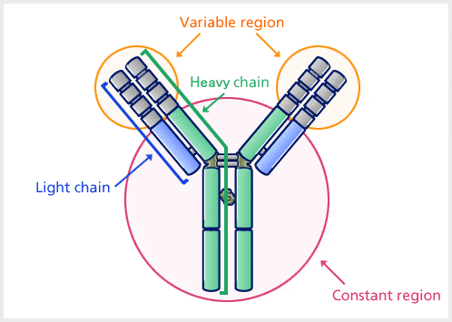
Introduction
Antibodies are glycoproteins, termed as immunoglobulins (Igs), which are produced in response to an immune reaction and specifically bind to antigens responsible for initiating the reaction.

Slide 3
Blood can be separated in a centrifuge into a fluid and a cellular fraction. The fluid fraction is the plasma.
Plasma contains all of the soluble small molecules and macromolecules of blood, including fibrin and other proteins required for the formation of blood clots. If the blood or plasma is allowed to clot, the fluid phase that re-mains is called serum.
E. A. Kabat in 1939, showed that ,the γ globulin fraction of serum contain antibodies, which were called immunoglobulins.

Slide 4
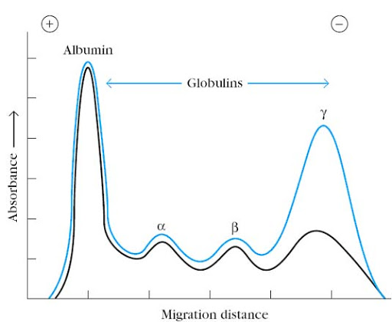
Experimental demonstration that most antibodies are in the γ globulin fraction of serum proteins.

Slide 5
Structure and Properties of Antibody
Antibodies are heavy (~150 kDa) globular plasma proteins. The basic structure of all antibodies are same.
There are four polypeptide chains: two identical heavy chains and two identical light chains connected by disulfide bonds.
Light Chain (L) consists polypeptides of about 22,000 Da and Heavy Chain (H) consists larger polypeptides of around 50,000 Da or more.

Slide 6
There are five types of Ig heavy chain (in mammal) denoted by the Greek letters: α, δ, ε, γ, and μ. There are two types of Ig light chain (in mammal), which are called lambda (λ) and kappa (κ).
Each light chain is bound to a heavy chain by a disulfide bond, and by non covalent interactions as salt linkages, hydrogen bonds and hydrophobic bonds to form a hetero dimer (H-L).
Similar non covalent interactions and disulfide bridges link the two identical heavy and light (H-L) chain combinations to each other to form the basic four-chain (H-L)₂

Slide 7
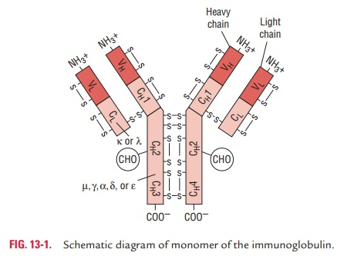

Slide 8
The first 110 or so amino acids of the amino-terminal region of both light or heavy chain varies greatly, hence called V regions (variable region): V_{L} and V_{H}
The differences among antibodies fall within areas of the V regions called complementarity-determining regions (CDRs), which constitute the antigen-binding site of the antibody molecule.
The regions of relatively constant sequence beyond the variable regions is called C regions (constant region): C_{L} and C_{H}
The sites of attachment for carbohydrates are restricted to the constant region. Glycosylation of antibodies probably increases the solubility of the molecules.

Slide 9
Chemical and Enzymatic Methods Revealed Basic Antibody Structure

Slide 10
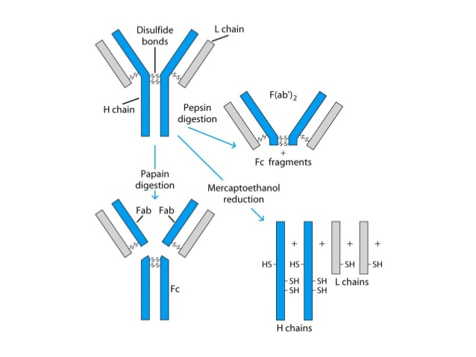
Enzymatic digestion of basic antibody structure

Slide 11
Papain produced three fragments, two of which were identical fragments and a third that was quite different, the two identical fragments (each with a MW of45,000 ) had antigen-binding activity and were called Fab fragments (fragment, antigen binding).
The other fragment (MW of 50,000) had no antigen-binding activity at all. Because it was found to crystallized uring cold storage, it was called the Fc fragment (fragment, crystallizable)

Slide 12
Pepsin, demonstrated that the antigen-binding properties of an antibody can be separated from the rest of the molecule.
Pepsin digestion generated a single 100,000 MW fragment composed of two Fab-like fragments designated the F(ab’)₂ fragment, which binds antigen.
The Fc fragment was not recovered from pepsin digestion because it had been digested into multiple fragments.

Slide 13
Mercaptoethanol irreversibly cleaves disulfide bonds.
Upon column separation, it was clear that the intact 150,000-MW antibody molecule is composed of subunits.
It contains two 50,000-MW polypeptide chains, designated as heavy (H) chains, and two 25,000-MW chains, designated as light (L) chains.

Slide 14
Immunoglobulin Fine Structure
The structure of the immunoglobulin molecule is determined by the primary, secondary, tertiary, and quaternary organization of the protein.
X-ray crystallographic analysis revealed that immunoglobulin domains are folded into a characteristic compact structure called the immunoglobulin fold.
Both chain contains several homologous units of about 110 amino acid residues, Within each unit, termed a domain, an intrachain disulfide bond forms a loop of about 60 amino acids.

Slide 15
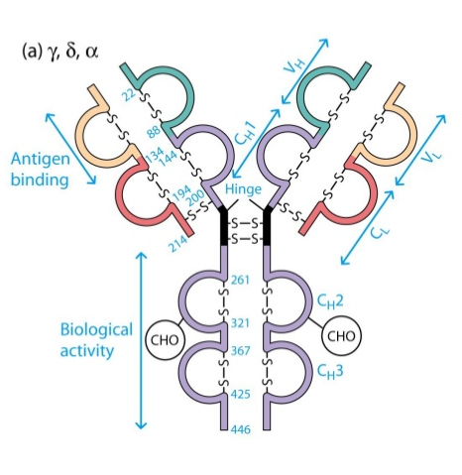

Slide 16
The amino terminal, bind to antigen where as effector functions are mediated by the carboxy-terminal domains.
Hyper variable regions form the antigen binding site of the antibody molecule. Also known as complementarity determining regions (CDRs). The remainder exhibit far less variation, called the framework regions (FRs).
V_{H} domain often contributes more to antigen binding than the V_{L} domain. The hinge region, is rich in proline residues and is flexible. As a result, the two Fab arms can assume various angles to each other when antigen is bound.

Slide 17
Functions of Antibody
Antigen recognition
The immune system is able to generate a large repertoire of antibody-combining sites capable of recognizing virtually all possible antigens present in pathogens and their products (bacteria, viruses, and protozoal and metazoal parasites), and in environmental antigens.
Pathogen neutralization
Antibodies recognize antigens outside the cells, where most bacteria and bacterial toxins are found. They can bind to a pathogen and block its access to cells, thereby preventing infection or destruction of host cells.

Slide 18
Antibodies as a first line of defence, for e.g secretory IgA.
Complement binding
Binding to determinants of the pathogen leads to the formation of antigen–antibody complexes and activation of the complement cascade, which comprises a series of plasma proteins involved in mast cell degranulation, chemotaxis, phagocytosis and cell lysis.

Slide 19
Opsonization
It is the molecular mechanism whereby pathogenic molecules, microbes, or apoptotic cells (antigenic substances) are connected to antibodies to attach to the cell surface receptors on macrophages.
Antibody-dependent cell-mediated cytotoxicity
Antibodies can contribute to elimination of undesirable cells by recruiting killer cells. Following antibody binding to allogeneic cells, the Fc region of the antibody may be recognized by natural killer (NK) cells, which will initiate an antibody-mediated cytotoxic process that will kill the target cells.

Slide 20
Classes/Types of Antibody
Serum containing antigen-specific antibodies is called antiserum. The 5 types – IgG, IgM, IgA, IgD, IgE – (isotypes) are classified according to the type of heavy chain constant region, and are distributed and function differently in the body.

Slide 21
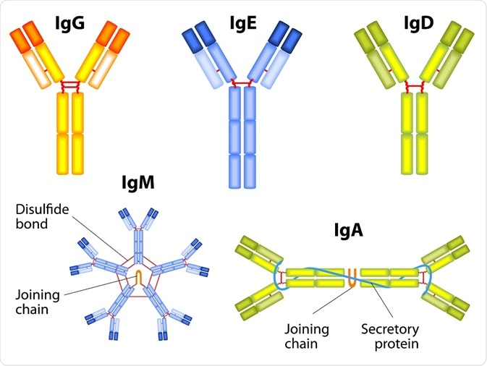

Slide 22
Immunoglobulin G (IgG)
Properties
IgG is the major Ig in serum - 75% of serum Ig is IgG, IgG is the major Ig in extra vascular spaces.
Placental transfer - IgG is the only class of Ig that crosses the placenta. Transfer is mediated by a receptor on placental cells for the Fc region of IgG. Not all subclasses cross equally well; IgG2 does not cross well.
IgG3 is tge most effective complement activator, followed by IgG1, IgG2 is less efficient and IgG4 is not able to activate complement at all.
Binding to cells - Macrophages and some lymphocytes have Fc receptors for the Fc region of IgG. Not all subclasses bind equally well; IgG2 and IgG4 do not bind to Fc receptors well. A consequence of binding to the Fc receptors on PMNs, monocytes and macrophages is that the cell can now internalize the antigen better. The antibody has prepared the antigen for eating by the phagocytic cells. The term opsonin is used to describe substances that enhance phagocytosis. IgG is a good opsonin.

Slide 23
Immunoglobulin M (IgM)
Properties
IgM is the third most common serum Ig.
IgM is the first Ig to be made by the fetus and the first Ig to be made by a virgin B cells when it is stimulated by antigen.
As a consequence of its pentameric structure, IgM is a good complement fixing Ig. Thus, IgM antibodies are very efficient in leading to the lysis of microorganisms.
As a consequence of its structure, IgM is also a good agglutinating Ig . Thus, IgM antibodies are very good in clumping microorganisms for eventual elimination from the body.
Surface IgM exists as a monomer and lacks J chain but it has an extra 20 amino acids at the C-terminus to anchor it into the membrane. Cell surface IgM functions as a receptor for antigen on B cells. Surface IgM is noncovalently associated with two additional proteins in the membrane of the B cell called Ig-alpha and Ig-beta.T hese additional proteins act as signal transducing molecules since the cytoplasmic tail of the Ig molecule itself is too short to transduce a signal

Slide 24
Immunoglobulin A (IgA)
Properties
IgA is the 2nd most common serum Ig.
IgA is the major class of Ig in secretions - tears, saliva, colostrum, mucus. Since it is found in secretions secretory IgA is important in local (mucosal) immunity.
Normally IgA does not fix complement, unless aggregated.
IgA can binding to some cells - PMN's and some lymphocytes.

Slide 25
Immunoglobulin E (IgE)
Properties
IgE is the least common serum Ig since it binds very tightly to Fc receptors on basophils and mast cells even before interacting with antigen.
Involved in allergic reactions - As a consequence of its binding to basophils an mast cells, IgE is involved in allergic reactions. Binding of the allergen to the IgE on the cells results in the release of various pharmacological mediators that result in allergic symptoms.
IgE also plays a role in parasitic helminth diseases. Since serum IgE levels rise in parasitic diseases, measuring IgE levels is helpful in diagnosing parasitic infections. Eosinophils have Fc receptors for IgE and binding of eosinophils to IgE-coated helminths results in killing of the parasite.
IgE does not fix complement.

Slide 26
Immunoglobulin D (IgD)
Properties
IgD is found in low levels in serum; its role in serum uncertain.
IgD is primarily found on B cell surfaces where it functions as a receptor for antigen. IgD on the surface of B cells has extra amino acids at C-terminal end for anchoring to the membrane. It also associates with the Ig-alpha and Ig-beta chains.
IgD does not bind complement.

Slide 27
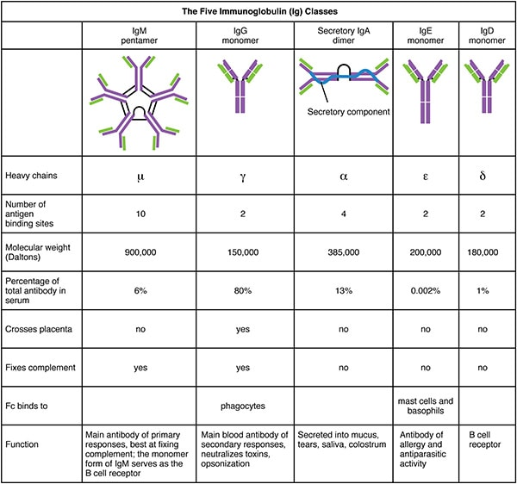

Slide 28
Antigenic Determinants on Immunoglobulins
It is observed that the entire immunoglobulin is not immunogenic but it contains antigenic determinants at specific sites. Based on the location of those antigenic determinants, immunoglobulins are divided into, isotypes, allotypes, and idiotypes.

Slide 29
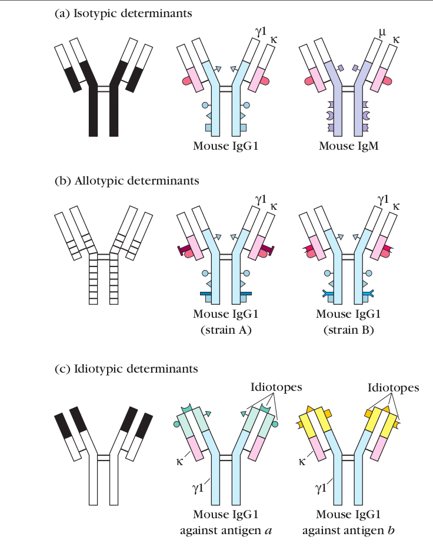

Slide 30
Isotypes
Each antibody has only one type of (γ, or α, or μ, or ε, or δ) heavy chain and one type of (k or λ) light chain. The structural differences in the constant region of a heavy chain or light chain determine immunoglobulin (Ig) class and sub-class, types and subtypes within a species. These constant region determinants are called isotypic determinants or isotypes.
Formation of anti-isotypic antibody
All members of a species carry the same constant-region genes (including multiple alleles) so when an antibody from one species is injected into another species, the isotypic determinants will be recognized as foreign, forming anti-isotypic antibody.

Slide 31
Allotypes
Although all members of a species inherit the same set of isotype genes, multiple alleles exist for some of the genes. These alleles encode subtle amino acid differences. Products of allelic forms of the same gene will have slightly different amino acid sequences in the constant regions, which are known as allotypic determinants. The sum of the individual allotypic determinants displayed by an antibody determines its allotype.
Each of these allotypic determinants represents differences in one to four amino acids that are encoded by different alleles.

Slide 32
Idiotype
VH and VL domains of an antibody constitute an antigen-binding site. To recognize the vast array of antigens that a human can encounter in its lifetime, this variable region has different structural conformation owing to the presence of different amino acids. There are millions of such antibodies in the human body specific for each antigen.
These unique amino acid sequences present in the VH and VL domains of a given antibody also serves as a set of antigenic determinants. Each individual antigenic determinant of the variable region is referred to as an idiotope. Each antibody will present multiple idiotopes; the sum of the individual idiotopes is called the idiotype of the antibody.

Slide 33
Mechanism of Rearrangement
VDJ/ VJ

Slide 34
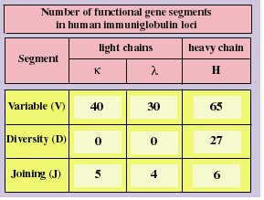
Possible variations through gene recombination
Over 1.5*10⁷combinations of variable, diversity and joining gene segments are possible.
Imprecise recombination and mutation increase the variability into billions of possible combinations

Slide 35
Mechanism of Rearrangement
Recombination Signal Sequences (RSSs).
Recombination Activating Genes: RAG-1 and RAG-2.

Slide 36
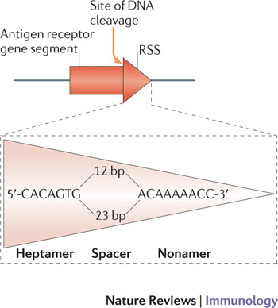
Recombination Signal Sequence
A short DNA sequence indicate the sites of recombination
seven conserved nucleotides (a heptamer) that reside next to the gene encoding sequence
a spacer (containing either 12 or 23 unconserved nucleotides)
a conserved nonamer (9 base pairs)

Slide 37
Recombination Activating Gene
RAG enzymes work as a multi-subunit complex to induce cleavage of a single double stranded DNA (dsDNA) molecule between the antigen receptor coding segment and a flanking recombination signal sequence (RSS).
Schatz, David G., and Patrick C. Swanson. "V (D) J recombination: mechanisms of initiation." Annual review of genetics 45 (2011): 167-202.

Slide 38
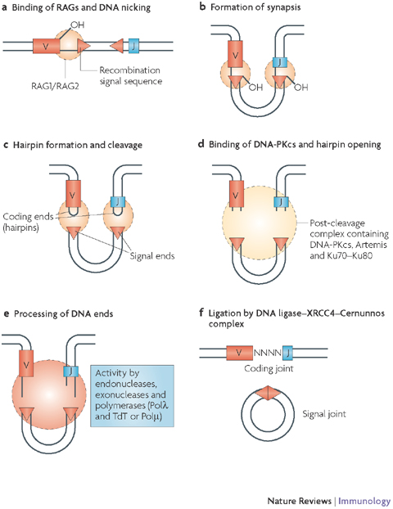
V(D)J recombination:
a complex containing RAG1 and RAG2 binds one RSS.
This RAG-RSS complex then captures the second RSS (of the gene segment to be joined) in a process known as synapsis.
Cleavage by RAG1/2 occurs between the RSS heptamer and flanking coding sequence, and proceeds in two steps. A nick is made at the 5’ end of the RSS heptamer. The second step is a hairpinning step joining the 3’-hydroxyl to the phosphoryl group at the same nucleotide position on the other strand.
DNA cleavage is completed within the synaptic complex.
The product of this first phase of V(D)J recombination is the “cleaved signal complex,” which contains four DNA ends: two blunt 5’-phosphorylated signal ends, and two coding ends terminating in DNA hairpin structures.
Nature Reviews Immunology 8, 302-312 (April 2008)

Slide 39
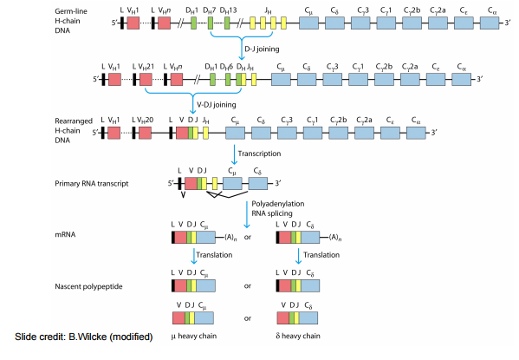
Heavy chain gene rearrangement

Slide 40
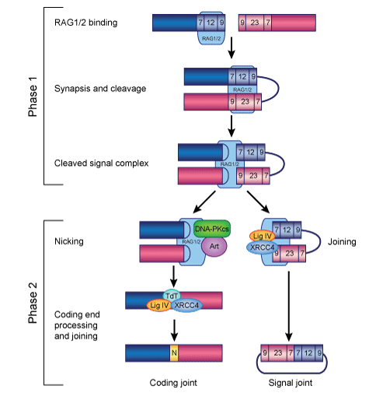
V(D)J recombination:
During the second phase of V(D)J recombination, RAG1 and RAG2 work together with DNA repair proteins to process and ligate coding ends to form a coding joint, and ligate signal ends to form a signal joint.
This phase requires ubiquitously expressed DNA repair factors of the non-homologous end joining (NHEJ) pathway.
Nature Reviews Immunology 8, 302-312 (April 2008)

Slide 41
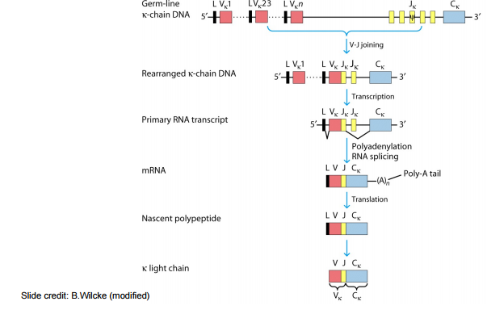
Light chain Gene rearrangement

Slide 42
Monoclonal Antibodies
Most antigens offer multiple epitopes and therefore induce proliferation and differentiation of a variety of B-cell clones, each derived from a B cell that recognizes a particular epitope.
The resulting serum antibodies are heterogeneous, comprising a mixture of antibodies, each specific for one epitope, such antibodies are called polyclonal antibody.

Slide 43
The antibody heterogenecity that increases immune protection in vivo often reduces the efficacy of an antiserum for various in vitro uses. For most research, diagnostic, and therapeutic purposes, monoclonal antibodies, derived from a single clone, specific for a single epitope, are preferable.
Direct biochemical purification of a monoclonal antibody from a polyclonal antibody preparation is not feasible. In 1975, Georges Köhler and Cesar Milstein devised a method for preparing monoclonal antibody.

Slide 44
fusing a normal activated, antibody-producing B cell with a myeloma cell (a cancerous plasma cell), they were able to generate a hybrid cell, called a hybridoma.
Hybridoma possessed the immortal growth properties of the myeloma cell and secreted the antibody produced by the B cell.
The resulting clones of hybridoma cells, which secrete large quantities of monoclonal antibody, can be cultured indefinitely.

Slide 45
