Slide 1
Spectrophotometry

Slide 2
Useful Terminology
Colorimetry Colorimetry is a scientific technique that is used to determine the concentration of coloured compounds in solutions.
Photometry Photometry is the science of the measurement of light, in terms of its perceived brightness to the human eye. Photometry deals with the study of phenomenon of light absorption by molecules in solution.
Spectrophotometry Spectrophotometry is a method to measure how much a chemical substance absorbs light by measuring the intensity of light as a beam of light passes through sample solution. The basic principle is that each compound absorbs or transmits light over a certain range of wavelength.

Slide 3
Spectroscopy refers to the study of how radiated energy and matter interact. The energy is absorbed by the matter, creating an excited state. When the matter is a metal, it is easy to see the interaction of energy and matter because the metal will produce visible evidence, usually as sparks. The interaction creates some form of electromagnetic waves, often in the form of visible light, such as sparks.
Spectrometry is the application of spectroscopy so that there are quantifiable results that can then be assessed. deals with the measurement of a specific spectrum. There are four primary types of spectrometers:
Mass spectrometry
Ion-mobility spectrometry
Neutron triple axis spectrometry
Rutherford backscattering spectrometry
Each of these types indicates the type of spectrum being measured. Typically, a spectrometer is used to measure a specific spectrometry.

Slide 4
Wavelength (λ) - length between two equivalent points on successive waves
Wavenumber (k) – the number of waves in a unit of length or distance per cycle - reciprocal of the wavelength
Frequency (ν) – is the number of oscillations of the field per second (Hz)
Velocity (c) – independent of wavelength – in vacuum is 3.00 x 1010 cm/s (3.00 x 108 m/s)
Photon (quanta) – quantum mechanics nature of light to explain photoelectric effect

Slide 5
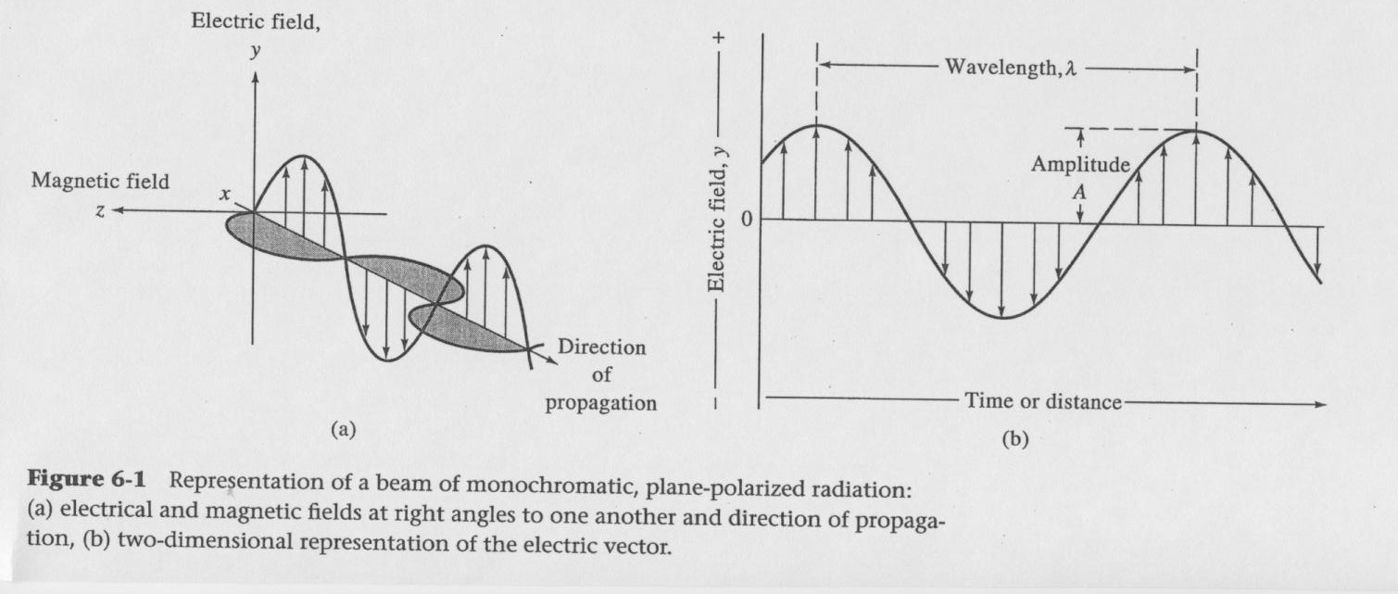

Slide 6
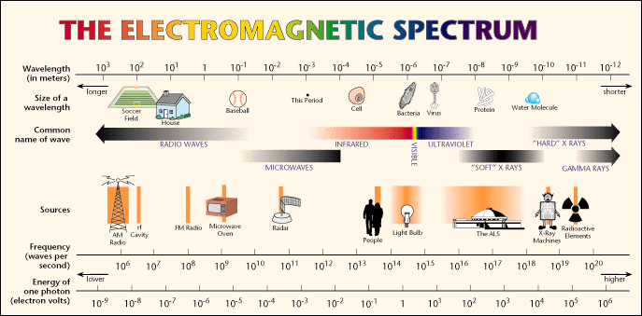
Visible light is only a very small portion
of the electromagnetic spectrum.

Slide 7
Electromagnetic Spectrum
Type of Radiation | Frequency Range (Hz) | Wavelength Range | Type of Transition
gamma-rays | 10²⁰-10²⁴ | <1 pm | nuclear
X-rays | 10¹⁷-10²⁰ | 1 nm-1 pm | inner electron
ultraviolet | 10¹⁵-10¹⁷ | 400 nm-1 nm | outer electron
visible | 4-7.5x10¹⁴ | 750 nm-400 nm | outer electron
near-infrared | 1x10¹⁴-4x10¹⁴ | 2.5 µm-750 nm | outer electron molecular vibrations
infrared | 10¹³-10¹⁴ | 25 µm-2.5 µm | molecular vibrations
microwaves | 3x10¹¹-10¹³ | 1 mm-25 µm | molecular rotations, electron spin flips*
radio waves | <3x10¹¹ | >1 mm | nuclear spin flips*

Slide 8
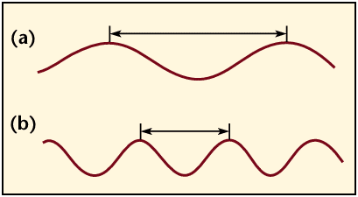
Electromagnetic radiation is characterized by its
wavelength, λ, Frequency, ν and energy, E:
E = hν = hc / λ c = ν λ
Where h = Planck’s constant & c = speed of light in a vacuum.
longer wavelength, lower energy;
shorter wavelength, higher energy.
Note: Frequency (υ) and Energy (E) are directly proportional
whereas Frequency (υ) and Wavelength (λ) are inversely proportional.

Slide 9
Light & Matter
Each Electron Can Be In Only Certain Energy Levels
Every wavelength has a specific Energy Level.

Slide 10
COLOR
RESULTS WHEN
RADIATION IS ABSORBED
BY AN ELEMENT OR
BY A COMPOUND FORMED
THROUGH A REACTION
RED
YELLOW
RED
ABSORBED
W H I T E
YELLOW
GREEN
BLUE
BLUE

Slide 11
TRANSMITTANCE (T)
RATIO
Of the intensity of light
LEAVING SOLUTION (emergent light) (I)
To the intensity of light
ENTERING SOLUTION (Incident light) (I_{O})

Slide 12
TRANSMITTANCE
I_{O}
I
I
T =
I_{O}
%T = T x 100

Slide 13
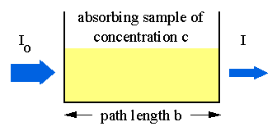
Transmittance is Related to Absorbance
Transmittance the fraction of incident radiation transmitted by the medium and is given by the equation:
T = I/I_{o}
where I is the intensity of the light after it has gone
through the sample & I_{o} is the initial light intensity.
Absorbance (A) the amount of incident radiation absorbed by the medium and is related to the T:
A = -logT = -log(I/ I_{o})

Slide 14
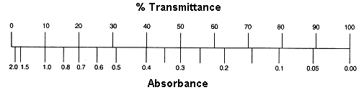
Equation Summary
T= (I/I_{o}) = 10^{-A} %T = (I/I_{o}) x 100 A = -logT = log(1/T)
Sample Calculation
If %T = 95%, then A = log(100/95) = log(1/.95) = -log(.95)
A = 0.02227
Note the scale for Absorbance: 9/10th of the scale is from 0-1 and 1/10th is from 1-2.
For this reason, the spectrometers have been calibrated in % Transmittance and
all readings will be taken in %Transmittance.

Slide 15
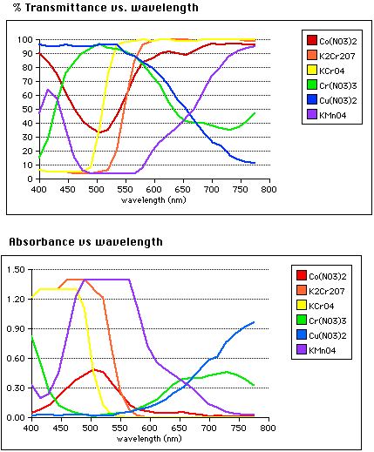

Slide 16
LAMBERT’S LAW
Relates the absorption of light to the depth or
thickness of the colored liquid
Each layer of equal thickness will absorb the same
fraction of light which passes through it
An arithmetic increase in thickness gives a
geometric decrease in light intensity transmitted

Slide 17
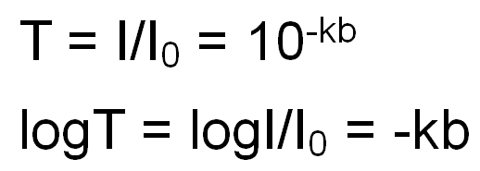
Where:
k – constant
T – the transmittance – the fraction of transmitted radiant energy
b – the path length of the medium

Slide 18
Comparing Light Transmittance to Cell Length
I₀
1.0
.9
.8
.7
.6
.5
.4
.3
.2
.1
0
Transmittance
I₁
I₂
I₃
I₅
I_{n}
I₄
0 1 2 3 4 5
Units of Optical Path

Slide 19
BEER’S LAW
Relates the absorption of light to the concentration
of the absorbing substance in the solution
The fraction of light absorbed is directly proportional to the concentration of the absorbing substance
An arithmetic increase in concentration gives a
geometric decrease in light intensity transmitted

Slide 20
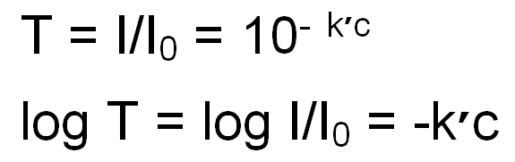
Where:
K’ – constant
T – the transmittance – the fraction of transmitted radiant energy
c – the concentration of the medium

Slide 21
Comparing Light Transmittance to Concentration
I₀
1.0
.9
.8
.7
.6
.5
.4
.3
.2
.1
0
Transmittance
I₁
I₂
I₃
I₅
I_{n}
I₄
0 1 2 3 4 5
Units of Concentration

Slide 22
THE COMBINED LAMBERT’S LAW
AND BEER’S LAW
T = 10 ^{-abc}
Where:
a = constant for particular solution
b = length of absorbing layer (light path length)
c = concentration of absorbing substance

Slide 23
TRANSMITTANCE
I
I_{o}
T =
Absorbance = A = - log T
T = 10 ^{-abc}
log T = log (10 ^{-abc})
log T = -abc
-log T = -(-abc) = abc
A =
-log T
= abc

Slide 24
ABSORBANCE (A)
A = - log T
A = abc
Where:
a = constant for particular solution
b = length of absorbing layer (light path length)
c = concentration of absorbing substance

Slide 25
ABSORBANCE (A)
A = - log T
A = abc
If:
a = held constant by carefully performing the analysis
b = held constant by controlling the light path length
Then:
A is Directly Related to c (conc. of absorbing substance)
If we can measure A, then we can determine c

Slide 26
Beer-Lambert Law(a.k.a. Beer's law) - the linear relationship between absorbance and concentration of an absorbing species.
A = abc
A is the absorbance
“a” is molar absorptivity in L/[(mole)(cm)]
Also called “extinction coefficient” or “ε”;
it is dependent on the material being studied.
“b” is the path length in cm
The diameter of the cuvette or sample holder which is the distance
the light travels through the absorbing sample. “b” is a constant
when the same size cuvette is used for all samples.
“c” is the concentration of the sample in (mol/L)
Main use of Beer’s Law is to determine the concentration
of various solutions.

Slide 27
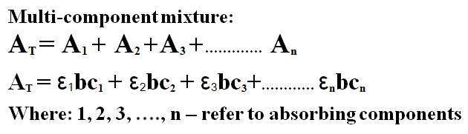
Spectroscopy- Mixture

Slide 28
CONCENTRATION CAN BE COLORIMETRICALLY
DETERMINED IF:
1. Able to chemically develop a color with that substance and only that substance
2. The developed color obeys (follows) Beer’s Law over a reasonable range of concentrations
3. The developed color must be stable for reasonable length of time, reproducible, and sensitive to small changes in concentration
4. All loss of transmitted light must be from absorbance by substance measured (developed color)
5. All of substance present in sample must be available for reaction with color developing agent
6. Able to measure amount of light absorbed

Slide 29
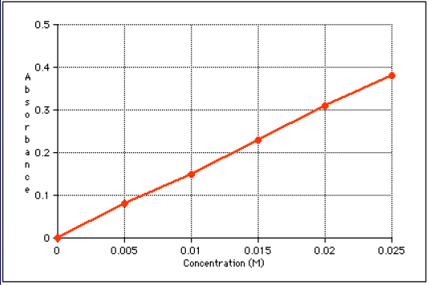

Slide 30
Beer’s Law Limitations
Deviations from the direct proportionality (b=const)
Valid at concentration usually below 0.01M
Molecules interference– distance between molecules affects charge distribution of molecules (ions)
Effect of refractive index– concentration affects refractive index- ε is affected (low, less important)
2. Chemical Deviations
Association, dissociation and reaction with solvent and other molecules
3. Instrumental Deviations
monochromatic radiation– quality of monochromator and control of bandwidth and slit
Instrumental noise – accuracy of measurement of transmittance –quality of detector

Slide 31
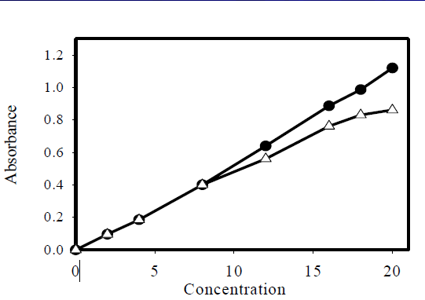
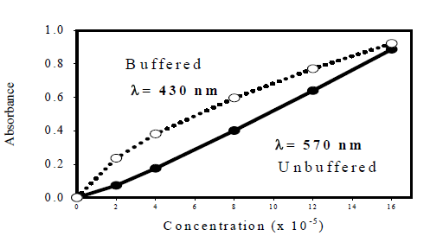

Slide 32
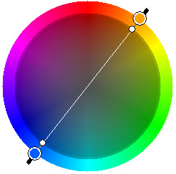
Color Wheel
Complementary colors lie across the diameter on the color wheel and combine to form “white light”, so the color of a compound seen by the eye is the complement of the color of light absorbed by a colored compound; thus it completes the color.

Slide 33
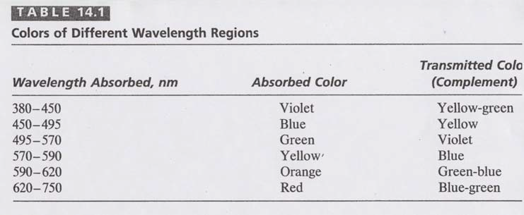

Slide 34
COLORIMETRY
Perform a Chemical Reaction with the Element to be Analyzed that Results in a Compound of that Element that Absorbs Light.
Measure the Amount
of Light Absorbed.

Slide 35
COLORIMETRY
The Amount of Light Absorbed
Is Related To:
The Chemistry Involved.
2. The Length of Light Travel.
3. The Amount (Concentration) of Absorbing Material.

Slide 36
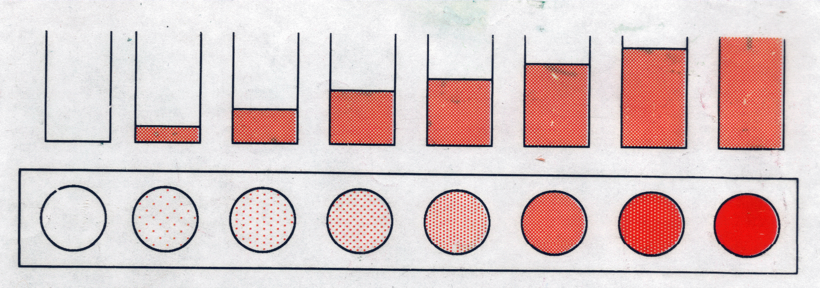
Visual Colorimetry
Intensity: For light shining through a colored solution, the observed intensity of the color is found to be dependent on both the thickness of the absorbing layer (path length) and the concentration of the colored species.
←Side view
←Top view
(a.k.a. Bird’s eye view)
For One Color: A series of solutions of a single color demonstrates the effect of either concentration or pathlength, depending on how it is viewed.

Slide 37
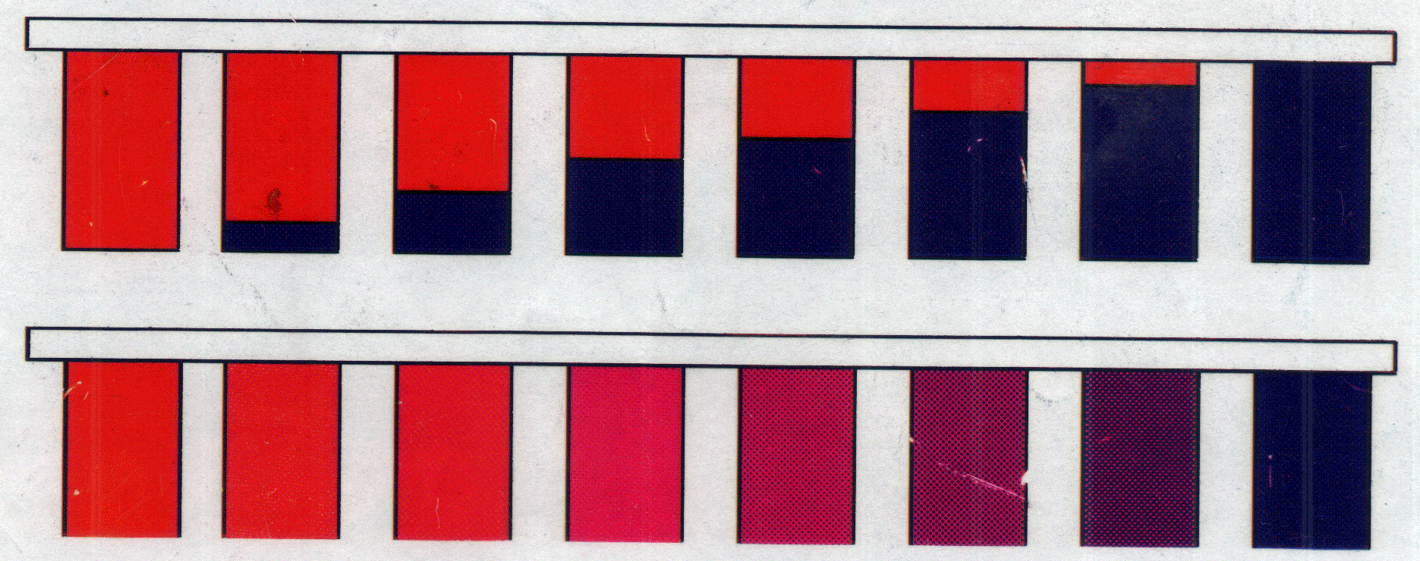
Visual Colorimetry
←Ratio used
←Purple produced
For more than one color: the ratio of an unknown mixture can also be determined by matching the shade of the color to those produced from known ratios.
In this example, the ratio of a mixture of red and blue can be determined visibly by comparing the mixture to purples produced from known ratios of red and blue.

Slide 38
Dilution Factor (constant pathlength)
Recall: C₁V₁= C₂V₂
Then for the dilution,
C_{diluted} x V_{diluted}=C_{std}x V_{std}
C_{diluted}= C_{std}x(V_{std}/ V_{diluted})
Since V_{diluted} = V_{total}
C_{diluted} = C_{std} x (V_{std} / V_{total})
Substituting the volumes:
C_{diluted}= C_{std}x (3 drops / 8 drops)
If the original concentration is 5.88 ppm,
then:
C _{diluted} = 5.88 ppm x (3 / 8)
C _{diluted}= 2.21 ppm
3 drops of dye std
+ 5 drops water
8 drops total volume

Slide 39
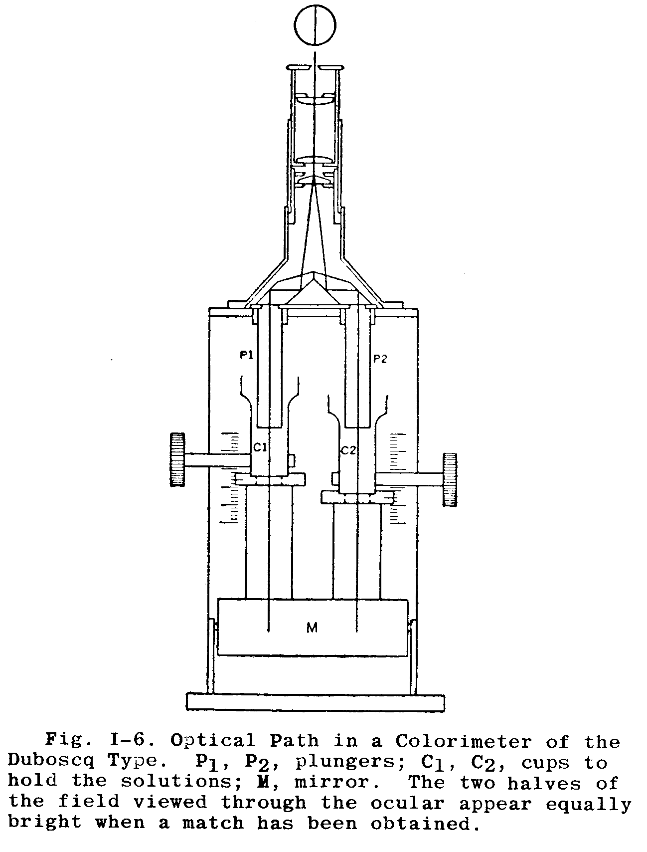
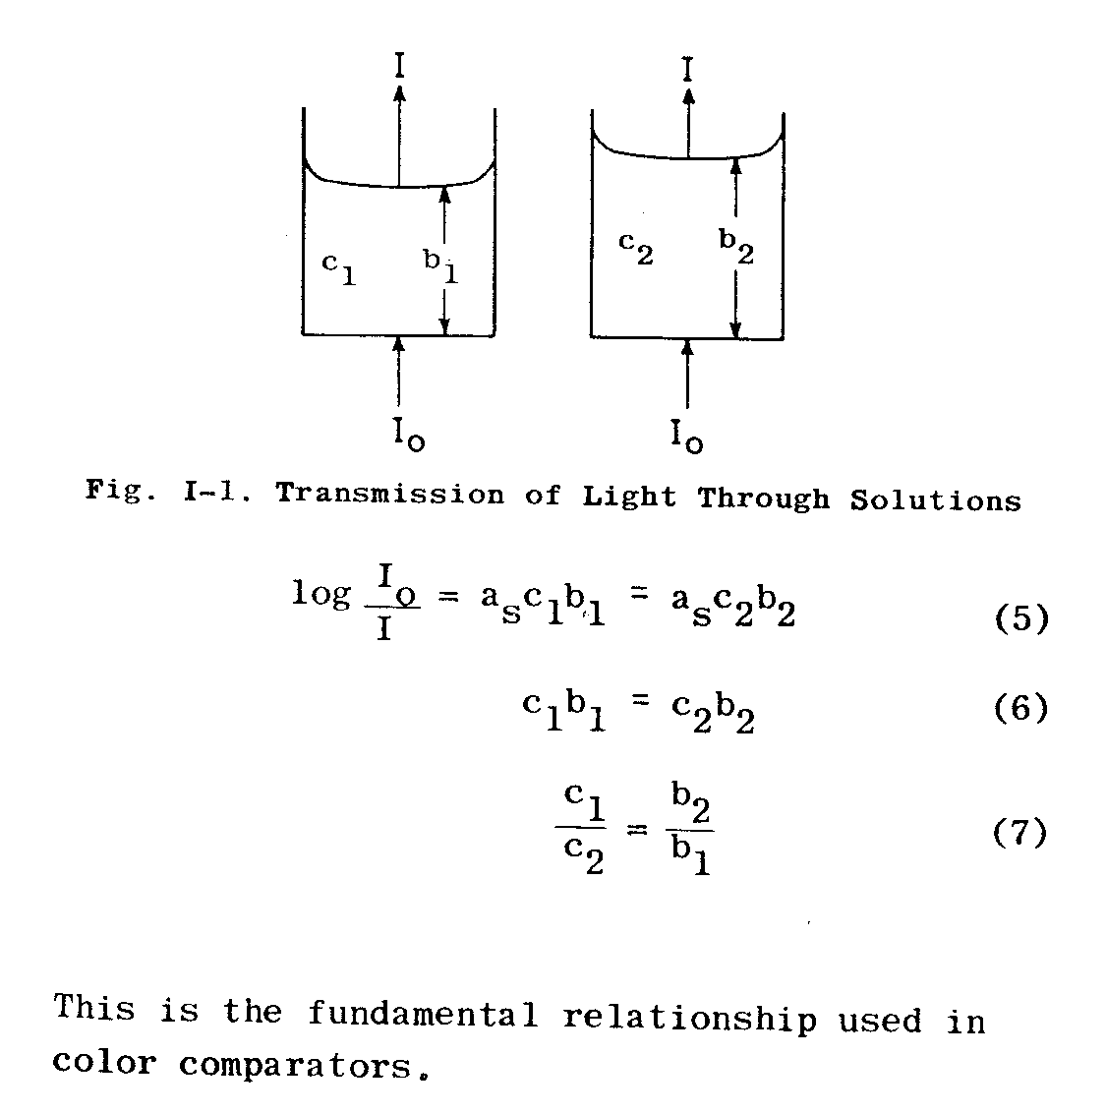
Intensity: When the product of the concentration and the pathlength of any two solutions of a colored compound are the same, the same intensity or darkness of color is observed.
Duboscq visual
colorimeter
Adjustable
Path Lengths

Slide 40
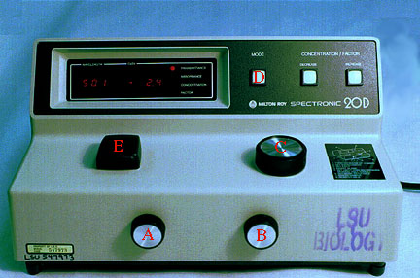
COLORIMETER
Many biochemical experiments involve the measurements of compound or group of compounds present in a complex mixture.

Slide 41
These reactions are fairly specific and in most cases very sensitive, so that quantities of material in the region of mM / L concentrations can be measured.
Many compounds are not themselves colored but can be made to absorb light in visible region by reaction with suitable reagents.

Slide 42
The big advantage is that complete isolation of compound is not necessary and the constituents of a complex mixture such as blood can be determined after little treatment.
The depth of the color is proportional to the concentration of the compound being measured, while the amount of light is proportional to the intensity of the color and hence the concentration.

Slide 43
The Colorimeter:
Colorimeter is generally any tool that characterizes colour samples to provide an objective measure of colour characteristics.
In chemistry, the colorimeter is an apparatus that allows the absorbance of a solution at a particular frequency (colour) of visual light to be determined. Colorimeters hence make it possible to determine the concentration of a known solute, since it is proportional to the absorbance.

Slide 44
The Colorimeter:
Different chemical substances absorb varying frequencies of the visible spectrum.
Colorimeters rely on the principle that the absorbance of a substance is proportional to its concentration i.e., a more concentrated solution gives a higher absorbance reading.

Slide 45
The Colorimeter:
Filter in the colorimeter is used to select the color of light which the solute absorbs the most, in order to maximize the accuracy of the experiment.
Note that the colour of the absorbed light is the 'opposite' of the colour of the specimen, so a blue filter would be appropriate for an orange substance. Sensors measure the amount of light which has passed through the solution, compared to the amount entering, and a display reads the amount absorbed.

Slide 46
The Colorimeter:
A quantitative reading for the concentration of a substance can be found by making up a series of solutions of known concentration of the chemical under study, and plotting a graph of absorbance against concentration. By reading off the absorbance of the specimen substance on the graph, a value for its concentration is found.

Slide 47

How colorimeter works?
1- White light from a tungsten lamp passes through a slit, then a condenser lens, to give a parallel beam which falls on the solution under investigation contained in an absorption cell or cuvette. The cell is made of glass with the sides facing the beam cut parallel to each other.
Light source slit condenser cuvette filter photocell galvanometer
lens

Slide 48
How colorimeter works?
2- Beyond the absorption cell is the filter, which is selected to allow maximum transmission of the color absorbed. If a blue solution is under examination, then red is absorbed and a red filter is selected.
NOTE: The color of the filter is complementary to the solution.
Light source slit condenser cuvette filter photocell galvanometer
lens

Slide 49
How colorimeter works?
3- The light then falls on to a photocell which generates an electrical current in direct proportion to the intensity of light falling on it.
Light source slit condenser cuvette filter photocell galvanometer
lens

Slide 50
How colorimeter works?
4- This small electrical signal is increased by the amplifier which passes to a galvanometer of digital readout to give absorbance reading directly.
Light source slit condenser cuvette filter photocell galvanometer
lens

Slide 51
Sample Preparation
Dilution
Solids Removal
--- Coagulation
--- Centrifuge
--- Filter
pH Adjustment
Digestion

Slide 52
DIGESTION
Destroy Organics
Release Combined Constituent
Change Form of Constituent

Slide 53
Color Development
Color Must Be:
Stable
Reproducible
Sensitive

Slide 54
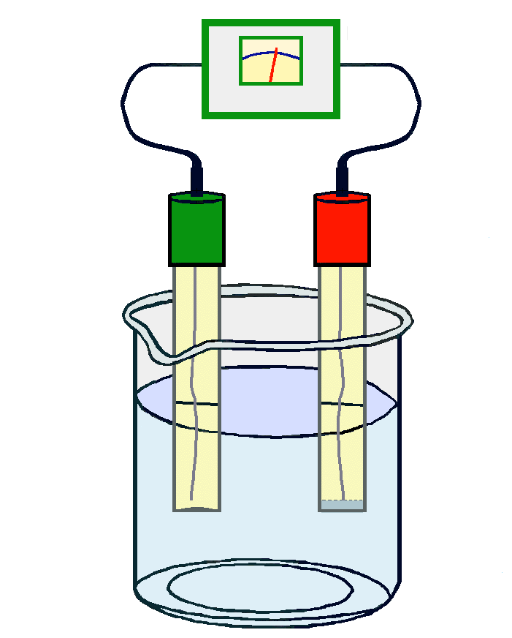
Color Development
Must Control:
pH
Time
Temperature
Ionic Strength

Slide 55
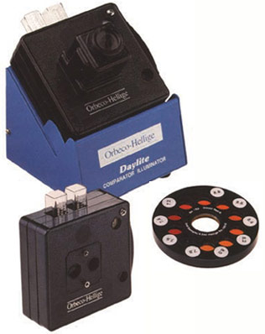

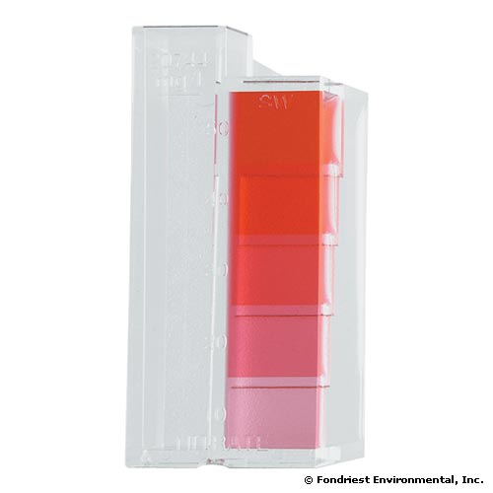
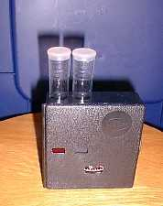
Color Measurement
Compare Sample Color to Known Standards
“Color Comparators”

Slide 56
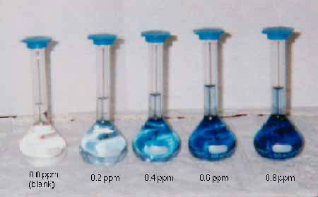
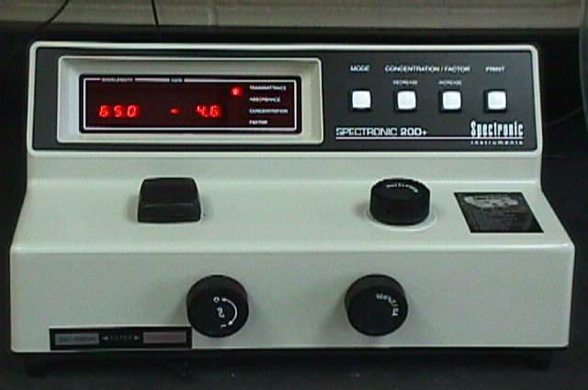
Color Measurement
Compare Sample Color to Known Standards
“Calibration Curve” (verified)

Slide 57
Instrument Operation:
Warm-up
Set Monochromator
Set Absorbance
Set Zero Absorbance w/Blank
Re-adjust as Needed

Slide 58
Instrument Operation:
General Rule –
Absorbance Between 0.100 and 0.700
Some Analyses More Restrictive
Best Readings –
Between Lowest and Highest Standards Used In Calibration
Watch for Irregularities

Slide 59
COLORIMETER CALIBRATION
Calibration or Standardized
By Measuring Absorbance Readings
of a Series of Known Standards
Comparison of These Readings to the Reading for a Sample
1. Computer Spreadsheet
2. Instrument with Internal Microprocessor
3. “Plotting” a Graph

Slide 60
COLORIMETER CALIBRATION
Calibration or Standardized
By Measuring Absorbance Readings
of a Series of Known Standards
Comparison of These Readings to the Reading for a Sample
Verified Frequently
At Least One Standard
In Acceptable Range
Each Time Samples Are Analyzed

Slide 61
Calibration Steps:
1. Prepare Stock Solution
2. Prepare a Series of Dilutions
3. Same Preparation Steps as Sample
4. Develop Color
5. Measure Absorbance of Each
6. Prepare Calibration “Curve”

Slide 62
Calibration Curve
(Using Phosphorus Analysis Example)

Slide 63
* Calculations
Absorbance of Unknown Absorbance of Standard
=
Concentration of Unknown Concentration of Standard
CUn. = A Un. × C St.
A St.

