Slide 1
ELECTROPHORESIS

Slide 2
What is electrophoresis?
Electrophoresis is the movement of charged particles through a porous supporting media when subjected to an electric field
• Cations move towards cathode
• Anions move towards anode
• By this technique solutes are separated by their different rates of travel through an electric field which depend on their mass and net electric charge on them
• Commonly used in characterization and differentiation of biological molecules , particularly in the separations of proteins, peptides and nucleic acids

Slide 3
• Proteins, nucleic acids, nucleotides and amino acids bear charged polar groups making them suitable groups for electrophoresis
• Carbohydrates carrying no charged groups are first bound to charged groups like Borate or Sulfite ions and then electrophoresis is carried out
• Lipids are not electrophoresed because electrophoretic current requires polar solvents in which most lipids are insoluble

Slide 4
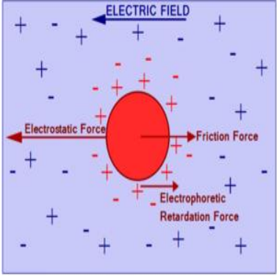
Factors affecting Electrophoresis
The rate of migration of a solute in an electric field depends on the following factors
Net charge on the particle
2) Mass and shape of the particles
3) pH of the medium
4) Strength of electric field
5) Properties of supporting medium
6) Temperature

Slide 5
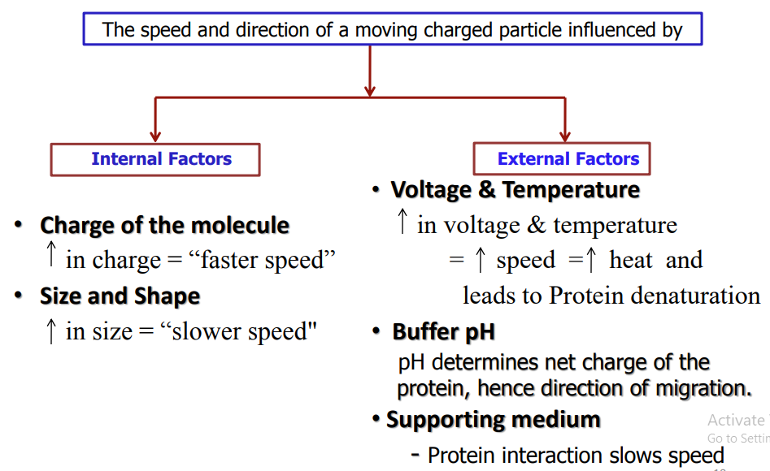

Slide 6
Electrophoretic Mobility
Electrophoretic mobility is defined as the rate of migration (cm/sec) per unit field strength(Volts/cm)
µ=Q/6πrη
Where µ- Electrophoretic mobility
Q-Net charge on the ion
r- Ionic radius of the solute
η- Viscosity of the medium
The Electrophoretic mobility is directly proportional to net charge and inversely proportional to molecular size/mass and viscosity of the electrophoresis medium
• The pH of solution affects the mobility of the ion by determining the amount and nature of charge

Slide 7
Electric current is carried by buffers
Buffers keep the pH and charge surrounding analyte constant.
Effects of the electric field on the sample:
In electrophoresis either current, voltage, or power, is always held constant.
Higher voltage causes greater migration speed.
Also leads to generation of heat.
May denature protein sample and destroy gel matrix
Also mixes samples through convection of buffer

Slide 8
ELECTROPHORESIS BUFFERS
Carry current and prevents analyte from being altered.
Common buffers are Tris-HCl and Tris-glycine.
Tris-Borate-EDTA (TBE), Tris-Acetate-EDTA (TAE), Tris Phosphate-EDTA (TPE) used most often for DNA.
10 mM sodium phosphate buffer used for RNA.
Buffer additives modify sample molecules– Formamide, urea (denaturing agents)

Slide 9
Gel Electrophoresis
“Gel" is the matrix used to contain, and then separate the target molecules
The gel is a cross linked polymer whose composition and porosity is chosen based on the specific weight and composition of material to be analyzed
The pH and other buffer conditions are arranged so that the molecules being separated carry a net (negative) charge so that they will be moved by the electric field toward the positive pole.
As they move through the gel, the larger molecules will be held up as they try to pass through the pores of the gel, while the smaller molecules will be impeded less and move faster.
This results in a separation by size, with the larger molecules nearer the well and the smaller molecules farther away.
• A gel block made of Polyacrylamide, Agarose or substituted starch gel is used in this method as the solid support
It is also frequently used in separating proteins, peptides and amino acids from microgram quantities of mixed samples

Slide 10
Agarose Gel Electrophoresis (AGE)
Agarose gel electrophoresis is a method to separate DNA or RNA molecules by size.
This is achieved by moving negatively charged nucleic acid molecules through an agarose matrix with an electric field (electrophoresis).
Shorter molecules move faster and migrate faster than longer ones .

Slide 11
Principle
powerful separation method frequently used to analyze DNA fragments generated by restriction enzymes
convenient analytical method for determining the size of DNA molecules in the range of 500 to 30,000 base pairs.
employs electromotive force to move molecules through a porous gel
separates molecules from each other on the basis of
– size and/or
– charge and/or
– shape
basis of separation depends on how the sample and gel are prepared

Slide 12
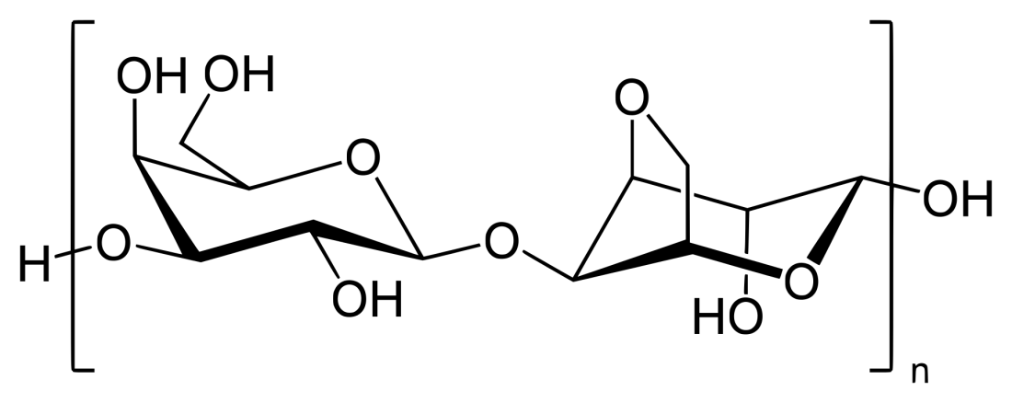
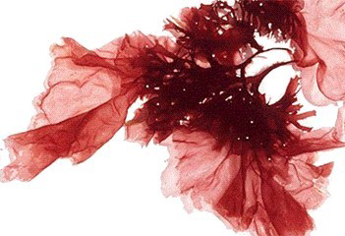
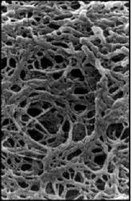
What is Agarose ?
• A polysaccharide extracted from red seaweeds
• a linear polymer made up of the repeating unit of agarobiose, which is a disaccharide made up of D-galactose and 3,6-anhydro-L-galactopyranose.
• forms a porous matrix as it gels
– shifts from random coil in solution to structure in which chains are bundled into double helices
• it gels and melts at different
temperatures
SEM photo of 1% Agarose

Slide 13
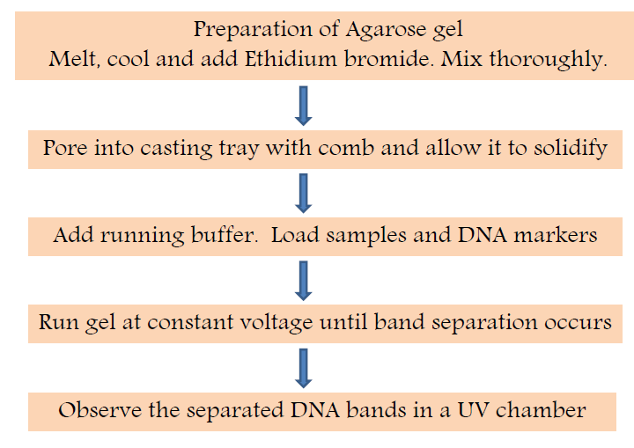
PROCESS

Slide 14
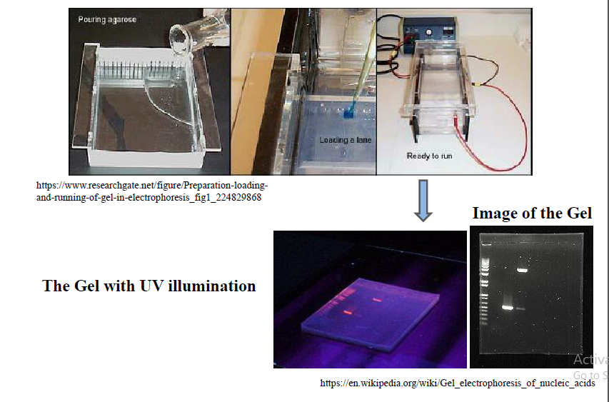

Slide 15
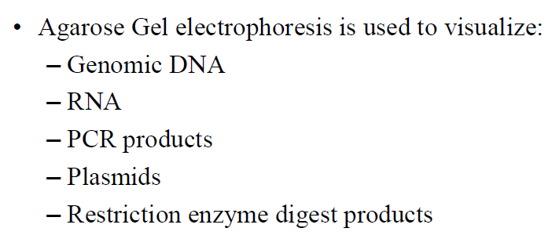
APPLICATIONS

Slide 16
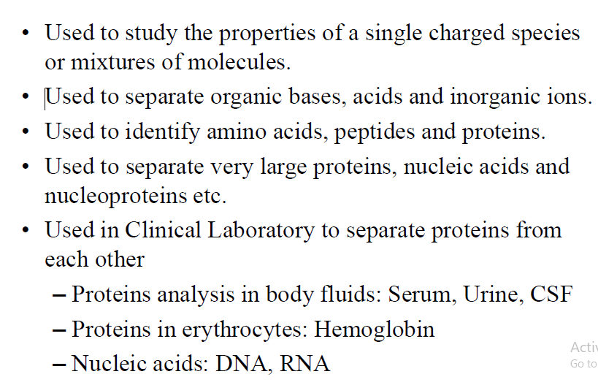

Slide 17
IMMUNOELECTROPHORESIS
Antigens and antibodies are allowed to interact with each other in agarose gel
Old one immune electrophoresis called as Rocket electrophoresis
Antibodies are embedded in agarose gel at the time of its solidification
Antigen mixture is allowed to migrate into the gel by electrophoresis
Frequently done in clinical serology
Crossed immunoelectrophoresis –(a variety of immunoelectrophoresis)
Both antigen and antibodies move towards each other under the influence of electrical field and form precipitation lines at places where the concentration of both are equimolar

Slide 18
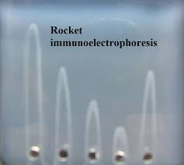

Slide 19
Poly Acrylamide Gel Electrophoresis (PAGE)
Most popular type
It is thermostable, transparent, strong and relatively chemically inert
Gels are uncharged and are prepared in a variety of pore sizes
Proteins are separated on the basis of charge to mass ratio and molecular size, a phenomenon called Molecular sieving.
PAGE is the backbone of blotting techniques
Polyacrylamide is a polymer formed when acrylamides are heated with a variety of catalysts with or without cross linking agents
Polyacrylamide gels are made from polymerization of Acrylamide and Bisacrylamide where Acrylamide forms linear strands and cross linking of the strands is brought by bisacrylamide.

Slide 21
Monomeric acrylamide (which is neurotoxic) is polymerized in the presence of free radicals to form polyacrylamide.
The chains of polyacrylamide are cross-linked by the addition of methylenebisacrylamide (bis) to form a gel whose porosity is determined by the length of chains and the degree of crosslinking.
Polymerization initiated as Ammonium Persulphate (1.5%,W/v) provides free radicals and TEMED (N,N,N,N-tetra-methylethylenediamine) acts as activator of reaction.
Most of the acrylamide solution is shielded from oxygen so that inhibition of polymerization is confined to the very top portion of the gel.
Concentration of acrylamide and Bisacrylamide solution is increased, the pore size of the gel is decreased.
Advantage of acrylamide gel systems is that initial concentrations of acrylamide and BIS control the hardness and degree of crosslinking of gel.

Slide 22
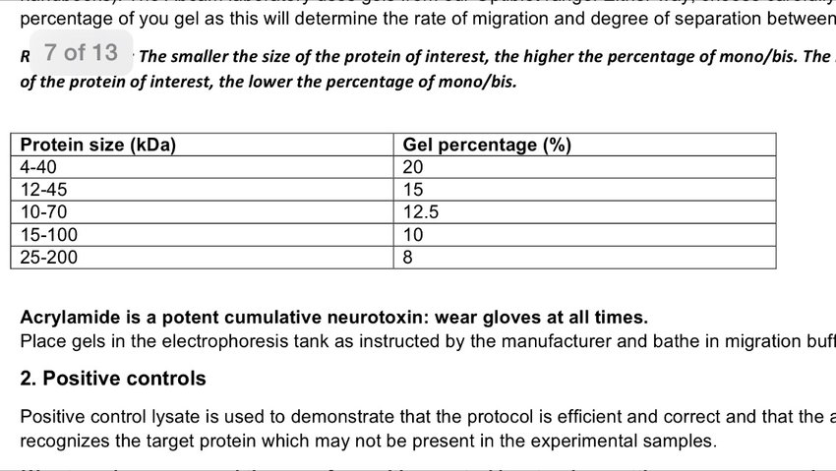

Slide 23
PAGE PROCEDURE

Slide 24
Use of PAGE
Separates proteins from each other
Proteins separated by size
Isoelectric point
Determines
Molecular size of protein
Quantifies the amount present
Displays Impurities
Used in western blot assays by antigen interactions

Slide 25
Types of PAGE
PAGE can be classified according the separation conditions into:
Native-PAGE: – Separation is based upon charge, size, and shape of macromolecules. Useful for separation and/or purification of mixture of proteins – This was the original mode of electrophoresis.
2) Denatured-PAGE or SDS-PAGE – Separation is based upon the molecular weight of proteins. The most common method for determining MW of proteins – Very useful for checking purity of protein samples

Slide 26
SDS-PAGE
When a detergent SDS (Sodium Dodecyl Sulfate) is added to PAGE the combined procedure is termed as SDS-PAGE
SDS-PAGE, sodium dodecyl sulfate polyacrylamide gel electrophoresis, is a technique widely used in biochemistry, forensics, genetics and molecular biology to separate proteins according to their electrophoretic mobility .
In their native form, proteins fold into a variety of shapes, some compact, some elongated.
The rate of migration of native proteins through a sieving medium is therefore more a reflection of their relative compactness, and less an accurate measure of molecular weight.
Denaturing the proteins nullifies structural effects on mobility, allowing separation on a true charge/mass ratio basis.
It also separates subunits in multimeric proteins, allowing analysis of large, complex aggregates.

Slide 27
Powerful electrophoretic techniques developed to separate macromolecules on the basis of molecular weight.
The mobility of a molecule in an electric field is inversely proportional to molecular friction which is result of its molecular size and shape, and directly proportional to voltage and charge of molecule.
In PAGE, proteins charged negatively by the binding of the anionic detergent SDS (sodium dodecyl sulfate) separate within a matrix of polyacrylamide gel in an electric field according to their molecular weights.

Slide 28
Molecular weight of a given protein can be determined by comparing the relative electrophoretic mobility of sample with that of standard protein of known molecular weight, when both the sample and the standard proteins are electrophoresed side by side in the same gel slab.
In oligomeric proteins, SDS-PAGE usually gives the molecular weight of separated monomer chains of the proteins because SDS cleaves the non-covalent bonds interlinking the monomer chains in the intact molecule.

Slide 29
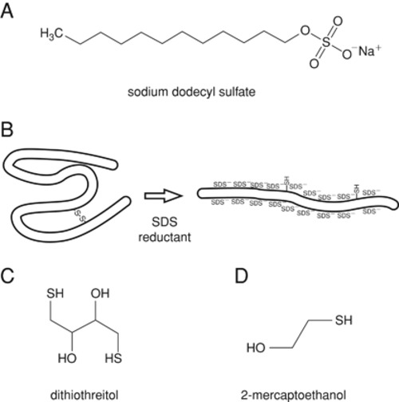

Slide 30
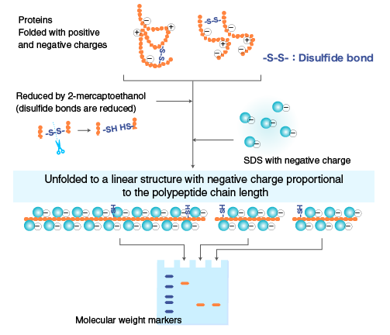

Slide 31
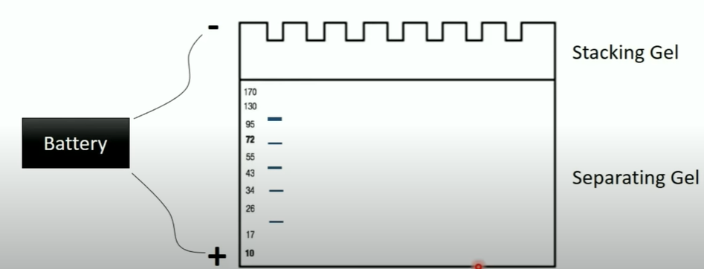

Slide 32
Polyacrylamide gels are poured between two glass plates held apart by spacers of 0.4 - 1.0 mm and sealed with tape.
The length of the gel can vary between 10 cm and 1m depending on the separation required.
They are always run vertically with 0.5x or 1x TBE as a buffer.
Two types of gels are used in discontinuous separation:
Stacking gel
Resolving gel
Generally resolving gels varying between 7-15% and stacking gels of 3-5% are used.

Slide 33
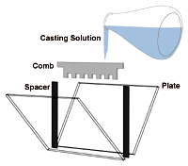
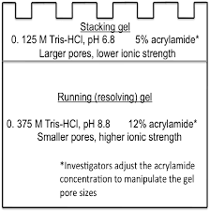
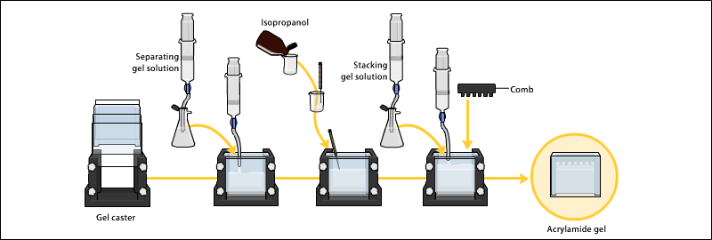

Slide 35
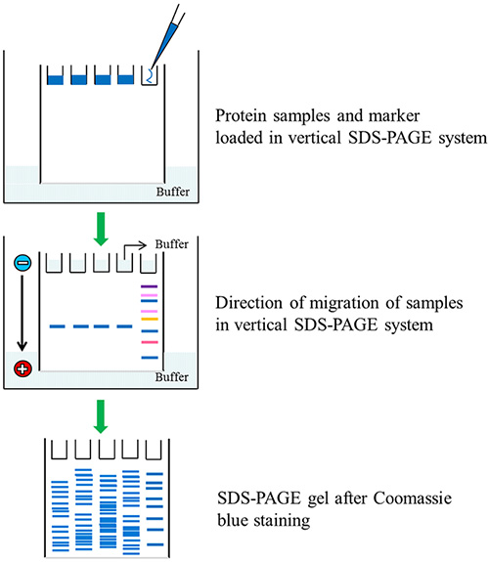
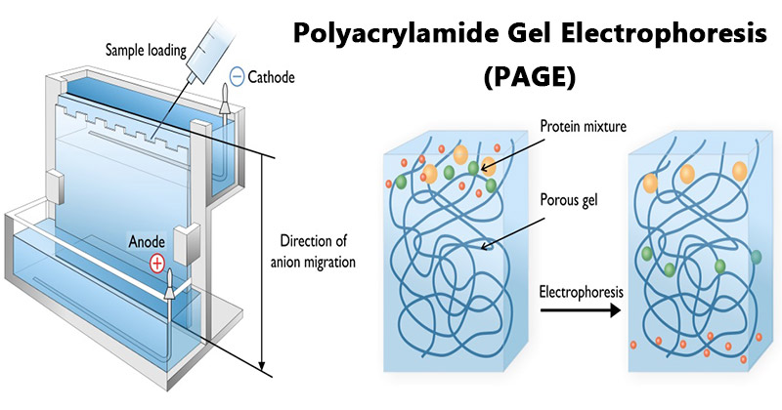

Slide 36
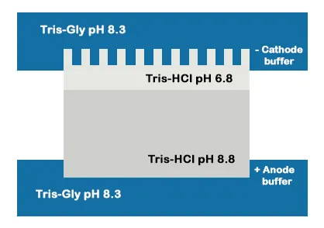
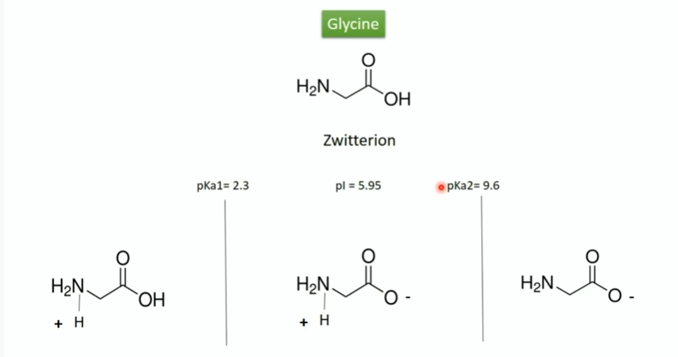

Slide 37
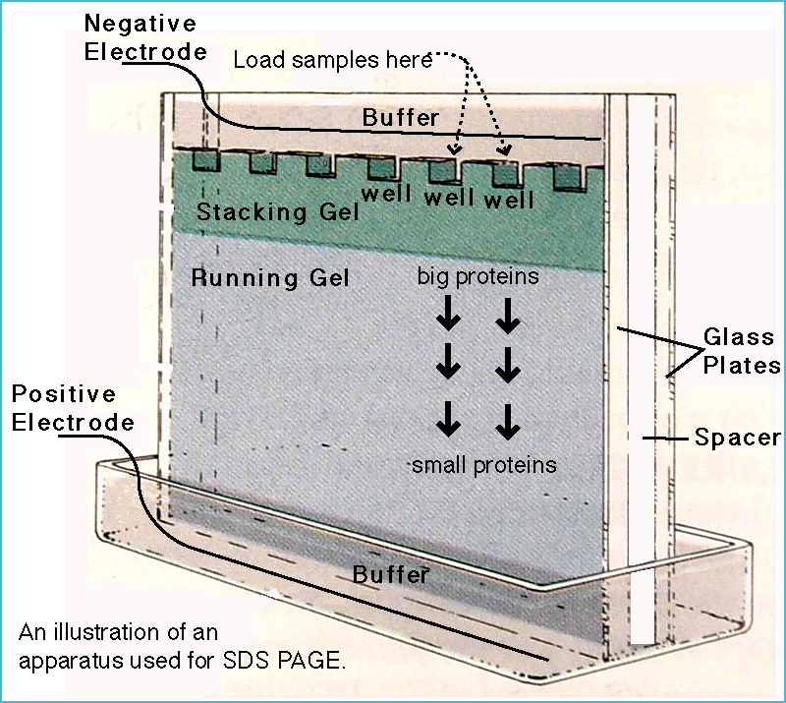

Slide 38
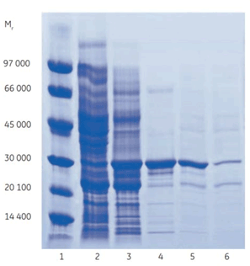
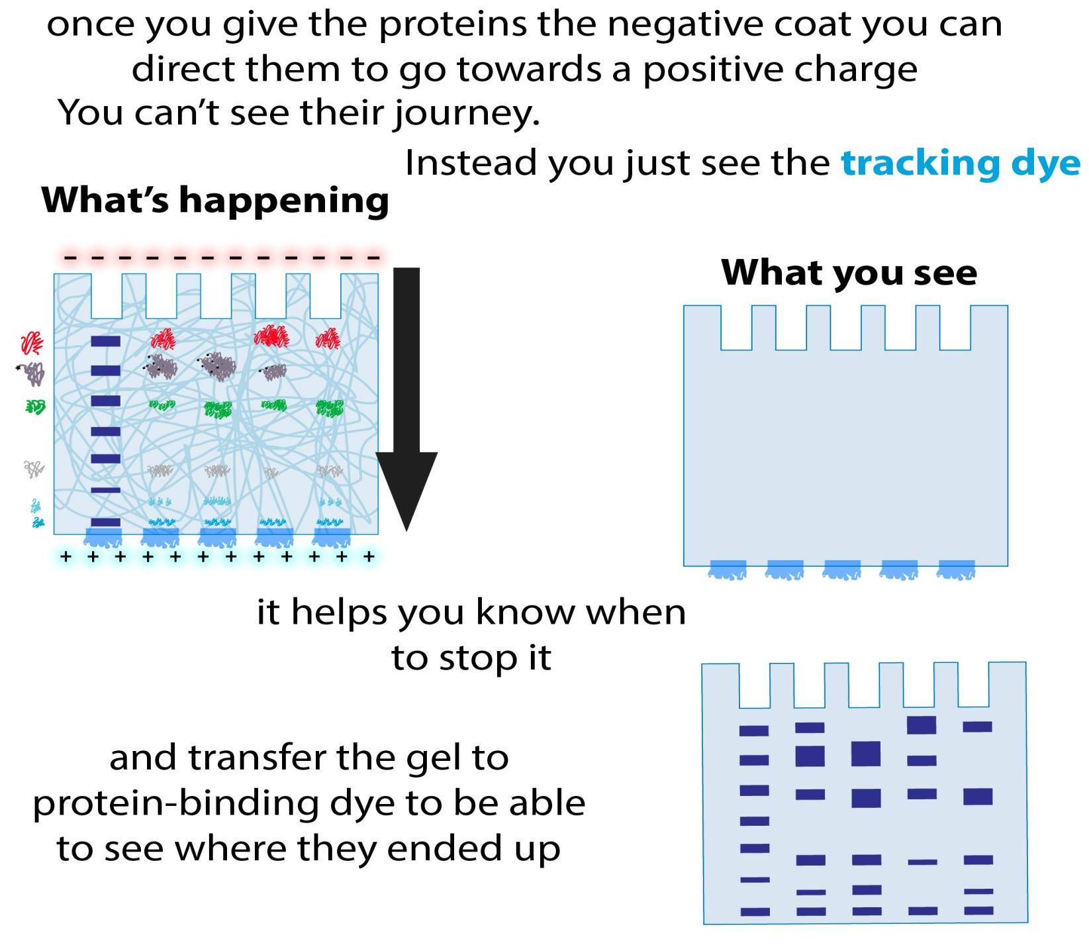
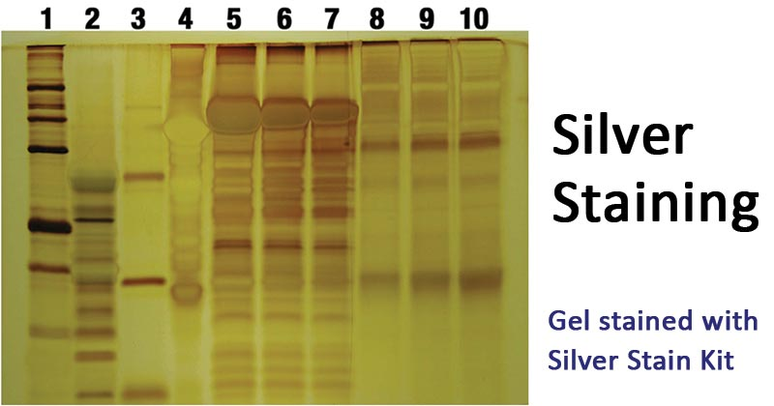

Slide 40
Applications
Used for estimation of molecular weight of proteins and nucleic acids.
Determination of subunit structure of proteins.
Purification of isolated proteins.
Monitoring changes of protein content in body fluids.
To identify whether a particular protein is pure or not.
Separation of proteins, prior to Western Blot transfer.
Species identification.
Antigen preparation.
To measure genetic diversity

Slide 41
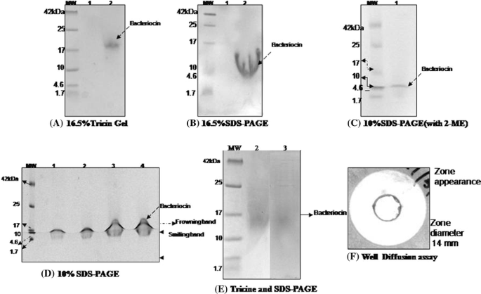
Potential problems with Polyacrylamide gels
Under loaded (bands invisible)
Sloppy loading or to little concentration of protein
Bent bands
Tearing
Frowning

Slide 42
2-D gel Electrophoresis
Two-dimensional gel electrophoresis, abbreviated as 2-DE or 2-D electrophoresis, is a form of gel electrophoresis commonly used to analyze or separate protein.
This technique separates proteins according to two independent properties in two discrete steps.
The first-dimension : isoelectric focusing (IEF)
The second-dimension : sodium dodecyl sulfate-polyacrylamide gel electrophoresis (SDS-PAGE)

Slide 43
The first-dimension : isoelectric focusing (IEF)
Isoelectric focusing (IEF), also known as electro focusing, is a technique for separating different molecules by differences in their isoelectric point (pI).
The isoelectric point (pI, pH(I), IEP), is the pH at which a particular molecule carries no net electrical charge in the statistical mean.

Slide 44
ISOELECTRIC FOCUSSING
Every protein has its own isoelectric point pI i.e pH at which they are neutral in electric field
Gels are impregnated with ampholine
Ampholine makes a continuous pH gradient in Polyacrylamide gels
Loading of sample /protein on these impregnated gel and kept in electrical field cause focusing of proteins to their pI
Formation of sharp bands occurs
Eg –separation of different isoenzymes clinically

Slide 45
A protein that is in a pH region below its isoelectric point (pI) will be positively charged and so will migrate towards the cathode (negatively charged electrode)
As it migrates through a gradient of increasing pH, however, the protein's overall charge will decrease until the protein reaches the pH region that corresponds to its pI.
At this point it has no net charge and so migration ceases (as there is no electrical attraction towards either electrode).
As a result, the proteins become focused into sharp stationary bands with each protein positioned at a point in the pH gradient corresponding to its pI

Slide 46
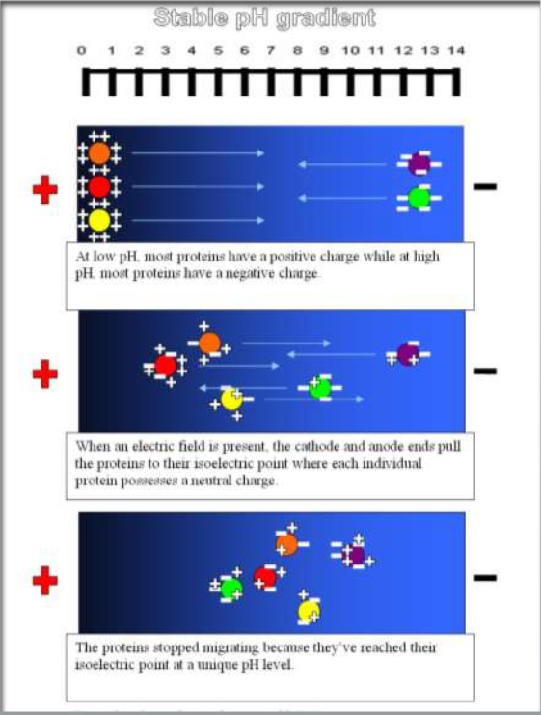
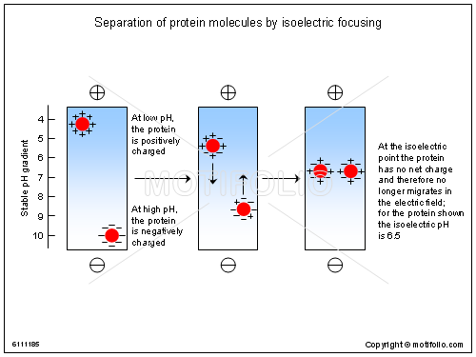

Slide 47
The second-dimension : sodium dodecyl sulfate polyacrylamide gel electrophoresis (SDS-PAGE)
This separates proteins by their sizes (molecular).
Normal SDS PAGE is done in this stage
Stacking is replaced by IPG strips and normal running gel separates molecules
2-D gel image can be analyzed using software
In quantitative proteomics, these tools primarily analyze bio-markers by quantifying individual proteins, and showing the separation between one or more protein "spots" on a scanned image of a 2-DE gel .

Slide 49
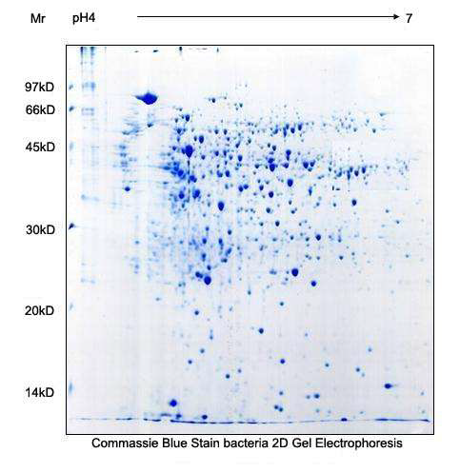

Slide 50
Advantages
Very sensitive
High resolution up to 10,000 different proteins
Unbiased search
Spatio temporal expression

Slide 51
Zymography
Zymogram is an electrophoresis technique which allows enzyme activity to be analysed in situ after the process of electrophoresis has been conducted on the enzyme.
It includes a substrate copolymerised with the polyacrylamide gel for the detection of enzymes and their activity.
It allows characterization of important physical properties of the enzyme within crude cell extracts or partially purified fractions.
This can assist subsequent purification.
Zymograms (also commonly known as “in-gel assays” or “activity gels”) have been used to analyze a wide variety of mammalian, plant, and microbial enzymes

Slide 52
Depending on substrate, zymographic assays can use organic molecules including peptides, lipids, and nucleic acids, detecting, among others, proteases, lipases, and nucleases.
Three types of zymography are used; in gel zymography, in situ zymography and in vivo zymography .
The one most commonly used form of ISZ utilizes gelatin and thus detects gelatinolytic activity
For instance, gelatin embedded in a polyacrylamide gel will be digested by active gelatinases run through the gel. After Coomassie staining, areas of degradation are visible as clear bands against a darkly stained background.

Slide 53
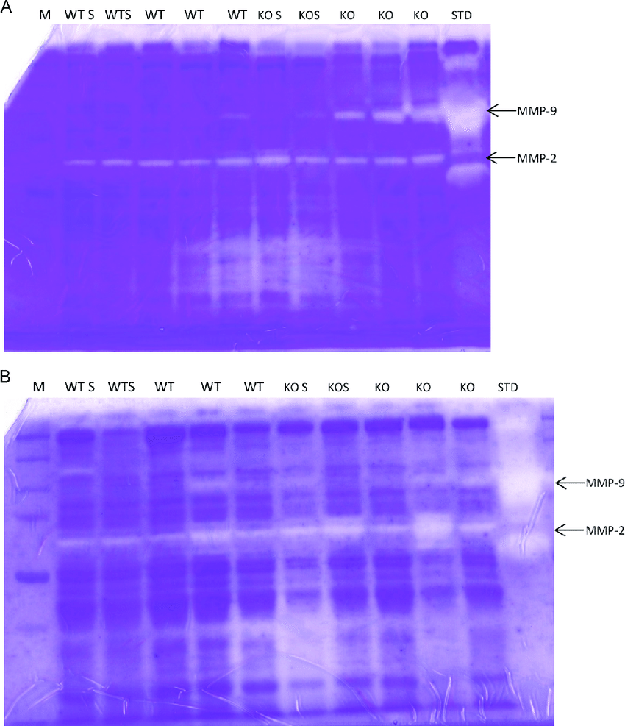

Slide 54
Samples are prepared without denaturing the active enzymes present in the samples.
Following electrophoresis, the gel is placed in an enzyme activation buffer which allows the enzymes present in the sample to become active and digest the substrates copolymerised in the gel.
The zymogram is subsequently stained and the areas of enzyme activity and digestion become visible.
Suitable for drug discovery and screening of low abundunt enzymes and their isomers in complex mixtures.

