Slide 1
Parental Care, Neoteny & Paedogenesis in Amphibia
Dr. Tanmay Datta

Slide 2
Parental Care
Parental care is a behavioural and evolutionary strategy adopted by some animals, involving a parental investment being made to the evolutionary fitness of offspring. Patterns of parental care are widespread and highly diverse across the animal kingdom. There is great variation in different animal groups in terms of how parents care for offspring, and the amount of resources invested by parents.
The amphibians were the pioneers amongst the vertebrates to invade land. On coming to this new environment, they had to face many hostile forces and they had to develop various ways and means to overcome the obstacles. Naturally greatest importance was given to the perpetuation of race, so that they can ultimately win the struggle As a result, the reproductive, mechanism had undergone extensive modifications. Although it has taken a perfect shape in mammals, the phenomenon of parental care is quite well-developed in amphibians where extreme modifications in structure and behaviour are observed.

Slide 3
Parental Care in Amphibia
Six modes of parental care are recognized: egg attendance, egg transport, tadpole attendance, tadpole transport, tadpole feeding, and internal gestation in the oviduct. Whereas egg attendance and internal gestation in the oviduct are the only modes of parental care known for caecilians and salamanders, anurans display all six modes. Although parental care is widely distributed phylogenetically within the Amphibia, the percentage of species providing care is low. Postoviposition parental care has been documented in only about 5% of caecilians, 18% of salamanders, and 6% of anurans. Internal gestation in the oviduct probably occurs in about 75% of all caecilians, in 4 species of salamanders, and in 5 species of anurans.

Slide 4
Protection of Nest, Nurseries or Shelters
Selection of Site: Care of the eggs is restricted to the selection of site in certain frogs and toads. In Rhacophorus schlegli of Japan, the eggs are laid in a hole on muddy bank of river or pond. The eggs are covered by foamy mucus to prevent desiccation . The eggs are washed out into the water of the river or ponds by the rain and development starts there.
In Gyrinophilus, the eggs are laid under the stones in stream. The eggs are then taken up on any part of the body and a secretion prevents growing of fungi over them. Eggs are laid on the under surface of leaves hanging above water in Hylodes. In Triton and Leptodactylus the eggs are laid under the surface of leaves near the vicinity of water. In Triton, the eggs may be fixed with the aquatic weeds by glues. Rhacophorus malabaricus deposits their spawn on trees.

Slide 5
Mud Nest of Rheobatrachus

Slide 6
Glued Eggs of Rhacophorus to Leaves Overhanging Water

Slide 7
Communal Nests
The toad Nectophrynoides malcolmi prepare communal nests in which eggs are deposited by several females. The nest is guarded by a single male.

Slide 8
Defending Eggs or Territories
In Urodela, males of Cryptobranchus and Hynobius drive away all enemies except ripe females of own species. In terrestrial plethodontid salamanders clutches are usually attended by females. They periodically rotates the eggs in order to increase aeration and to prevent adhesive malformation. Either sex of Proteus anguinus may attend the eggs. It waves its tail to direct water currents over the eggs for proper aeration.
In Anura, males of green frog Rana clamitans maintain territories and attack small intruders to defend eggs. Males of nest building gladiator frog, Hyla rosenbergi are highly territorial and aggressive. Male of Mantophryne robusta sits over and holds with hands the elastic gelatinous envelope containing eggs. Some tree frogs sit besides or rest on top of hanging clutch. The terrestrial eggs of Dendrobates auratus are periodically moistened by males urinating on the clutch.

Slide 10
Tree Frogs attending Nests

Slide 11
Direct Caring: Carrying Eggs over the Body
In Hyla goeldii , the females carry the eggs on their back in incipient brood pouches. The youngs come out as full-fledged frogs, but with tail. The males of midwife toad, Alytes obstetricians show peculiar type of parental care. After competition, successful male grasp round the waist of the female, massages and lubricates the cloacal region of the female, whereupon the females discharge the eggs. After fertilization, the eggs are wrapped round the back of the thigh and he withdraws himself into a hole near the pond. When the eggs are ready to hatch, the male carries them to nearest water where the larvae come out. Phyllobates , an inhabitant of western Colombia, transport the tadpoles, carrying on the back of the females to the nearest water body. In Desmognathus, the females carry the eggs and live in underground hole. In Pipa pipa, the eggs are carried by females on the back. Similar phenomenon is observed in Cryptobatrachus evansi . The soft spongy skin on the dorsal side sinks into small pockets into which eggs are lodged . The same phenomenon is also observed in Pipa dorsigera where the eggs are deposited in pits on the back of females. During breeding season, the dorsal skin of the females becomes soft, spongy and gelatinous. The male place the eggs on the back of the female where each egg sinks into a small pit. An operculum covers the pit. It is developed out of the remnant of the egg envelop and integumentary secretion. Development is completed inside the cutaneous pit. The partitions between the pits become highly vascularized. The developing larva attains a vascular tail. Physiological exchange of materials between the embryonic and maternal tissues is claimed to occur in this animal. The larva fails to develop gills and the tadpole larva comes out 80 days after the deposition of the egg.

Slide 12
Egg Brooding in Fritziana goeldii

Slide 13
Parental Care of Midwife Toad (Alytes)

Slide 14
Parental Care in Pipa pipa

Slide 15
Direct Caring: Coiling around Eggs
In oviparous caecilians as exemplified by Ichthyophis the body remains coiled round the egg mass to guard them until hatching. Also, female eats the infected eggs and thus saves other eggs from infection.
In the salamander, Congo eel Amphiuma, the female lays large eggs in burrows in damp soil and carefully guard them by coiling her body round them until they hatch. In Megalobatrachus maximus, the Japanese giant salamander, it is the male who coils round the eggs.

Slide 16
Coiling around Eggs
Ichthyophis
Amphiuma

Slide 17
Direct Development
In ovoviviparous caecilian, Geotrypetes, the eggs are yolky and migrate to the last part of the oviducts. When the yolk is exhausted and the external gills are atrophied, the embryos, about 25 mm long, hatch and remain inside the oviducts till the embryos become 75 mm in length. The developing youngs get nutrition from the uterine ‘milk’. Metabolic exchanges also occur between the vascular maternal and foetal tissues.
In Rhinoderma darwini ,the eggs are swallowed by the males and are placed inside the inflated vocal sac. The eggs may remain there up-till hatching or even up to the completion of metamorphosis.
In the West African tree frog, Hylambates breviceps, the female carries eggs in her buccal cavity.
Viviparity: Extreme modification is observed in Salamandra atra and S. maculosa. The eggs are placed inside the uterine cavity where entire tadpole hood is completed. Two eggs are laid at a time. The larvae remain attached with the uterine wall by membrane which functions physiologically in the manner of a primitive placenta. The broad and vascular tail.

Slide 18
Development inside Vocal Sac in Rhinoderma darwini

Slide 19
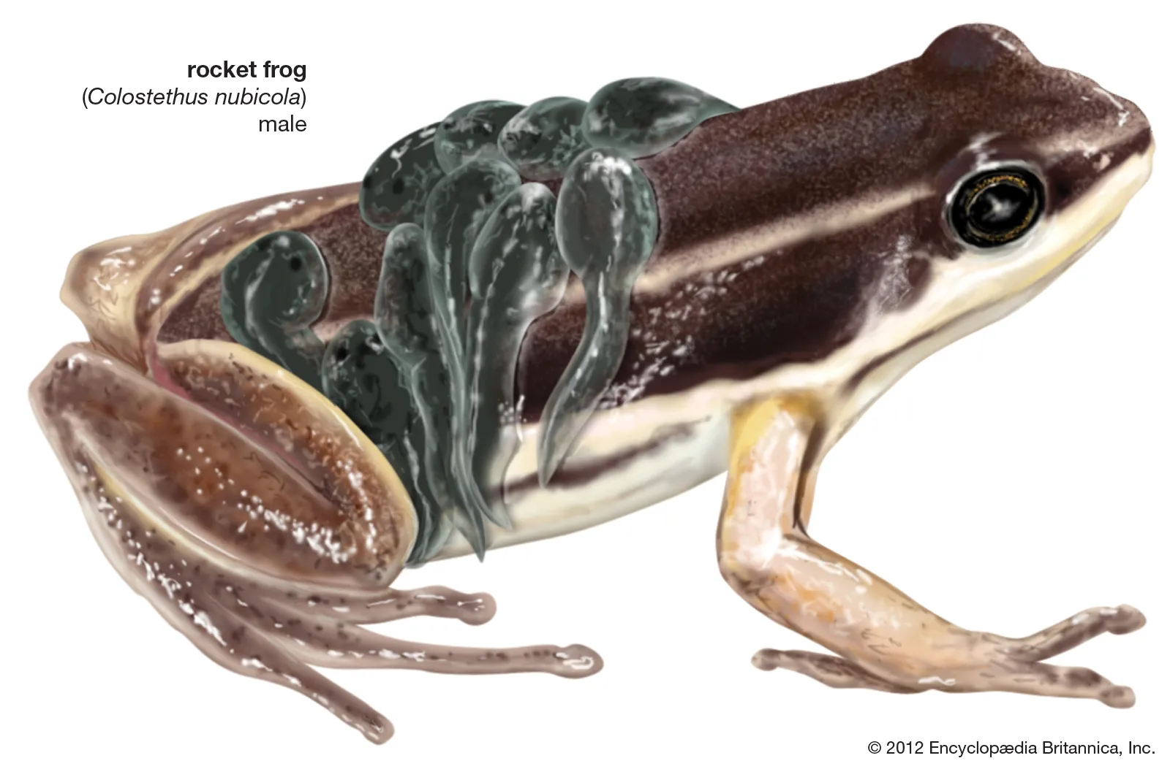
Transferring Tadpoles to the Water
Some species of small frogs such as Phyllobates, Pelobates, Dendrobates, Sooglossus, etc. in both tropical Africa and South America, deposit their eggs on ground. After hatching the tadpoles fasten themselves to the back of one of the parents with their sucker-like mouth on their sticky ventral side and are transported to water.

Slide 20
Larval Feeding
Dendrobates is the only amphibian known to feed their youngs.

Slide 21
Conclusion
Parental care refer to any behaviour that contributes to offspring survival. Forms of care may include the preparing of a physical rearing environment, the provisioning of offspring or the defending of offspring from predators. Parental care may be beneficial if offspring survival, quality, or reproductive success is improved, as this ultimately increases the parent's inclusive fitness. Since parental care is costly and often affects the parent's own future survival and reproductive success, parents will make sure that any investment made into their offspring is well-spent. As it directly correlated with the inclusive fitness of the species as a whole, type and degree of parental care has an evolutionary significance.

Slide 22
Neoteny and Paedogenesis
PAEDOGENESIS: The phenomenon of attainment of sexual maturity leading to reproduction in an arrested larval stage (preadult stage) is referred to as Paedogenesis.
NEOTENY: Neoteny is a special case of paedogenesis where sexual maturity occur but somatic development slows allowing juvenile features to persist. Neotenous larval stage is found in Axolotl larval stage of Ambystoma.

Slide 23
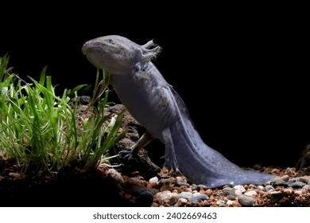
AXOLOTL LARVA: MODEL FOR STUDY OF NEOTENY
Neoteny in axolotl larvae is a condition where the axolotl retains its larval features and doesn't undergo metamorphosis. This means that the axolotl stays in its tadpole-like form and lives in water throughout its life. Axolotls with neoteny have frilly three pairs external gills and other juvenile features. They are sexually mature and can breed. Axolotl larva of Ambystoma has a well developed post anal tail with a continuous tail fin unsupported by fin rays.

Slide 24
TYPES OF NEOTENY
PARTIAL NEOTENY- This illustrates simple retardation of metamorphosis beyond the normal time period. Here we find extension of larval characters and temporary retardation of metamorphosis owing to certain temporary changes in the neighboring environment. But sooner or later they will be metamorphosed into adults in natural optimum condition. Example : Bufo vulgaris
TOTAL NEOTENY- When the animals retain their gills but becomes sexually matured throughout the life. E.g. Necturus maculosus is permanently neotenic. It lives on the bottoms of lakes and retains its gills throughout life.
QUASI PERMANENT NEOTENY: Larva does not metamorphose into adult in certain specific natural condition and attains sexual maturity. But metamorphosis can take place after artificial treatment or suitable natural conditions. Example- Axolotl larva of Ambystoma typically exhibits this type of neoteny. The larva remains throughout its life without metamorphosis, but under suitable conditions they may metamorphose into adult form.

Slide 25
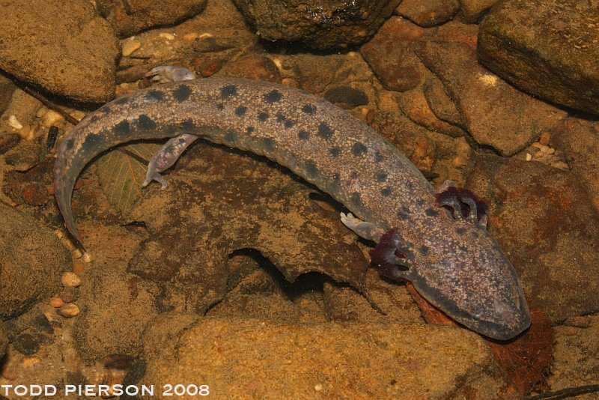
TYPES OF NEOTENY (According to young 1981)
1.OBLIGATE NEOTENY: Neoteny occurs in all individuals and metamorphosis cannot be induced by T4. E.g. Necturus.
2. FACULTATIVE NEOTENY: Some or all the individuals of a given population metamorphose. In facultative neoteny, T4 generally induces metamorphosis. E.g. Axolotl larva of Ambystoma.

Slide 26
COMPARATIVE LARVAL NATURE OF AXOLOTL
Organ | Changes in other Urodels | Changes in Axolotl
Caudal Fin | Disappears | Persists
External gills | Disappear in most forms | Persists with four gill slits
Head | Proportionate with the developing trunk | Comparatively large
Eyes | Prominent | Weakly developed
Limbs | Moderately developed | Feeble in nature
Lateral line sense organ | Disappears | Persists
Vertebrae | Procoelous | Amphicoelous
Heart | Symmetrical | Asymmetrical

Slide 27
Hormonal Regulation of Neoteny
Failure of metamorphosis in the Axolotl is due to the inability of the thyroid to secrete thyroxine.
• The thyroids are sensitive to the thyroid stimulating hormone (TSH), but the evidence suggests that the neoteny is due to a low level of thyrotropin releasing hormone (TRH) from hypothalamus, probably due to a combination of genetic predisposition with environmental factors.

Slide 28
INTRINSIC AND EXTRINSIC FACTORS INVOLVED IN NEOTENY
EXTRINSIC FACTORS • Abundant food materials and other favorable requisites for larval and aquatic life is the cause of Neoteny. • Deep and cold water inhibit the production of thyroxine hormone which retards metamorphosis. • Larval tissues loose sensitivity to thyroxine as temperature drops. • Inadequate iodine content of water. • Retardation of metamorphosis is due to the saline nature of water.
INTRINSIC FACTORS • Calcium ion concentration inhibits metamorphosis in Axolotl larva and therefore favors neoteny. • Different threshold values of thyroxine- The timing of metamorphic events is controlled by thyroxine concentration. • Insulin hormones inhibit metamorphosis. • Prolactin acts as an inhibitor of metamorphosis.

Slide 29
ENVIRONMENTAL INFLUENCE ON NEOTENY
In lowland populations of the northwestern salamander, Ambystoma gracile, individuals remain aquatic for several years and then metamorphose into sexually mature terrestrial adults that breed.
In high montane populations of this same species, many individuals stop short of metamorphosis. Their larval forms become sexually mature and breed.
Note: For these montane individuals, forgoing metamorphosis means that they avoid becoming a terrestrial form exposed to harsh alpine winters. By remaining larval, they retain their aquatic lifestyle in which they can safely over winter in the unfrozen depths of ponds.

