Slide 1
Digestion
Dr. Tanmay Datta

Slide 2
Ingestion
Mastication (Chewing): Jaw muscles can close the teeth with a force as great as 55 pounds on the incisors and 200 pounds on the molars.
It is especially important for fruits and raw vegetables to break cellulose membrane.
As digestive enzymes act only on the surface of food particles, tearing of food materials in smaller parts by chewing aids the digestion process by increasing the rate of digestion.

Slide 3
Swallowing (Deglutition)
Voluntary stage: Upward and backward movement of tongue against palate squeeze and rolls the food posteriorly into the pharynx.
Pharyngeal stage: 1. Soft palate is pulled upward to close the posterior nares; 2. Palatopharyngeal folds on each side of the pharynx are pulled medially to form a sagittal slit through which only sufficiently masticated food can enter into the esophagus; 3. Epiglottis swings backward over the opening of the larynx to prevent passage of food into the nose and trachea; 4. upward movement of larynx pulls up and enlarges the opening to the esophagus. At the same time pharyngoesophageal sphincter relaxes allowing food to move easily into the upper esophagus; 5. Peristalsis of muscular wall of pharynx propels the food down into the esophagus.
Esophageal stage: Peristaltic movements of esophagus conduct food rapidly (8 to 10 seconds) from the pharynx to the stomach. Gastroesophageal sphincter, which remains constricted otherwise, opens, when the peristaltic wave passes down up to this point, allowing each propulsion of food into the stomach.

Slide 4
Motor Functions of the Stomach
Storage of large quantities of food.
Mixing the food with gastric juices forming a semifluid mixture called chyme.
Slow emptying of chyme into the small intestine at a suitable rate. Peristaltic waves, in addition to causing mixing in the stomach, also provide a pumping action called the “pyloric pump”. Gastrin plays an excitatory effect on stomach peristalsis.
However, the more important control of stomach emptying resides in inhibitory feedback signals from the duodenum, including both enterogastric inhibitory nervous feedback reflexes and hormonal feedback by CCK (Cholecystokinin). Other possible inhibitors of stomach emptying are the hormones secretin and gastric inhibitory peptide (GIP).

Slide 5
Physiologic anatomy of the Stomach

Slide 6
Movements of the Small Intestine
Mixing (Segmentation) Contractions: Localized concentric contractions along the intestine and lasting a fraction of a minute causing “segmentation” of small intestine. The segmentation contractions “chop” the chyme 2 to 3 times per minute, in this way promoting progressive mixing of the food with secretions of the small intestine.
Propulsive Movements: Chyme is propelled by peristaltic waves. These can occur in any part of the small intestine, and they move toward the anus at a velocity of 0.5 to 2.0 cm/sec, faster in the proximal intestine and slower in the terminal intestine. Peristaltic movements begin by a so-called gastroenteric reflex that is initiated by distention of the stomach and conducted through the myenteric plexus from the stomach down along the wall of the small intestine. Several hormonal factors like gastrin, CCK, insulin, motilin, and serotonin enhance intestinal motility. Conversely, secretin and glucagon inhibit small intestinal motility.

Slide 7
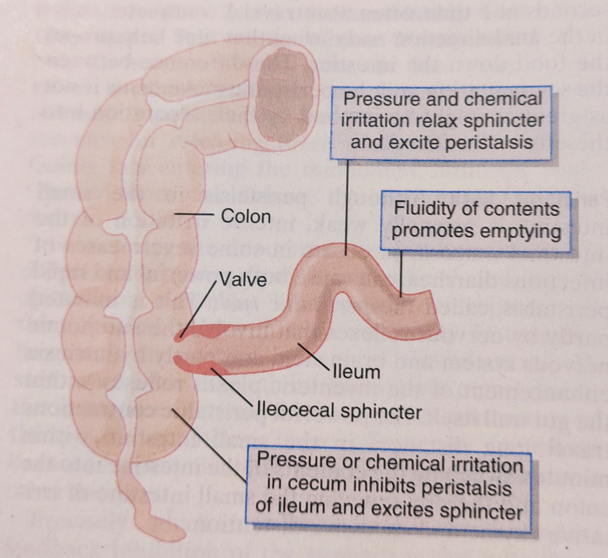
Function of the Ileocecal Valve
Principal function of the ileocecal valve is to prevent backflow of fecal contents from the colon into the small intestine.

Slide 8
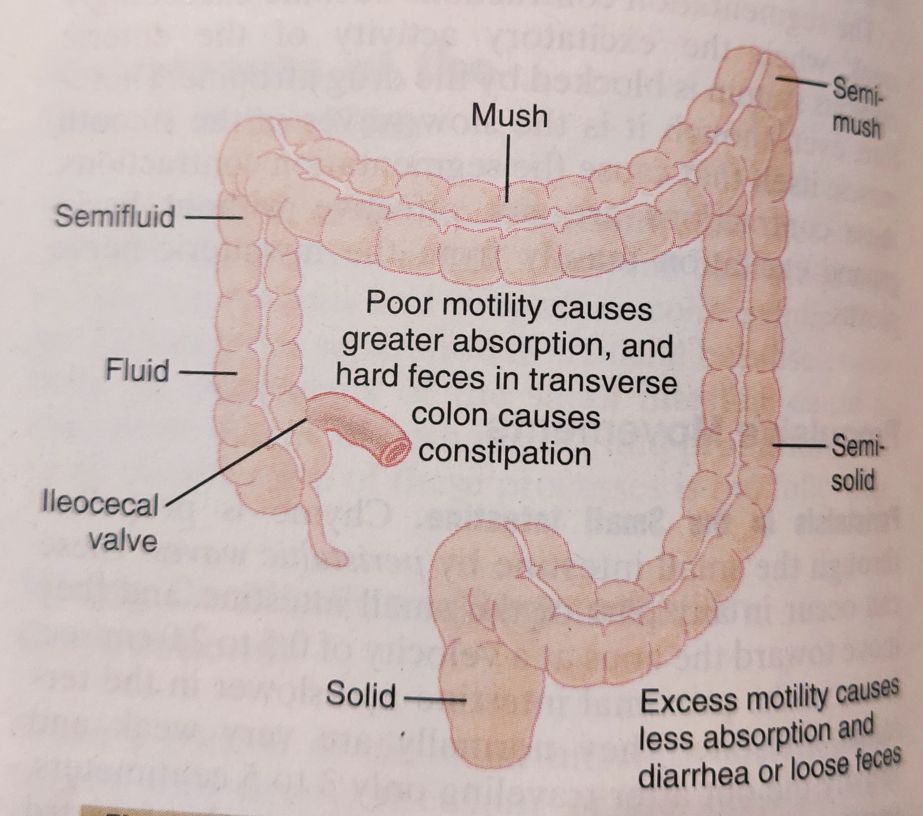
Movements of the Colon
Principal functions of the colon are (1) absorption of water and electrolytes from the chyme to form solid feces and (2) storage of fecal matter until it can be expelled. Movements of the colon are normally very sluggish and have characteristics similar to those of small intestine.

Slide 9
Digestion of Carbohydrates
During condensation of monosaccharides one hydrogen ion has been removed from one of the monosaccharide, and a hydroxyl ion has been removed from the next one; and the monosaccharides combine with each other at this site of removal. When carbohydrates are digested, the above process is reversed and the carbohydrates are converted into monosaccharides. Specific enzymes in the digestive juices return the hydrogen and hydroxyl ions from water to the polysaccharides. This process is called hydrolysis.

Slide 10
Digestion in the Mouth and Stomach
During chewing food is mixed with the saliva that contains ptyalin secreted mainly by the parotid glands. This enzyme hydrolyzes starch into the disaccharide maltose and other oligosaccharides. Only 5% of starch become hydrolyzed in mouth.
However, starch digestion continues in the body and fundus of the stomach as long as the food becomes mixed with the stomach secretions. As the pH of the medium falls below 4.0, the salivary amylase activity is blocked.
Before being completely mixed with the gastric secretions, as much as 30 to 40% of the starches become hydrolyzed to maltose.

Slide 11
Digestion in the Small Intestine
Pancreatic secretion contains large quantity of alpha-amylase. It is very powerful, within 15 to 30 minutes after the chyme entries from the stomach into the duodenum, virtually all the carbohydrates become digested.
All carbohydrates almost totally converted into maltose and very smaller glucose polymers before passing beyond the duodenum or upper jejunum.
The enterocytes lining the villi of the small intestine contain four enzymes (lactase, sucrase, maltase, and alpha-dextrinase), which are capable of splitting the disaccharides lactose, sucrose, and maltose, plus other small glucose polymers, into constituent monosaccharides.
Lactose splits into a molecule of galactose and a molecule of glucose. Sucrose splits into a molecule of fructose and a molecule of glucose. Maltose and other small glucose polymers splits into multiple molecules of glucose.

Slide 12
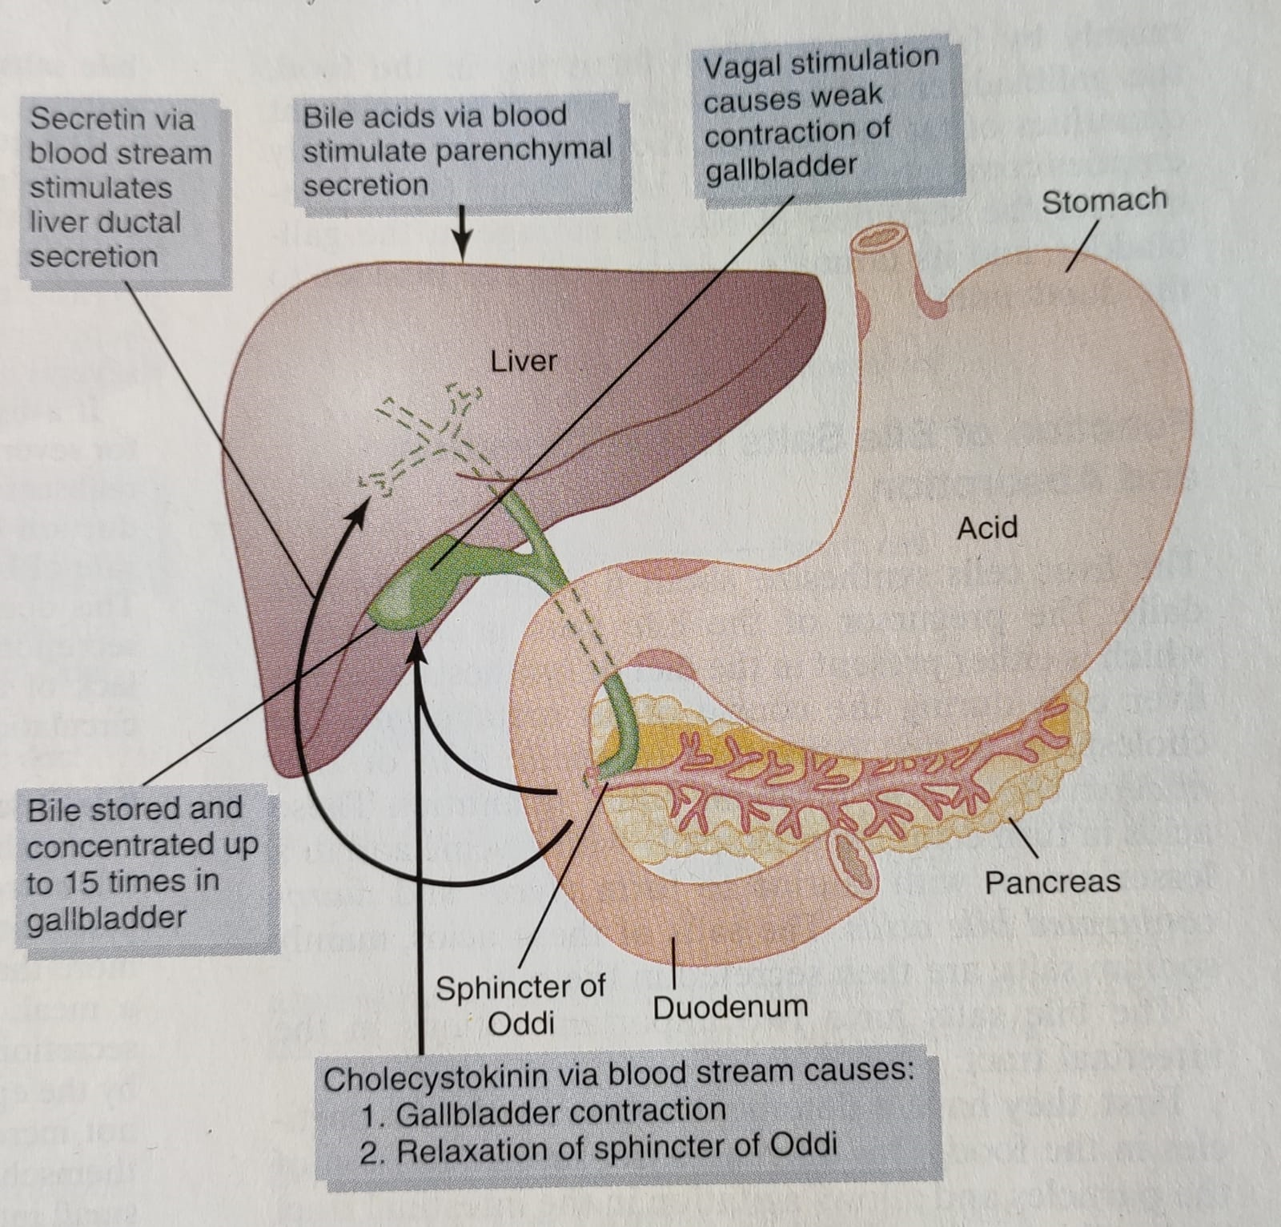

Slide 13
Digestion of Protein
The dietary proteins are chemically long chains of amino acids bound together by peptide linkages. At each linkage, a hydroxyl ion has been removed from one amino acid and a hydrogen ion has been removed from the succeeding one. Digestion occurs by hydrolysis: proteolytic enzymes return hydrogen and hydroxyl ions from water molecules to the protein molecules to split them into their constituent amino acids.

Slide 14
Digestion of Protein

Slide 15
Digestion in the Stomach
Gastric glands in stomach secrete large quantity of hydrochloric acid. Parietal (oxyntic) cells in the glands secrete HCl at a pH of about 0.8 that maintains the average pH of stomach around 2.0 to 3.0, a highly favorable range of acidity for pepsin, the important peptic enzyme of the stomach.
Pepsin digests the protein collagen, an albuminoid type of protein that is affected little by other digestive enzymes. Collagen is a major constituent of the intercellular connective tissue of meats; therefore, for the digestive enzymes of the digestive tract to penetrate meats and digest the other meat proteins, it is first necessary that the collagen fibers be digested.
Pepsin only initiates the process of protein digestion, usually providing only 10 to 20% of the total protein digestion to convert the protein to proteoses, peptones, and a few polypeptides.

Slide 16
Digestion by Pancreatic Secretions
Most protein digestion occurs in the upper part of small intestine, in the duodenum and jejunum, under the influence of proteolytic enzymes from pancreas. Major proteolytic enzymes are trypsin, chymotrypsin, carboxypolypeptidase, and proelastase.
Both trypsin and chymotrypsin splits protein molecules into small polypeptides; carboxypolypeptidase then cleaves individual amino acids from the carboxyl ends of the polypeptides. Proelastase, in turn is converted into elastase, which then digests elastin fibers that partially hold meats together.
Only a small percentage of the proteins are digested all the way to their constituent amino acids by the pancreatic juices. Most remain as dipeptides and tripeptides.

Slide 17
Digestion by Peptidases in the Enterocytes
Enterocytes have brush borders that consist of hundreds of microvilli projecting from the surface of each cell to the intestinal lumen. In the membrane of the microvilli are multiple peptidases that protrudes through the membranes to the exterior, where they come in contact with the intestinal fluids.
Two types of peptidase enzymes are especially important, aminopolypeptidase and several dipeptidases. They split the remaining polypeptides into tripeptides and dipeptides and a few amino acids. Both the amino acids plus the dipeptides and tripeptides are easily transported through the microvillar membrane to the interior of the enterocyte.
Finally, inside the cytosol of the enterocytes are multiple other peptidases that are specific for the remaining types of linkages between amino acids. Within minutes, virtually all the last dipeptides and tripeptides are digested to the final stage to form single amino acids; these then pass on through to the other side of the enterocyte and thence into the blood.

Slide 18
Fig. Diagram of an Enterocyte

Slide 19
Digestion of Fats
Most abundant fats of the diet are the neutral fats, also known as triglycerides, each molecule of which is composed of a glycerol nucleus and three fatty acid side chains. Also, small quantities of phospholipids, cholesterol, and cholesterol esters are present in usual diet, that are digested like neutral fats.
During digestion the fat digesting enzymes return three molecules of water to the triglyceride molecule and thereby split the fatty acid molecules away from the glycerol. Here again, the digestive process is one of hydrolysis.

Slide 20
Digestion in the Intestine
Only a small amount (less than 10%) of triglycerides is digested in the stomach by lingual lipase. Mainly fat digestion occurs in the small intestine as follows:
Emulsification by Bile Acids and Lecithin
The first step in fat digestion is physically to break the fat globules into very small sizes so that the water-soluble digestive enzymes can act on the globule surfaces. This process is called emulsification of fat, and it begins by agitation in the stomach to mix the fat with the products of stomach digestion.

Slide 21
……continued
Major part of emulsification occurs in the duodenum under the influence of bile. Bile does not contain any digestive enzymes but, contains large quantity of bile salts as well as the phospholipid lecithin. The polar parts of the bile salts and lecithin molecules are highly soluble in water, whereas most of the remaining portions of their molecules are highly soluble in fat. Thus, one part of these molecules dissolve in the surface layer of the fat molecule and other (polar) part binds with the surrounding watery fluids, which greatly decreases the interfacial tension of the fat and makes it soluble as well.
When the interfacial tension of a globule of non-miscible fluid is low, it can be broken up easily on agitation. Consequently, a major function of the bile salts and lecithin is to make the fat globules readily fragmentable by agitation with the water in the small bowl. Ultimately fat particles broken up in fragments of 1 micrometer diameter and thereby increases the surface area of the fats as much as 1000-fold. Water-soluble enzymes like lipase can attack the fat globules only on their surfaces.

Slide 22
Digestion by Pancreatic Lipase
The most important enzyme for digestion of the triglycerides is pancreatic lipase. It can digest triglycerides within 1 minutes upon reaching the surface and present in large quantities in pancreatic juice. There is enteric lipase in enterocyte, but is usually not needed. Pancreatic lipase splits almost all the triglycerides into free fatty acids and 2-monoglycerides.

Slide 23
Role of Bile Salts to Accelerate Fat Digestion: Formation of Micelles
Hydrolysis of triglycerides is a highly reversible process; therefore, accumulation of free fatty acids and monoglycerides blocks further digestion. Bile salts play an important role to remove these products of fat digestion from the digestion site. High concentration of bile salts in water, have the propensity to form micelles, which are small spherical, cylindrical globules 3 to 6 nanometers in diameter composed of 20 to 40 molecules of bile salt. These develop because each bile salt molecule is composed of a sterol nucleus that is highly fat-soluble and a polar group that is highly water-soluble. The sterol nucleus encompasses the fat digestate, forming a small fat globule in the middle of a resulting micelle, with polar groups of bile salts projecting outward to cover the surface of the micelle and thus dissolves in water. The bile salt micelles transport the free fatty acids and monoglycerides to the brush borders of the intestinal epithelium. There the free fatty acids and monoglycerides are absorbed into the blood, but the bile salts are released back to be used again and again for this “ferrying” service.

Slide 24
Digestion of Cholesterol Esters and Phospholipids
Most cholesterol in the diet is in the form of cholesterol esters, which are combinations of free cholesterol and one molecule of fatty acid. Phospholipids also contain fatty acid. Enzyme cholesterol ester hydrolase hydrolyze the cholesterol ester, and phospholipase A₂ hydrolyze phospholipids to free fatty acids. These two other lipases are also present in the pancreatic secretion. The bile salt micelles play the same role in “ferrying” free cholesterol, phospholipid molecule and free fatty acids.

Slide 25
Anatomical Basis of Absorption
The stomach is a poor absorptive area because it lacks the typical villus type of absorptive membrane, and also because the junctions between the epithelial cells are tight junctions. Only a few highly lipid-soluble substances, such as alcohol and some drugs like aspirin, can be absorbed in small quantities in stomach.
The surface of the small intestinal mucosa has many folds called valvulae conniventes (folds of Kerckring), which increase the surface area of the absorptive mucosa about threefold. Also located on the epithelial surface of the small intestine all the way down to the ileocecal valve are millions of small villi. These project about 1 mm from the surface of the mucosa. The distribution of villi is less profuse in the distal small intestine. The presence of villi on the mucosal surface enhances the total absorptive area another 10-fold. Inside the villi there is a special arrangement of vascular system for absorption of fluid and dissolved material into the portal blood; and the “central lacteal” lymph vessel is meant for absorption of fatty elements into the lymph (Fig.).
Finally, each intestinal epithelial cell on each villus is characterized by a brush border, consisting of as many as 1000 microvilli 1 micrometer in length and 0.1 micrometer in diameter protruding into the intestinal lumen. This increases the surface area at least 20-fold. Thus, the combination of the folds of Kerckring, the villi, and the microvilli increases the total absorptive area of the mucosa perhaps 1000-fold, making a tremendous total area of 250 square meter or more.

Slide 26
Fig. Longitudinal section of small intestine.

Slide 27
Fig. Absorption of sodium through the intestinal epitheliu.

Slide 28
Absorption of Carbohydrates
All the carbohydrates in the food are absorbed mostly in the form of monosaccharides and only a small fraction is absorbed as disaccharides. Of the absorbed monosaccharides, 80% is glucose and the remaining 20% are composed of galactose and fructose.
Virtually all the monosaccharides are absorbed by an active transport process. Glucose absorption occurs in a cotransport mode with active transport of sodium. The process starts with active transport of Na⁺ through the basolateral membranes of the intestinal epithelial cells into the blood, thereby depleting Na⁺ inside the epithelial cells. Decrease of sodium inside the cells causes sodium from the intestinal lumen to move through the brush border to the cell interiors by a process of facilitated diffusion. At this stage, a Na⁺ combines with a transport protein, but the transport protein will not transport the sodium to the interior of the cell until the protein itself also combines with glucose. Thus, the low concentration of sodium inside the cell literally “drags” sodium to the interior of the cell and along with it the glucose at the same time. Once inside the epithelial cell, other transport proteins and enzymes cause facilitated diffusion of the glucose through the cell’s basolateral membrane into the paracellular space and from there into the blood.
Galactose is transported by almost exactly the same mechanism as glucose. Conversely, fructose transport does not occur by the sodium co-transport mechanism. Instead, fructose is transported by facilitated diffusion. On entering the cell, fructose becomes phosphorylated, then converted to glucose, and finally transported in the form of glucose into the blood.

Slide 29
Absorption of Proteins
Most proteins are absorbed in the form of dipeptides, tripeptides, and a few free amino acids. Most of this transport occurs as sodium co-transport mechanism like glucose. A few amino acids do not require this sodium co-transport mechanism but instead are transported by special membrane transport proteins in the same way that fructose is transported, by facilitated diffusion. At least five types of transport proteins for transporting amino acids and peptides have been found in the luminal membranes of intestinal epithelial cells.

Slide 30
Fig. Functional organization of villus. A. Longitudinal section. B. Cross section

Slide 31
Absorption of Fats
End products of fat digestion (monoglycerides and fatty acids) are carried to the surface of the microvilli as micelles and then penetrate into the recesses among the moving, agitating microvilli. Here, both the monoglycerides and fatty acids diffuse immediately out of the micelles and into the interior of the epithelial cells, which is possible because the lipids are soluble in the cell membrane. This leaves the bile micelles still in the chyme, where they function again and again to help absorb still more monoglycerides and fatty acids.
After entering the epithelial cell, the fatty acids and monoglycerides are taken up by the cell’s smooth endoplasmic reticulum and used to form new triglycerides that are subsequently released in the form of chylomicrons through the base of the epithelial cell into the lacteal, to flow upward through the thoracic lymph duct and empty into the circulating blood.
However, small quantities of short- and medium-chain fatty acids, such as those from butterfat, are absorbed directly into the portal blood rather than being converted into triglycerides. It is possible because the short-chain fatty acids are more water-soluble and mostly are not reconverted into triglycerides by the ER.

