Slide 1
Gastrulation in Chick
Dr. Tanmay Datta

Slide 2
Introduction
The gastrulation of chick is very peculiar as the egg is telolecithal and no true archenteron is formed. At the end of cleavage, a flat, disc-shaped shaped blastula is formed, called discoblastula.
Discoblastula: Above the yolk, the disc-shaped blastula floats. Between the blastula and yolk is a space called subgerminal cavity. At the center of the disc is a one-cell-thick blastoderm, called area pellucida, that shed yolk-laden cells in the subgerminal cavity and thus appears comparatively transparent. The peripheral ring of blastoderm that have not shed their deep cells constitutes the area opaca. Between the area pellucida and area opaca is a thin layer of cells called the marginal zone. Blastoderms of area pellucida forms the most part of embryo proper. Some of the marginal zone cells become very important in determining cell fate during early chick development.

Slide 3
Formation of Hypoblast and Epiblast
By the time a hen has laid an egg, the blastoderm contains some 20,000 cells. At this time most of the cells of area pellucida remain at the surface, forming the epiblast, while other cells have delaminated and migrated individually into the subgerminal cavity to form the poly-invagination islands (primary hypoblast). It comprises of separate clusters, each consisting of 5 – 20 cells. Simultaneously, a thickening of sickle-shaped cells, called Koller’s sickle, form at the posterior margin of the blastoderm. Shortly after forming primary hypoblast, a sheet of cells from Koller’s sickle migrates anteriorly and pushes the primary hypoblast cells anteriorly, thereby forming the secondary hypoblast (endoblast). The resulting two-layered blastoderm (epiblast and hypoblast) is joined together at the marginal zone of the area opaca, and the space between the layers forms a blastocoel.
The avian embryo comes entirely from the epiblast. The hypoblast cells form portions of the external membranes, especially the yolk sac and stalk linking the yolk mass to endodermal digestive tube.

Slide 4
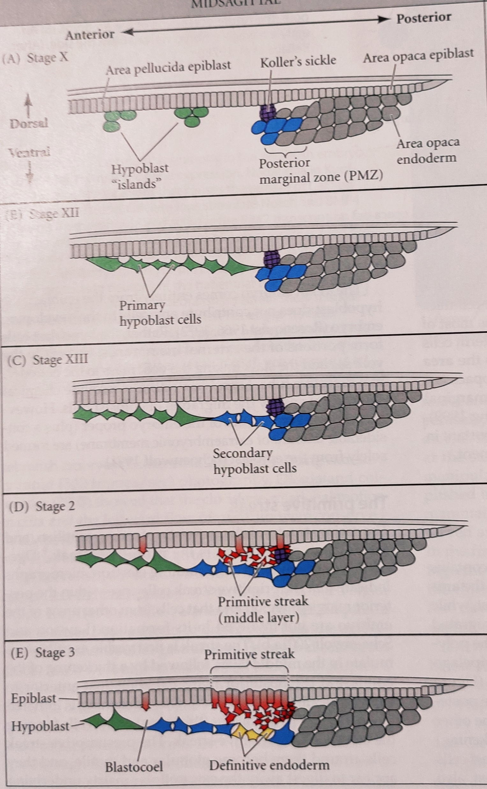
Fig. Formation of three layered blastoderm.

Slide 5
Formation of Primitive Streak
The formation of primitive streak is a major structural characteristic of avian, reptilian and mammalian gastrulation. At 3 to 4 hours of incubation the streak starts as a thickening of the epiblast just anterior to Koller’s sickle. This thickening is initiated by an increase in the height of the cells, then they become globular and motile, and digest away the extracellular matrix. This process allows their intercalation (mediolaterally) and convergent extension. Those cells that initiated streak formation appear to migrate anteriorly and constitute an unchanging cell population that directs the movement of epiblast cells into the streak.

Slide 6
…Continued
After about 16 hours of incubation the primitive streak becomes very prominent. As the cells converge to form the streak, a depression forms centrally, called primitive groove. It serves as an opening through which migrating cells pass into the blastocoel. The primitive groove is flanked on both sides by thickened margins called the primitive ridge. At the anterior end of the primitive streak is a regional thickening of cells called primitive knot or Hensen’s node. The center of this node contains a funnel-shaped depression, called primitive pit, through which cells can pass into the blastocoel. Hensen’s node is the functional equivalent of the dorsal lip of the amphibian blastopore.

Slide 7
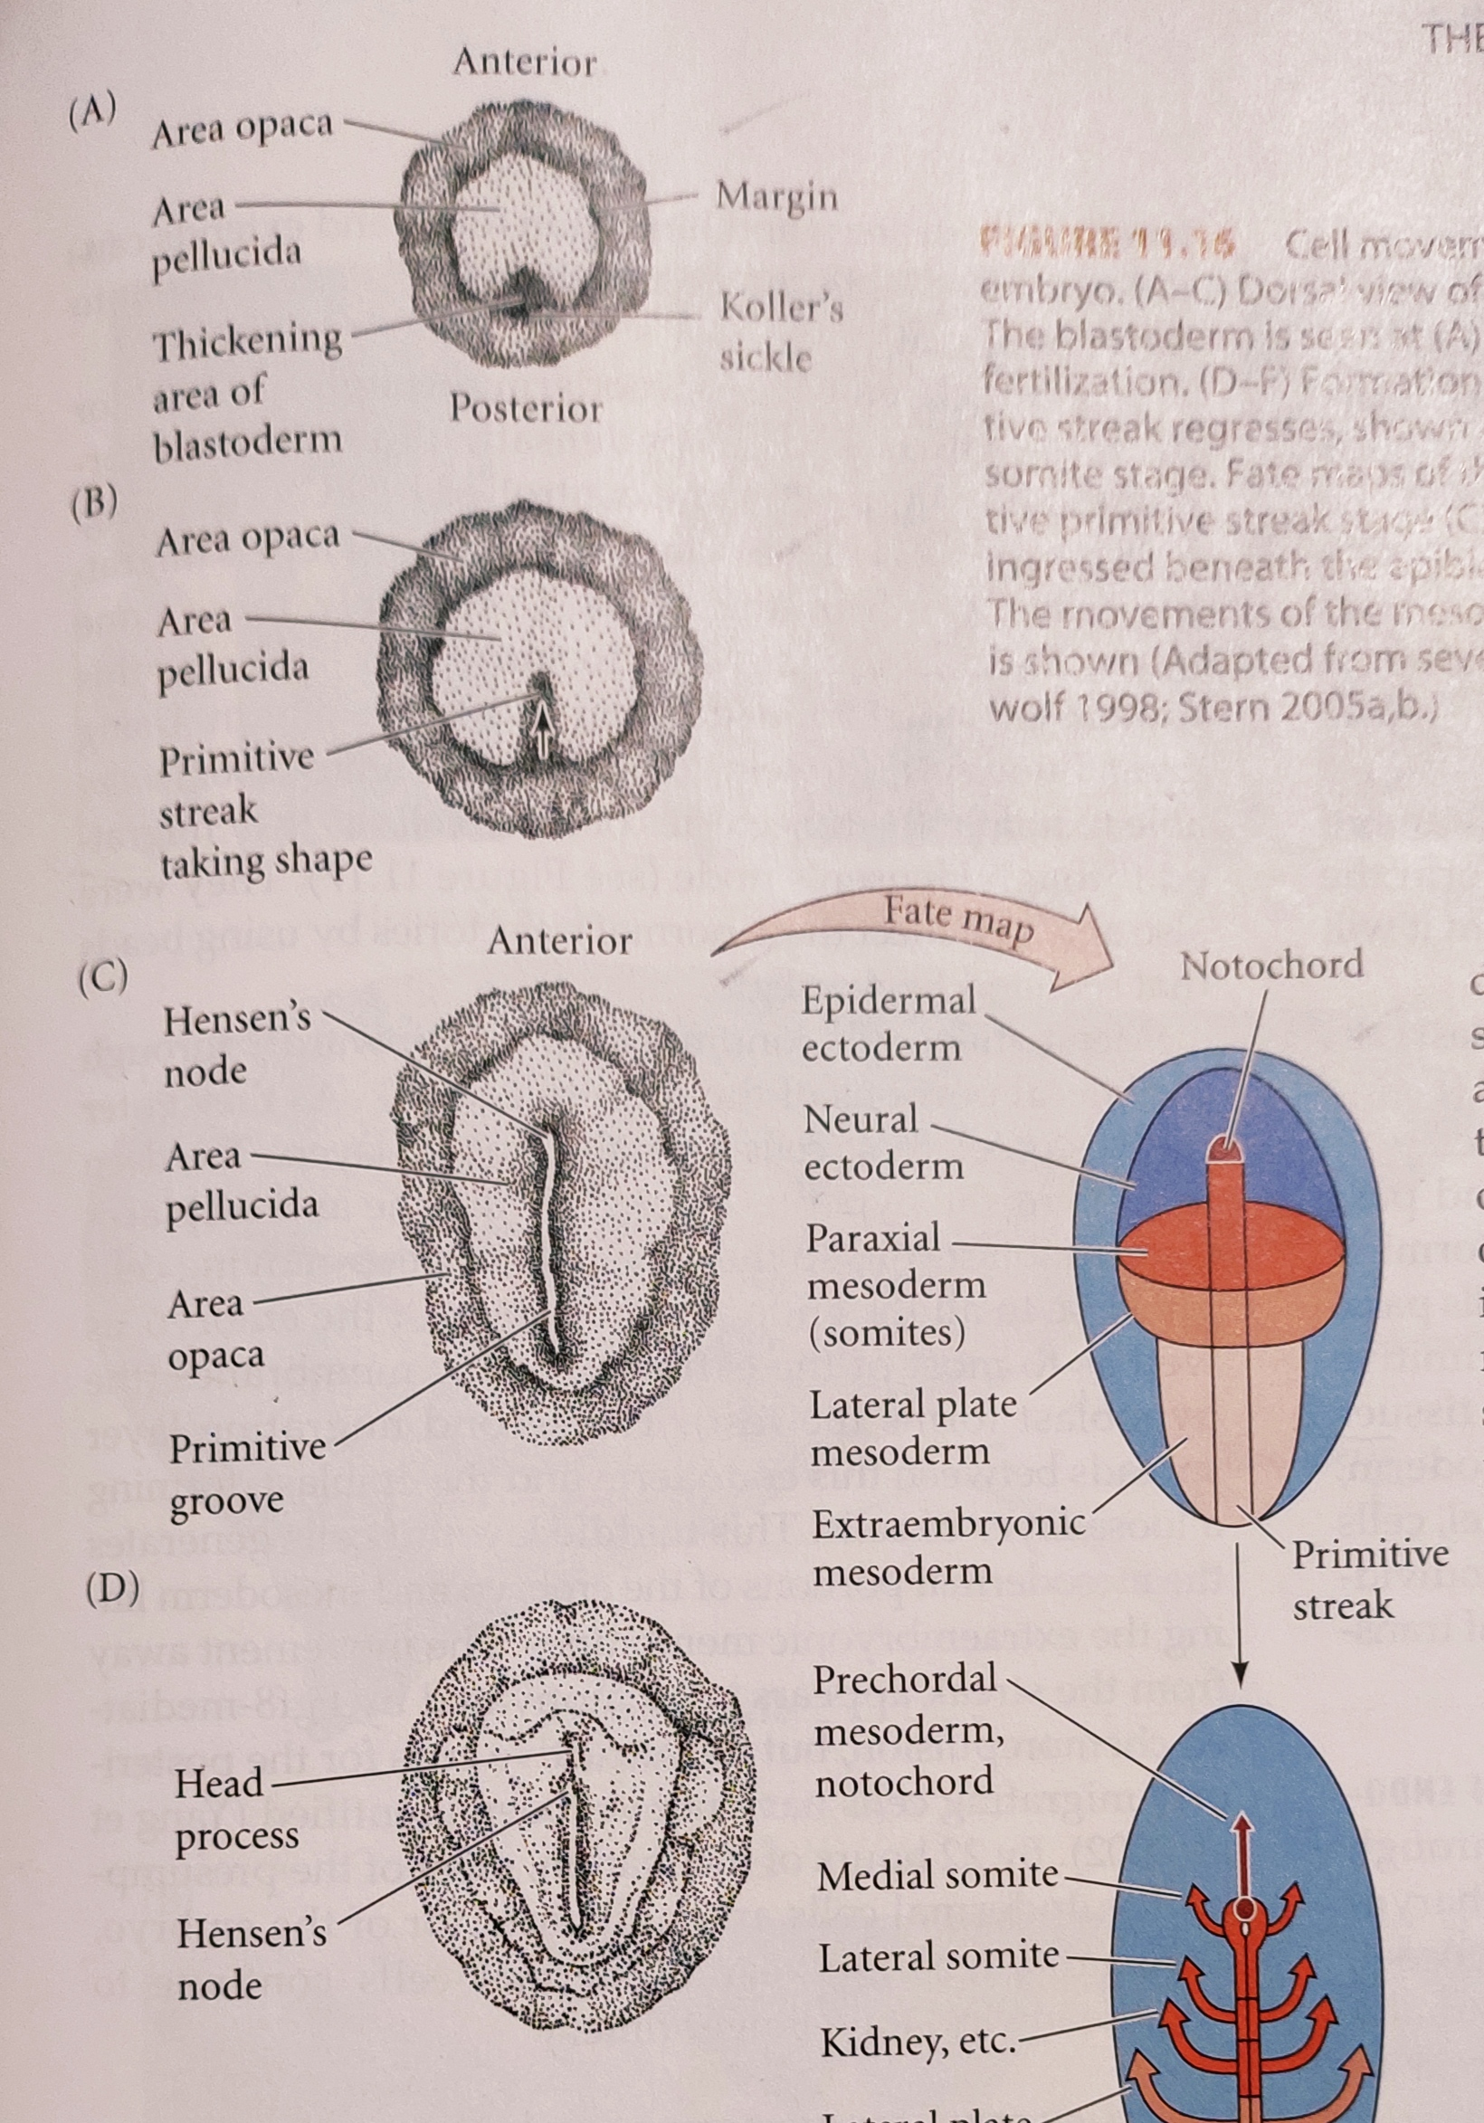
Fig. Different stages of primitive streak.

Slide 8
Migration of Endoderm and Mesoderm Cells through Primitive Streak
As soon as the primitive streak is formed, the epiblast cells start to ingress through it into the blastocoel. The first cells to ingress are the endodermal precursors. As the cells enter the primitive streak, the streak elongates toward the future head region. These cells pass down into the blastocoel, migrate anteriorly and eventually displace the hypoblast cells. The elongation of the primitive streak appears to be coextensive with the anterior migration of secondary hypoblast cells, which ultimately get confined at the anterior portion of the area pellucida, called the germinal crescent. The germinal crescent contains precursor of the germ cells, that later migrate via blood to the gonads. The streak eventually extends to 60-75 percent of the length of the area pellucida.
The streak thus has a continually changing cell population. Cells migrating through the anterior end pass down into the blastocoel and migrate anteriorly, forming the endoderm, head mesoderm, and notochord; cells passing through the more posterior portions give rise to the majority of mesodermal tissues.

Slide 9
…Continued
The first cells to migrate through the Hensen’s node are destined to become the pharyngeal endoderm of foregut. The next cells entering through Hensen’s node also move anteriorly, but they remain between the presumptive foregut endoderm and the epiblast to form the head mesenchyme and the prechordal plate mesoderm. The next cells migrating through Hensen’s node become the chorda- mesoderm. The cells of chordamesoderm that move anteriorly behind the prechordal plate mesoderm to form the head process. The head process will underlie those cells that form the forebrain and midbrain. As the primitive streak regresses, the chordamesodermal cells migrating through Hensen’s node become the notochord.
Meanwhile, cells continue migrating inwardly through the lateral portion of the primitive streak. As they enter the blastocoel, these cells separate into two layers. The layers join the hypoblast along its midline and displaces the hypoblast cells to the sides. These cells give rise to endodermal organs of the embryo, as well as most of the extraembryonic membranes. The second migrating layer spreads between this endoderm and the epiblast, forming a loose layer of cells. This middle layer forms the mesodermal part of the embryo and mesoderm lining of extraembryonic membrane.

Slide 10
Regression of Primitive Streak
While mesodermal ingression continues, the primitive streak starts to regress, moving Hensen’s node backward. As Hensen’s node moves caudally, the posterior region of the notochord is laid down. Finally, the Hensen’s node regresses to its posterior position, forming the anal region. By this time, all the presumptive endodermal and mesodermal cells have entered the embryo, and the epiblast is composed entirely of presumptive ectodermal cells.

Slide 11
Epiboly of the Ectoderm
While the presumptive endodermal and mesodermal cells are moving inward, the ectodermal precursors proliferate and migrate to surround the yolk by epiboly. The enclosure of the yolk by the ectoderm is enormous task that takes the greater part of four days to complete.
Thus, as avian gastrulation draws to a close, the ectoderm has surrounded the yolk, the endoderm has replaced the hypoblast, and the mesoderm has positioned itself between these two layers.

