Slide 1
Haemopoiesis
Dr. Tanmay Datta

Slide 2
HAEMOPOIESIS
General term for production of blood cells from Haemopoietic stem cell.
It includes
Erytropoiesis
Leucopoiesis
Thrombopoiesis

Slide 3
Site of Haemopoiesis
3rd week of intra-uterine life –area vasculosa of yolk
In liver & Spleen – 3rd month of intra –uterine life
Bone marrow-5th month of intra- uterine life & after birth

Slide 5
Bone Marrow
RED marrow – active, found inside all bones till the age of 20 years, most of it replaced by yellow marrow. adult pattern of marrow distribution - cranial bones, vertebrae, pelvic bones, ribs, sternum, upper ends of femur & humerus.
YELLOW marrow – inactive, filled with fatty tissue, on demand become active converted into red marrow producing blood cells.

Slide 6
Haemopoietic Stem Cells
All the blood cells begin their lives in the bone marrow from a single type pluripotential hematopoietic stem cell.
On division, a small portion of them remains exactly like the original pluripotential cells and is retained in the bone marrow, although their numbers diminish with age.
Most of the reproduced cells, however, start new differentiation.
The intermediate stage cells are very much like the pluripotential stem cells, even though they have already become committed to a particular line of cells and are called committed stem cells.
The different committed stem cells, when grown in culture, will produce colonies of specific types of blood cells. A committed stem cell that produces erythrocytes is called a colony-forming unit–erythrocyte, and the abbreviation CFU-E is used to designate this type of stem cell. Likewise, colony-forming units that form granulocytes and monocytes have the designation CFU-GM, and so forth.

Slide 7
Haemopoietic Stem Cells
Growth and reproduction of the different stem cells are controlled by multiple proteins called growth inducers.
Four major growth inducers have been described, each having different characteristics. One of these, interleukin-3, promotes growth and reproduction of virtually all the different types of committed stem cells, whereas the others induce growth of only specific types of cells.
The growth inducers promote growth but not differentiation of the cells.
This is the function of another set of proteins called differentiation inducers. Each of these causes one type of committed stem cell to differentiate one or more steps toward a final adult blood cell.
Formation of the growth inducers and differentiation inducers is itself controlled by factors outside the bone marrow. For instance, in the case of erythrocytes (red blood cells), exposure of the blood to low oxygen for a long time results in growth induction, differentiation, and production of greatly increased numbers of erythrocytes.
In the case of some of the white blood cells, infectious diseases cause growth, differentiation, and eventual formation of specific types of white blood cells that are needed to combat each infection.

Slide 8
Formation of Different Type of Blood Cells from Pluripotent Hematopoietic Stem Cells in Bone Marrow

Slide 9
Cell Renewal
Progenitor cells – in between committed stem cells & blast cells.
Eg. Progenitor of erythrocytic series
Blast cells –immature cells found in the early stages of development, normally not found in peripheral blood but only in bone marrow
Eg. erythroblast, myeloblast, megakaryoblast, lymphoblast, monoblast

Slide 10
Erythropoiesis: Genesis of RBC
The first cell that can be identified as belonging to the red blood cell series is the proerythroblast. Under appropriate stimulation, large numbers of these cells are formed from the CFU-E stem cells.
Once the proerythroblast has been formed, it divides multiple times, eventually forming many mature red blood cells. The first-generation cells are called basophil erythroblasts because they stain with basic dyes; the cell at this time has accumulated very little hemoglobin.
In the succeeding generations, the cells become filled with hemoglobin to a concentration of about 34 per cent, the nucleus condenses to a small size, and its final remnant is absorbed or extruded from the cell.
At the same time, the endoplasmic reticulum is also reabsorbed. The cell at this stage is called a reticulocyte because it still contains a small amount of basophilic material, consisting of remnants of the Golgi apparatus, mitochondria, and a few other cytoplasmic organelles.
During this reticulocyte stage, the cells pass from the bone marrow into the blood capillaries by diapedesis (squeezing through the pores of the capillary membrane).
The remaining basophilic material in the reticulocyte normally disappears within 1 to 2 days, and the cell is then a mature erythrocyte. Because of the short life of the reticulocytes, their concentration among all the red cells of the blood is normally slightly less than 1 per cent.

Slide 11
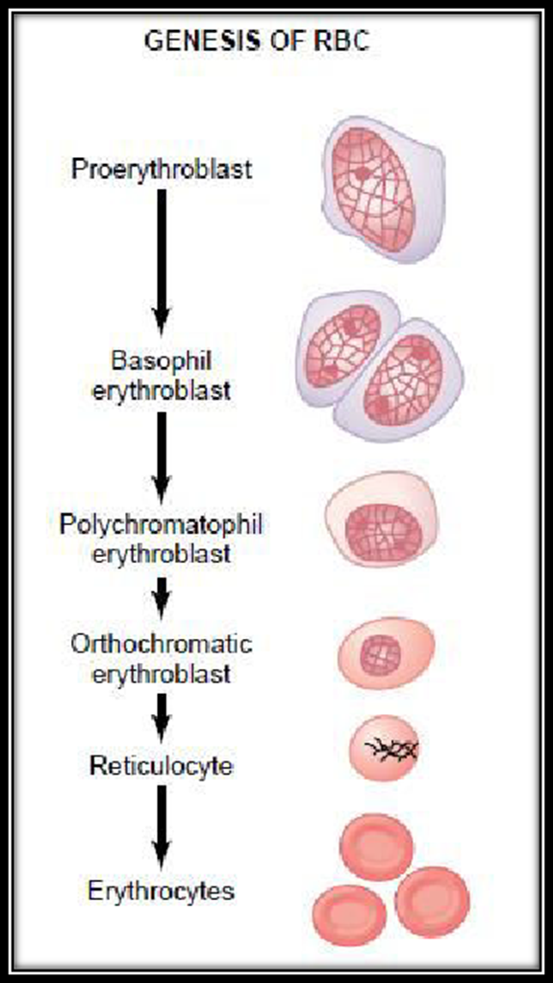

Slide 12
Steps of Erythropoiesis

Slide 14
Regulation of RBC Production – Role of Erythropoietin
The total mass of red blood cells in the circulatory system is regulated within narrow limits, so that
an adequate number of red cells is always available to provide sufficient transport of oxygen from the lungs to the tissues, yet
the cells do not become so numerous that they impede blood flow.

Slide 15
Tissue Oxygenation & RBC Production
Any condition that causes the quantity of oxygen transported to the tissues to decrease ordinarily increases the rate of red blood cell production.
anemic condition due to hemorrhage or any other condition
destruction of major portions of the bone marrow by any means
At very high altitudes, where the quantity of oxygen in the air is greatly decreased
Various diseases of the circulation that cause decreased blood flow through the peripheral vessels, and particularly those that cause failure of oxygen absorption by the blood as it passes through the lungs.
Tissue hypoxia resulting from these above conditions increases red cell production, with a resultant increase in hematocrit and usually total blood volume as well.

Slide 16
Erythropoietin Mechanism to Produce RBC

Slide 17
Erythropoietin Stimulation
In the absence of erythropoietin, hypoxia has little or no effect in stimulating red blood cell production. But when the erythropoietin system is functional, hypoxia causes a marked increase in erythropoietin production, and the erythropoietin in turn enhances red blood cell production until the hypoxia is relieved.
Renal as well as nonrenal sensor sends signal to the kidneys (renal tubular epithelial cells) to produce & secrete the erythropoietin under low oxygen state.
Erythropoietin a glycoprotein hormone with a molecular weight of about 34,000.
In the normal person, about 90 per cent of all erythropoietin is formed in the kidneys; the remainder is formed mainly in the liver.
Both norepinephrine and epinephrine and prostaglandins stimulate
erythropoietin production.

Slide 18
Leukopoiesis
The leukocytes, also called white blood cells, are the mobile units of the body’s protective system. They are formed partially in the bone marrow (granulocytes and monocytes and a few lymphocytes) and partially in the lymph tissue (lymphocytes and plasma cells). After formation, they are transported in the blood to different parts of the body where they are needed.

Slide 19
Leukopoiesis
Apart from those cells committed to form red blood cells, two major lineages of white blood cells are formed, the myelocytic and the lymphocytic lineages.
The granulocytes and monocytes are formed only in the bone marrow.
Lymphocytes and plasma cells are produced mainly in the various lymphogenous tissues—especially the lymph glands, spleen, thymus, tonsils, and various pockets of lymphoid tissue.
The white blood cells formed in the bone marrow are stored within the marrow until they are needed in the circulatory system. Then, when the need arises, various factors cause them to be released.
The lymphocytes are mostly stored in the various lymphoid tissues, except for a small number that are temporarily being transported in the blood.

Slide 20
Different Cell Types of Myelocyte Series
1. myeloblast;
2. promyelocyte;
3. megakaryocyte;
4. neutrophil myelocyte;
5. young neutrophil metamyelocyte;
6. “band” neutrophil metamyelocyte;
7. polymorphonuclear neutrophil;
eosinophil myelocyte;
eosinophil metamyelocyte;
polymorphonuclear eosinophil;
basophil myelocyte;
12. polymorphonuclearbasophil;
13–16,stages of monocyte formation

Slide 21
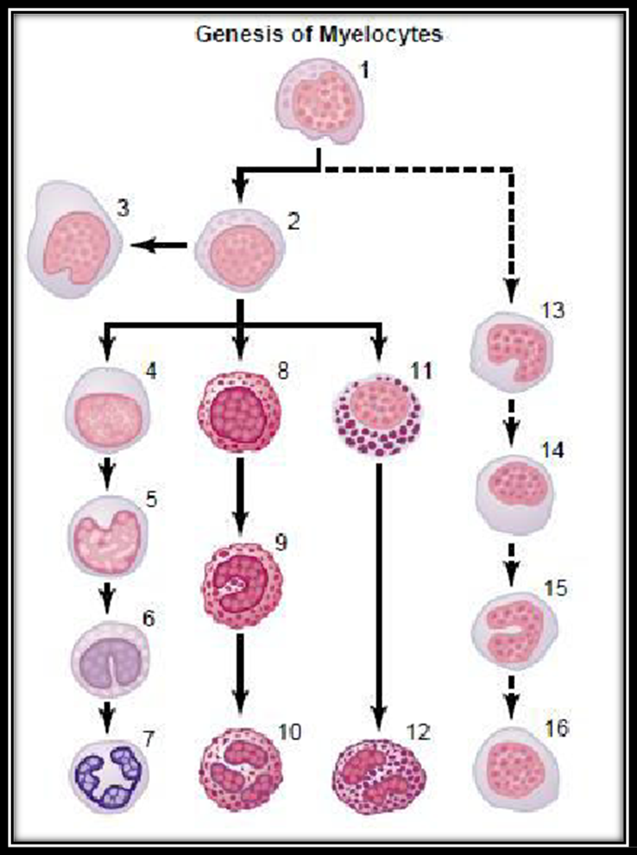

Slide 22
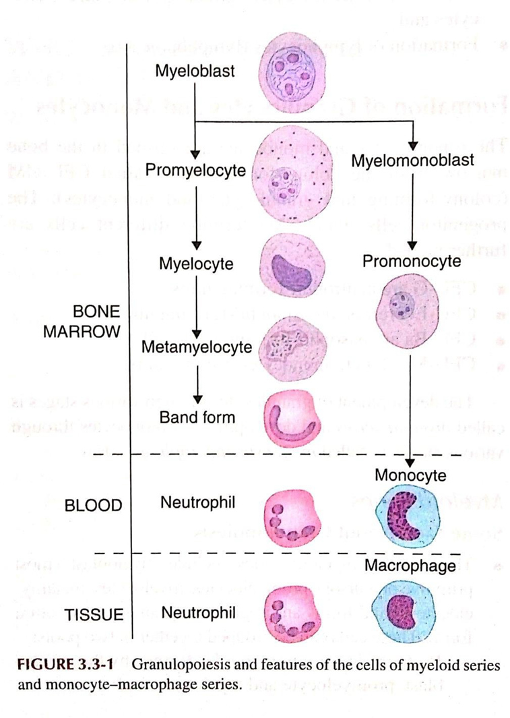

Slide 23
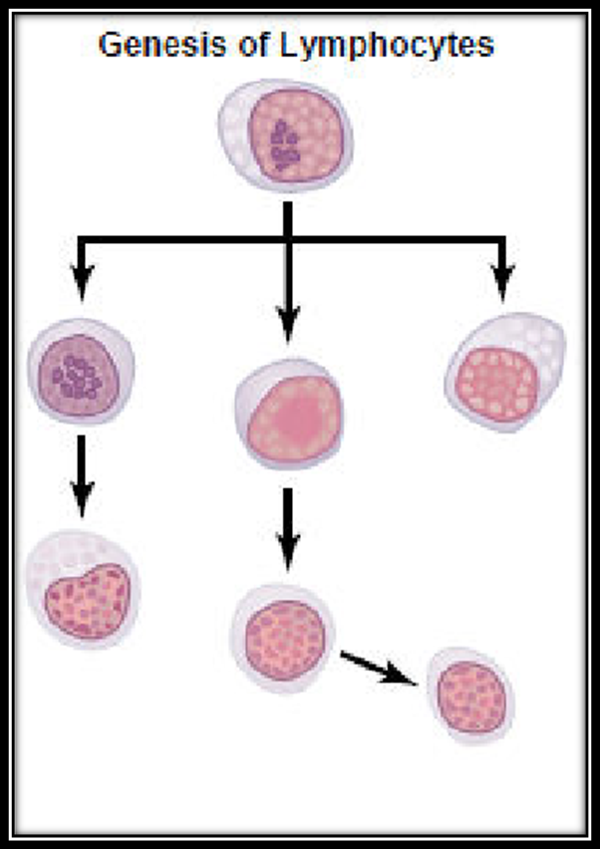

Slide 24
Control of White Blood Cell Production
The cause of the increased production of granulocytes and monocytes by the bone marrow is mainly the three colony-stimulating factors, one of which, GM-CSF (granulocyte-monocyte colony-stimulating factor), stimulates both granulocyte and monocyte production; the other two, G- CSF (granulocyte colony-stimulating factor) and M-CSF (monocyte colony- stimulating factor), stimulate granulocyte and monocyte production, respectively.
These factors are formed by activated macrophage cells in the inflamed tissues
This combination of TNF (tumor necrosis factor), IL-1 (interleukin-1) , and colony-stimulating factors provides a powerful feedback mechanism that begins with tissue inflammation and proceeds to formation of large numbers of defensive white blood cells that help remove the cause of the inflammation.

Slide 25
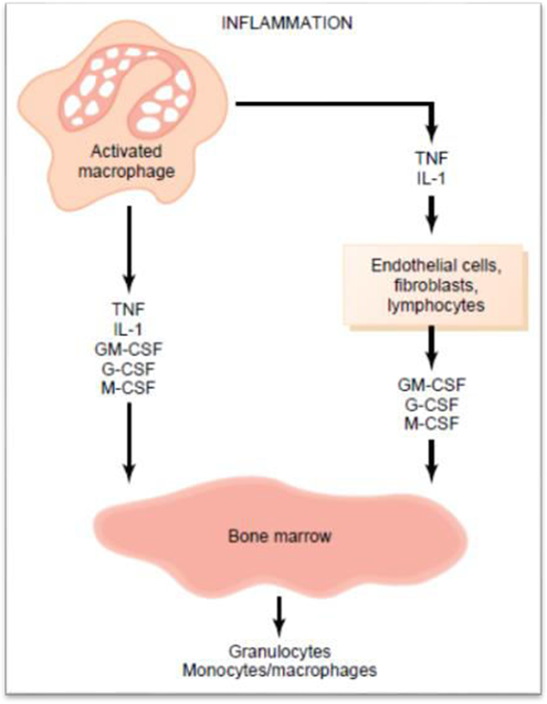

Slide 26
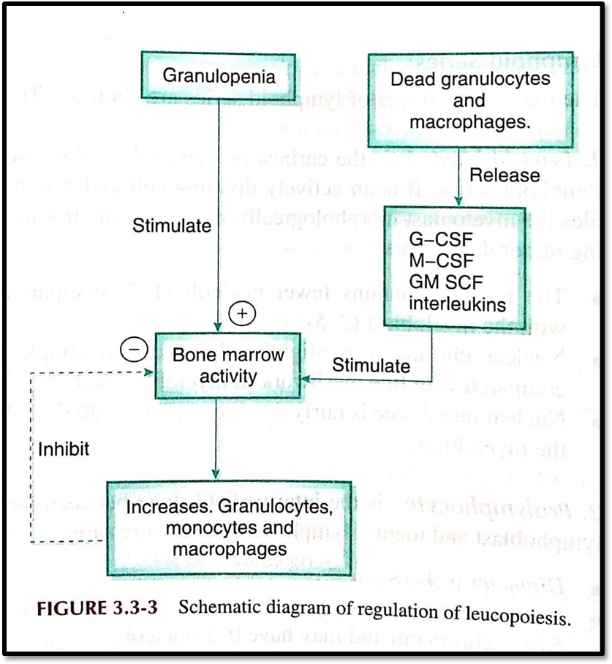

Slide 27
Thrombopoiesis: Genesis of Platelets
Platelets (also called thrombocytes) are minute discs 1 to 4 micrometers in diameter.
They are formed in the bone marrow from megakaryocytes, which are extremely large cells of the hematopoietic series in the marrow.
The megakaryocytes fragment into the minute platelets either in the bone marrow or soon after entering the blood, especially as they squeeze through capillaries.
The normal concentration of platelets in the blood is between 150,000 and 300,000 per microliter.

Slide 28
