Slide 1
Structure of Kidney
Dr. Tanmay Datta

Slide 2
Major Functions of Kidney
Excretion of metabolic wastes (urea from amino acids, creatinine from muscle creatine, uric acid from nucleic acid, etc.) & foreign chemicals.
Regulation of water and electrolyte balance.
Regulation of arterial pressure.
Regulation of acid-base balance.
Regulation of Erythrocyte production: Secrete erythropoietin (stimulated by hypoxia), which stimulates the production of RBC.
regulation of 1,25-Dihydroxyvitamin D3 production.
Secretion, metabolism and excretion of hormones.
Gluconeogenesis.

Slide 3
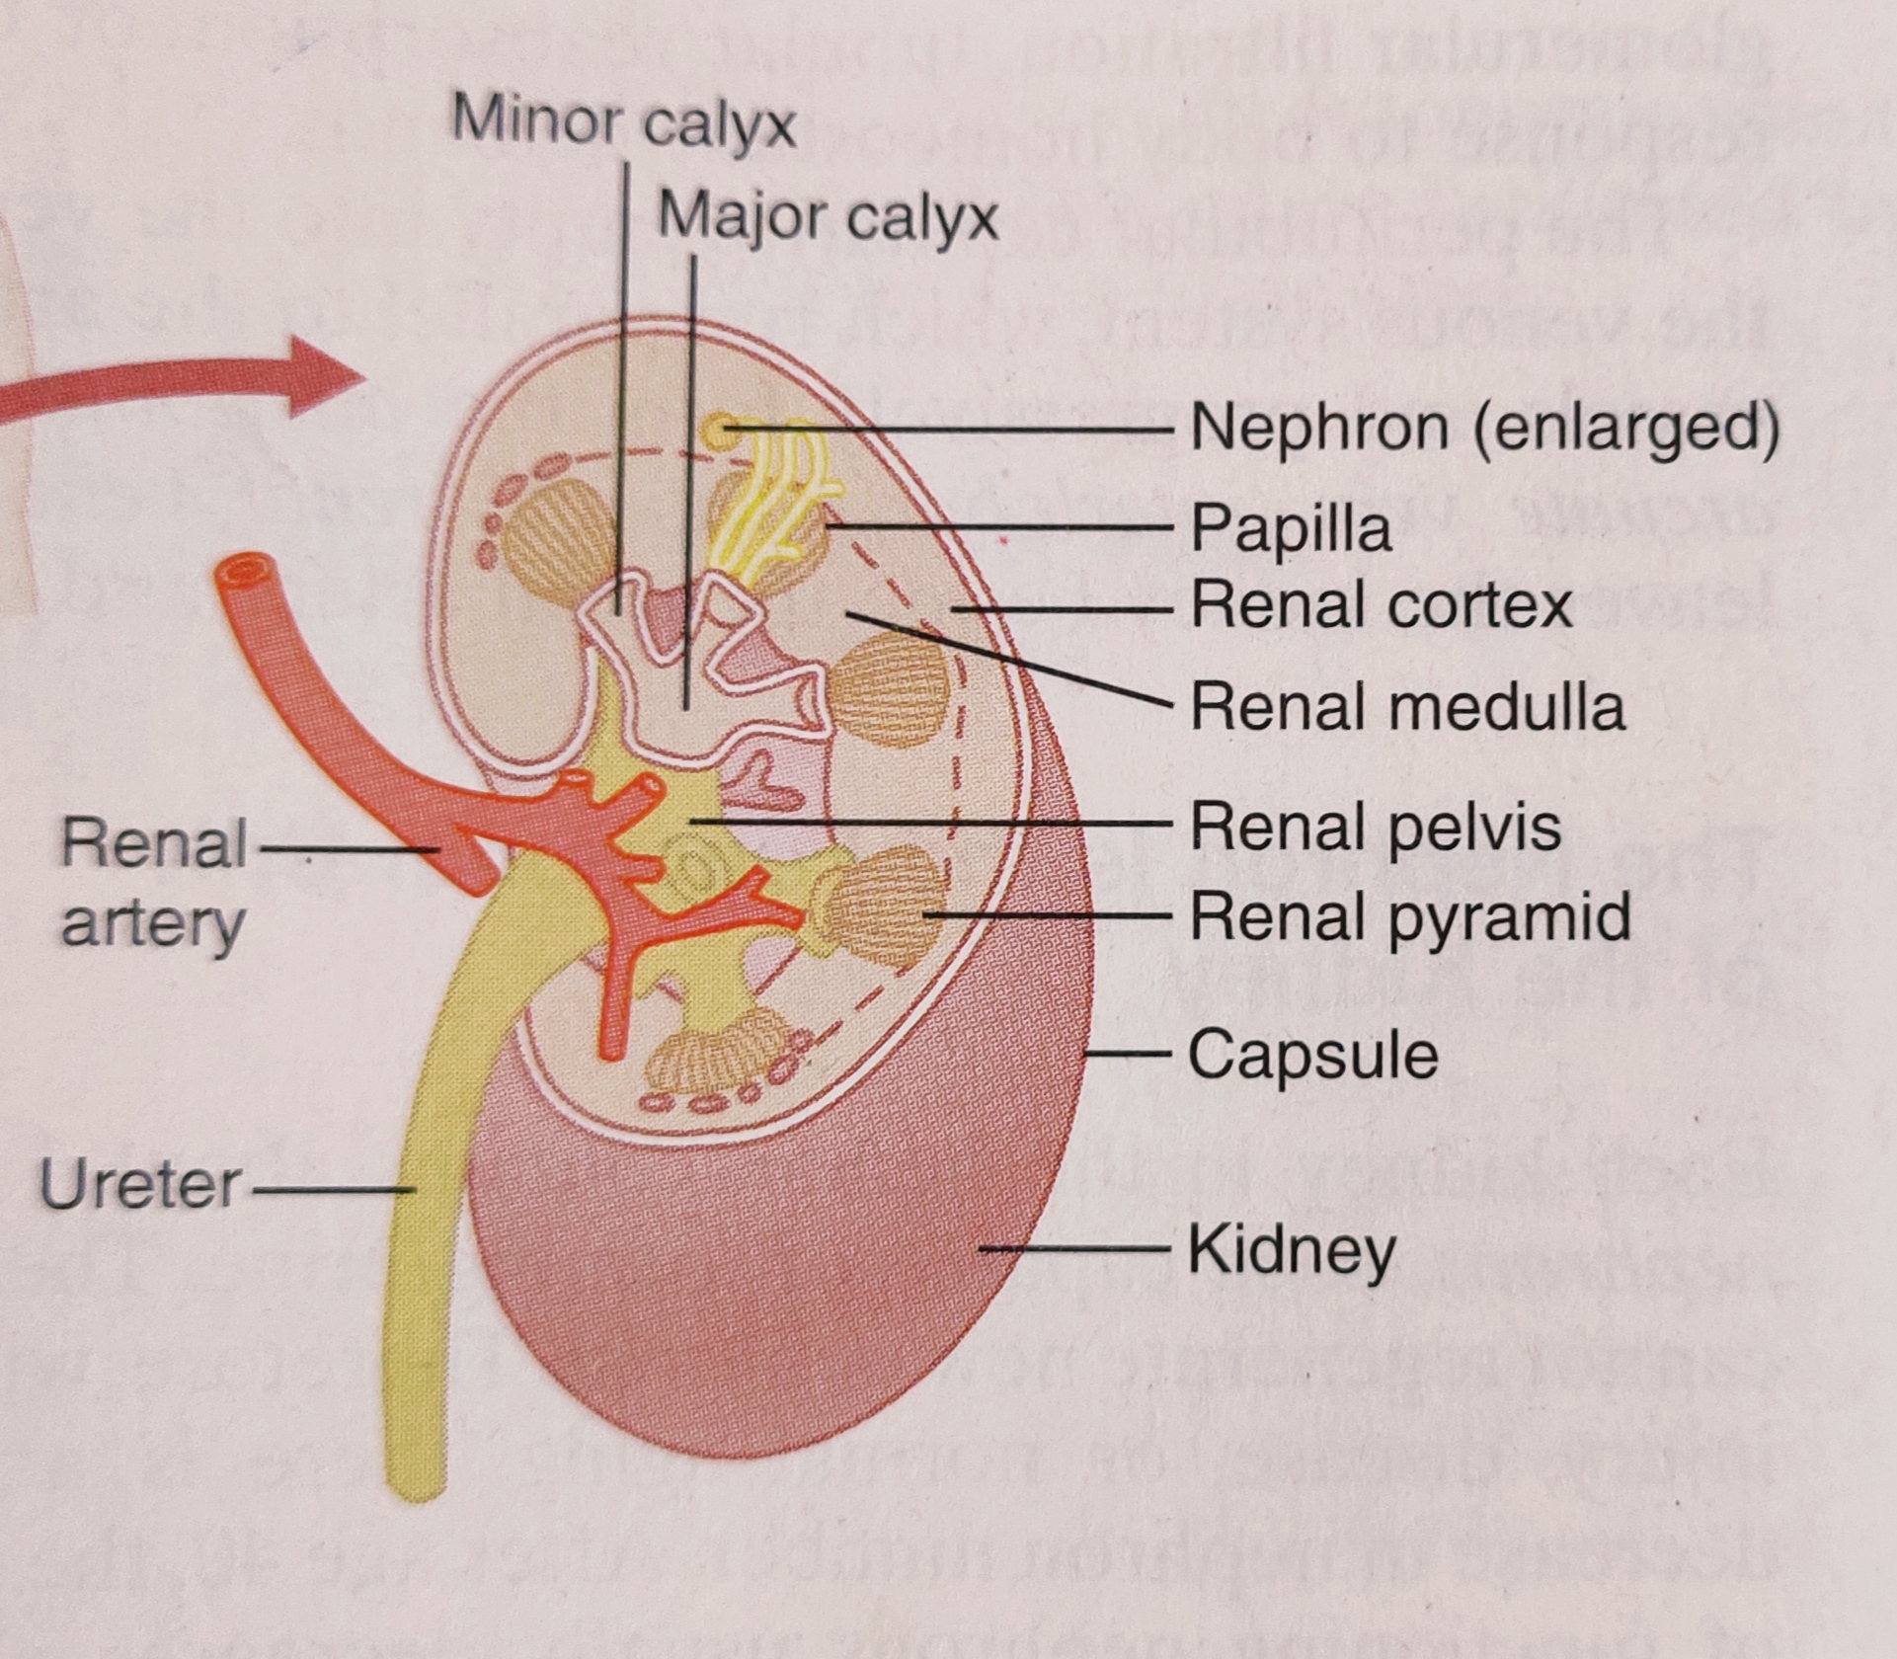
General Organization of Kidney

Slide 4
Nephron
Each kidney contains about 1 million nephrons. Can't regenerate.
Each nephron contains: (1) glomerulus, and (2) a long tubule.
The glomerulus contains a network of capillaries with high hydrostatic pressure (60 mm Hg). The glomerulus is encased in Bowman’s capsule. Fluid filtered from the glomerular capillaries flows into Bowman’s capsule and then into the proximal tubule (PT), which lies in the cortex.
Fluid from PT flows into the loop of Henle, which dips into the renal medulla. Most part of the descending limb and lower part of ascending limb are very thin (thin segment of LoH). Near the cortex, ascending limb becomes thicker (thick segment of the LoH).
At the end of the thick ascending limb is a short segment, actually a plaque in its wall, known as the macula densa.
Beyond macula densa is the distal tubule which lies in the renal cortex.
In each kidney 250 large collecting ducts, each of which collects urine from about 4000 nephrons.

Slide 5
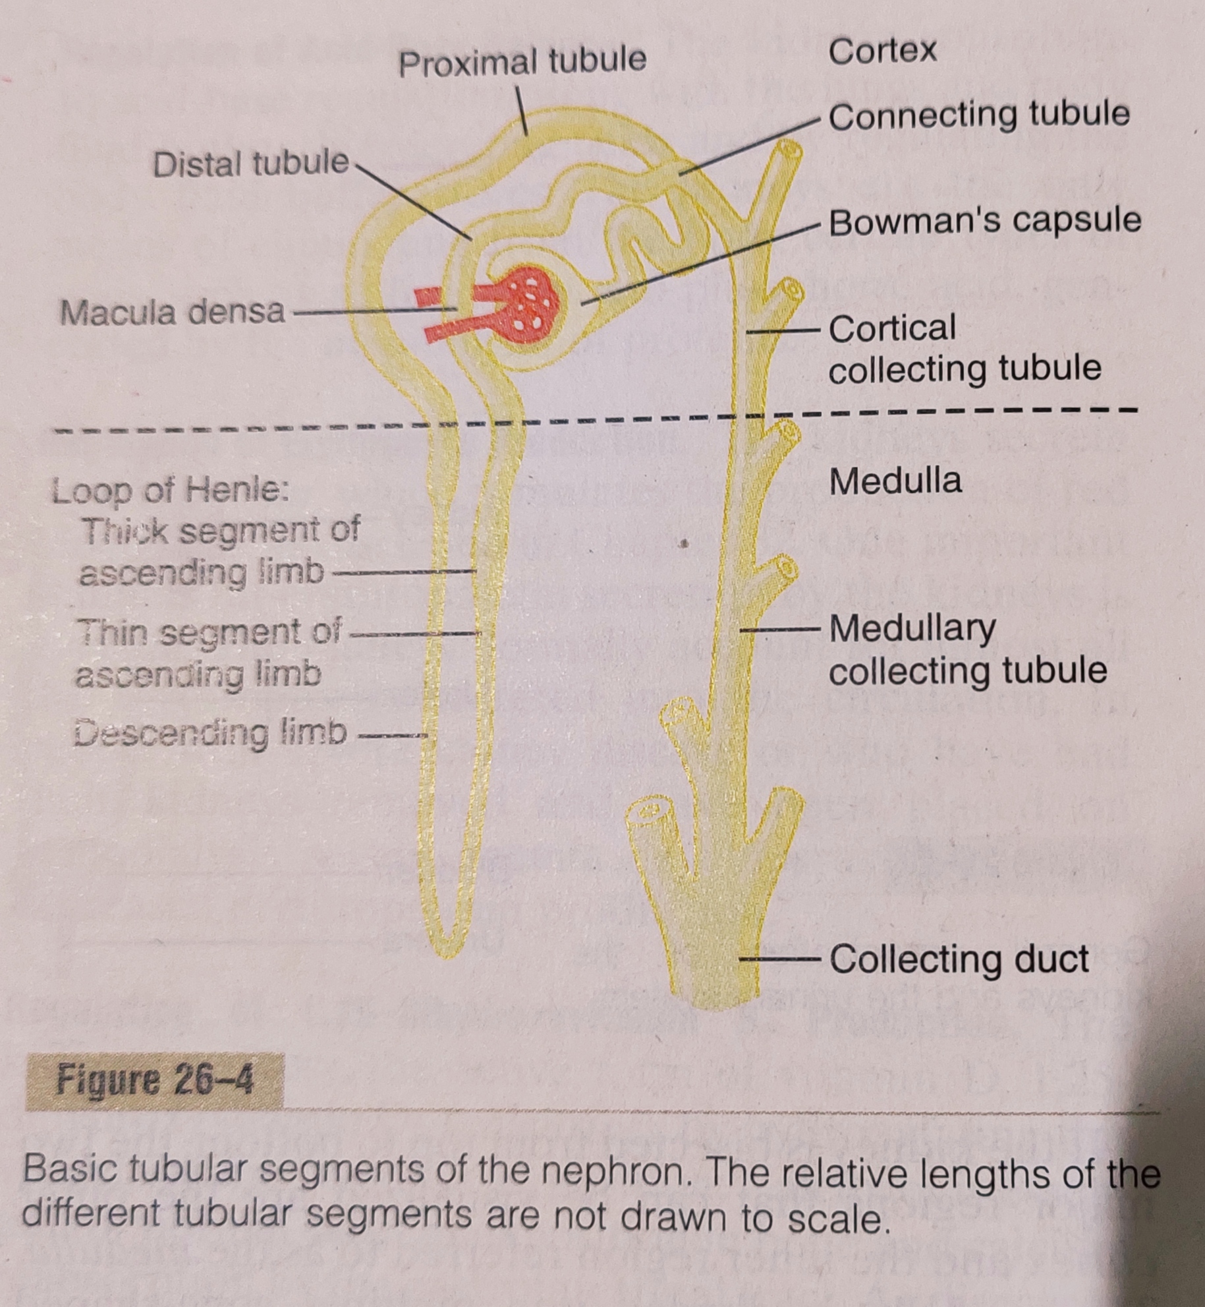
Nephron

Slide 6
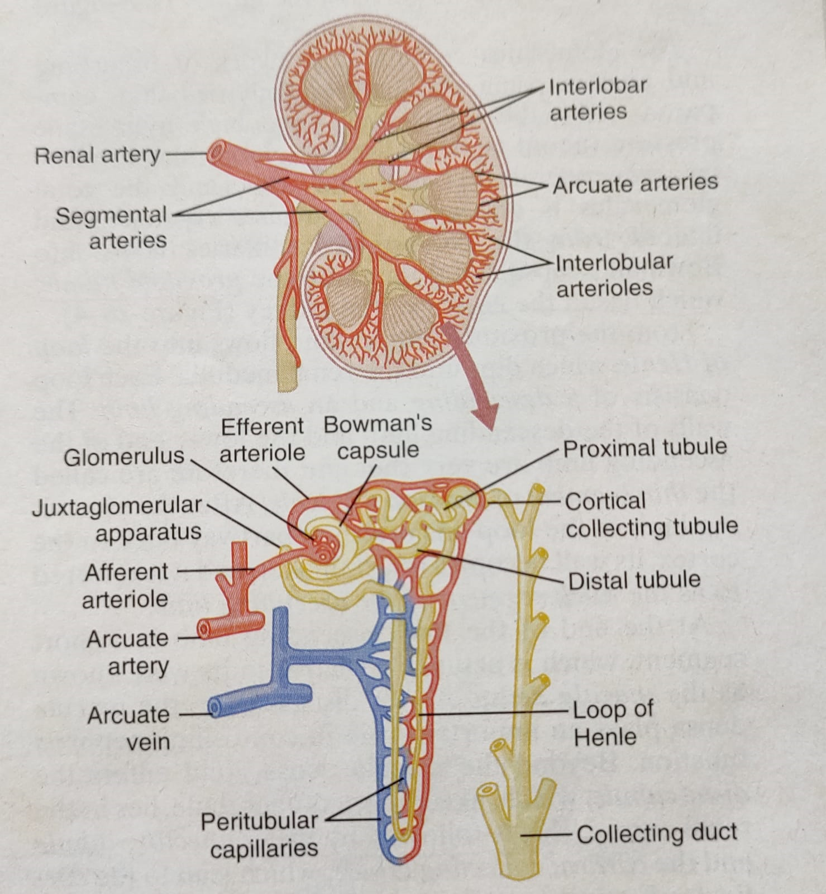
Renal Blood Supply

Slide 7
Regional Differences in Nephron Structure
Cortical nephrons (glomeruli located in the outer cortex): Short loops of Henle that penetrate only a short distance into the medulla.
Juxtamedullary nephrons (glomeruli lie deep in the renal cortex): Long loops of Henle that dip deeply into the medulla. 20-30%.
For cortical nephrons, entire tubular system is surrounded by peritubular capillaries. For JMN, long efferent arterioles extend from the glomeruli down into the outer medulla and then divide into specialized peritubular capillaries called vasa recta, lying side by side with the LoH. Then the vasa recta return toward the cortex and empty into the cortical veins.

Slide 8
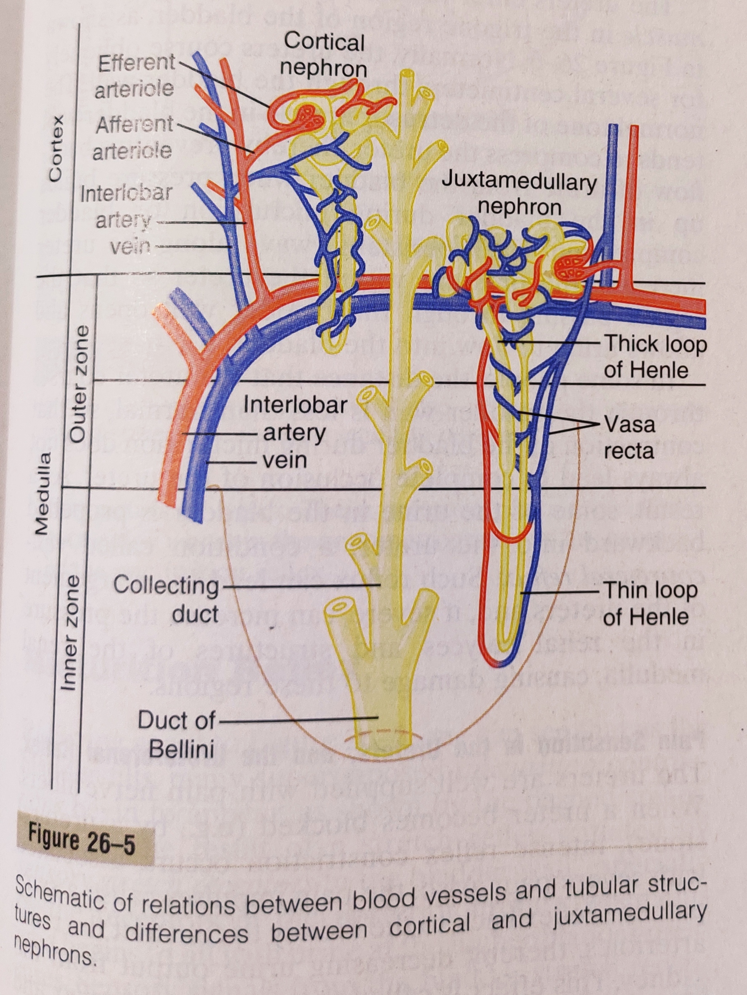
Nephron types

Slide 9
Glomerular Filtration
Glomerular filtration rate (GFR) is determined by (1) the balance of hydrostatic and colloid osmotic forces acting across the capillary membrane and (2) the capillary filtration coefficient, K_{f}
Like most capillaries, glomerular capillaries are relatively impermeable to proteins, so that the filtered fluid (called the glomerular filtrate) is essentially protein-free.
The concentration of other constituents of the glomerular filtrate, including most salts and organic molecules, are similar to the concentrations in the plasma.
In the average adult human, the GFR is about 125 ml/min, or 180 L/day.

Slide 10
Glomerular Capillary Membrane
Except usual two major layers in other capillaries, glomerular capillary membrane has three layers: (1) the endothelium, (basement membrane, and (3) a layer of epithelial cells (podocytes) surrounding the outer surface of the capillary basement membrane.
Fenestrations of endothelium are relatively large and richly endowed with fixed negative charges that hinder the passage of proteins.
Basement membrane is a meshwork of collagen and proteoglycan fibrillae. It also prevents filtration of plasma proteins, because of strong negative electrical charges associated with proteoglycans.
Podocytes with long foot-like processes and stilt pores in between, encircle the outer surface of capillaries. It also has negative charges.
Thus, all layers of glomerular capillary provide a barrier to filtration of plasma proteins.

Slide 11
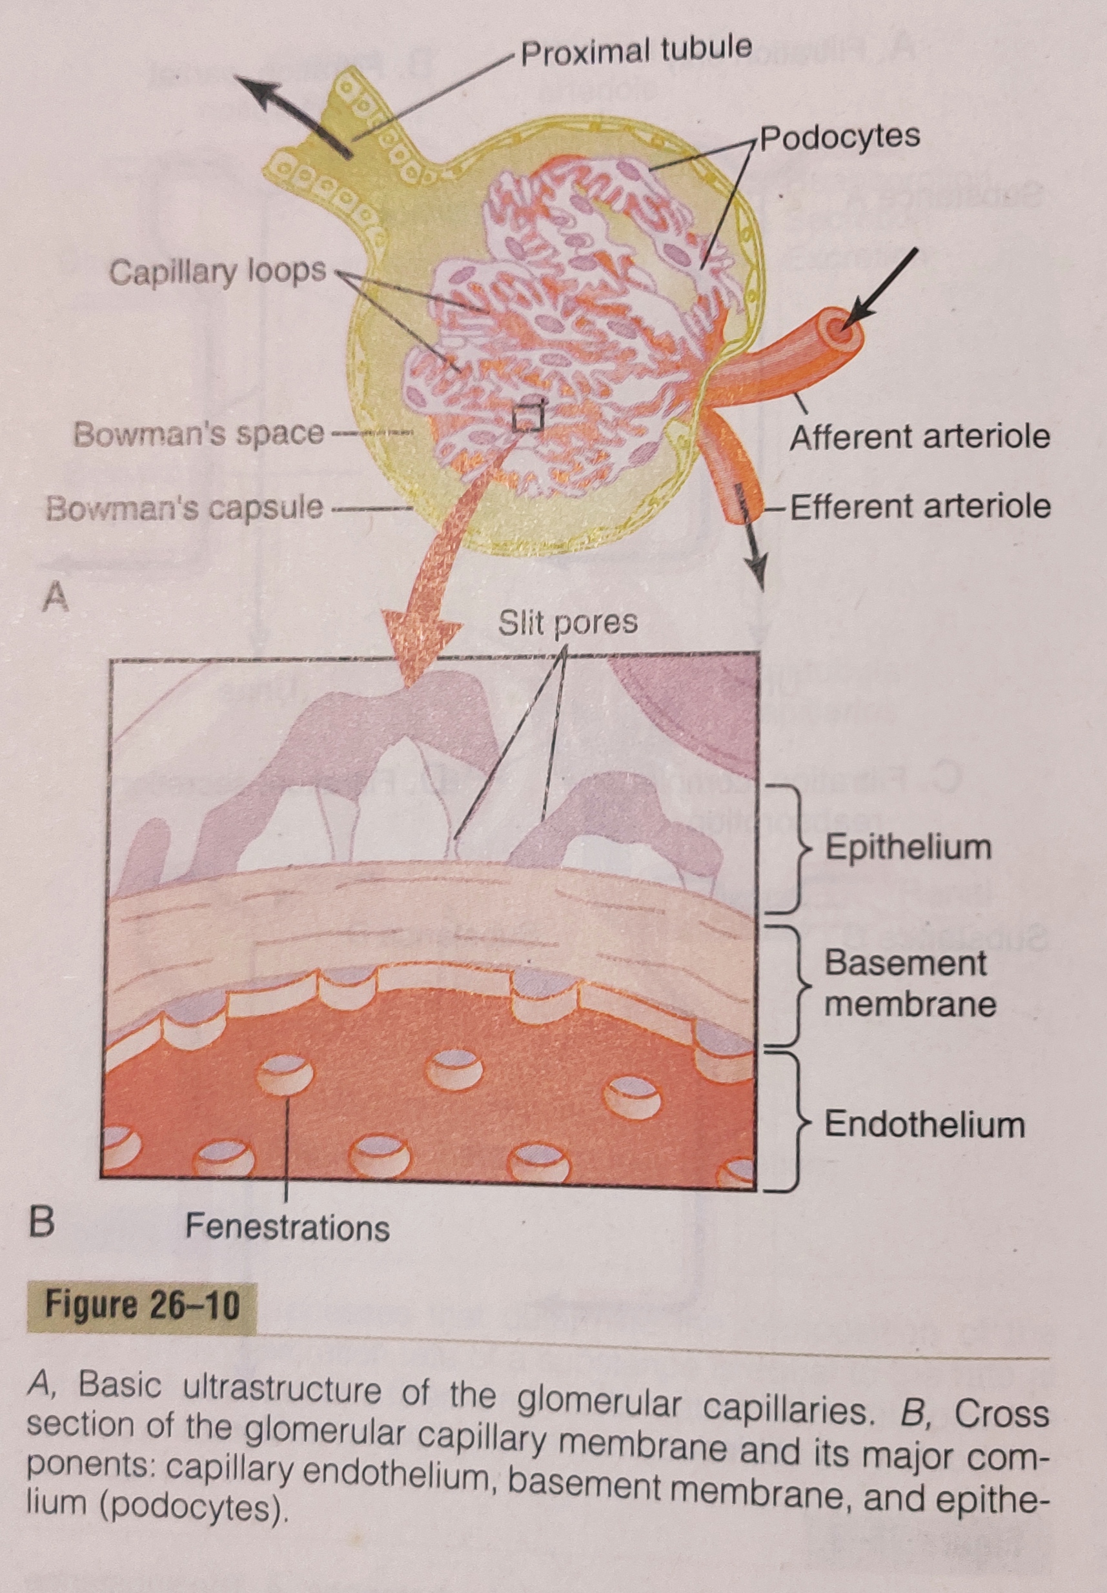
Glomerulus

Slide 12
Determination of the GFR
GFR = Kf × (glomerular hydrostatic pressure – Bowman’s capsule hydrostatic pressure – colloid osmotic pressure of the glomerular capillary plasma proteins + colloid osmotic pressure of the proteins in Bowman’s capsule.
Net filtration pressure = 60 -18 – 32 + 0
Glomerular hydrostatic pressure is determined by three variables, each of which is under physiologic control: (1) arterial pressure, (2) afferent arteriolar resistance, and (3) efferent arteriolar resistance.

Slide 13
Physiologic Control of Glomerular Filtration
Strong activation of the renal sympathetic nerves can constrict the renal arterioles and decrease renal blood flow and GFR.
Hormonal and Autacoid Control of Renal Circulation:
Norepinephrine, Epinephrine, and Endothelin Constrict Renal Blood Vessels and Decrease GFR. Endothelin is a peptide vasoconstrictor that can be released by damaged vascular endothelial cells of the kidneys as well as by other tissues.
Angiotensin II Constricts Efferent Arterioles. This powerful vasoconstrictor is a circulating hormone/autacoid that is formed in the kidneys and in the systemic circulation.
Increased Angiotensin II formation usually occurs in circumstances associated with decreased arterial pressure or volume depletion.

Slide 14
Hormonal and Autacoid Control of Renal Circulation
Endothelial derived Nitric Oxide Decreases Renal Vascular Resistance and Increases GFR.
Prostaglandins (Prostaglandins are a group of physiologically active lipid compounds called eicosanoids that have diverse hormone-like effects in animals. Prostaglandins have been found in almost every tissue in humans and other animals. They are derived enzymatically from the fatty acid arachidonic acid.) and Bradykinin (Bradykinin is a peptide that promotes inflammation. It causes arterioles to dilate via the release of prostacyclin, nitric oxide, and endothelium-derived hyperpolarizing factor) Tend to Increase GFR.

Slide 15
Macula Densa
The juxtaglomerular complex consists of macula densa cells in the initial portion of the distal tubule and juxtaglomerular cells in the walls of the afferent and efferent arterioles.
The macula densa is a specialized group of epithelial cells in the distal tubules that comes in close contact with the afferent and efferent arterioles.
The macula densa cells contain Golgi apparatus directed toward the arterioles, suggesting that these cells may be secreting a substance toward the arterioles.

Slide 16
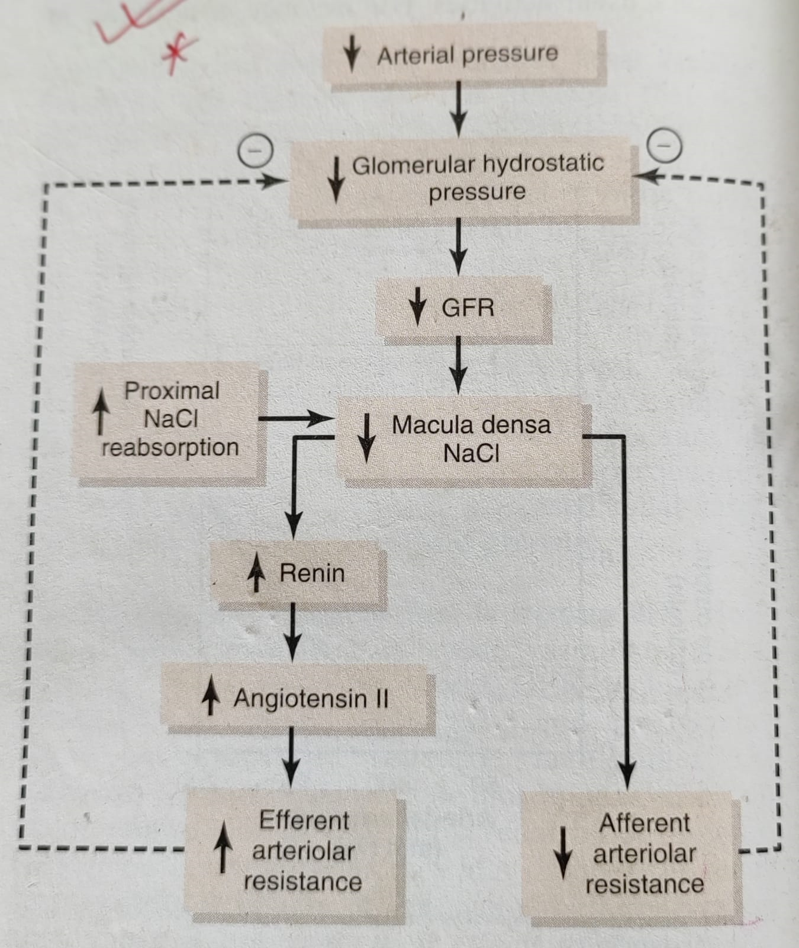
Autoregulation of GFR

Slide 17
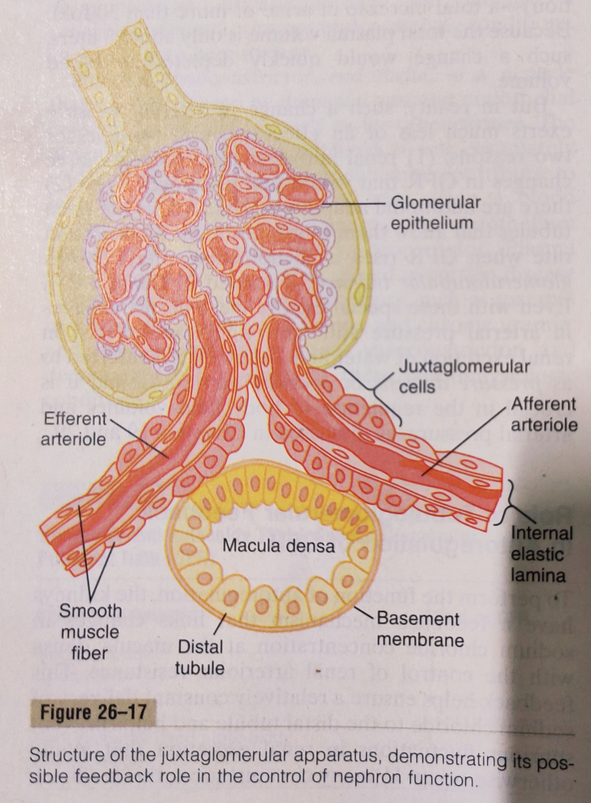
Juxta-glomerular apparatus

Slide 18
Tubular Reabsorption
Includes passive and active mechanisms.
Primary Active Transport through the tubular membrane is linked to hydrolysis of ATP.
  Sodium diffuses across the luminal membrane into the cell down an electrochemical gradient established by the Na-K ATPase pump on the basolateral side of the membrane.
  Na is transported across the basolateral membrane against an electrochemical gradient by the Na-K ATPase pump.
  Na, water and other substances are reabsorbed from the interstitial fluid into the peritubular capillaries by ultrafiltration, a passive process driven by the hydrostatic and colloid osmotic pressure gradients.
  In Secondary Active Transport, two or more substances (for instance, sodium and glucose) interact with a specific membrane protein and are transported together down its electrochemical gradient. In the same way, secondary active transport enables uphill movement of other substances (e.g., hydrogen ions) involving counter-transport.
  Some parts of tubule, especially the proximal tubule, resorb large molecules such as proteins by pinocytosis.

Slide 19
Reabsorption and Secretion along Proximal Tubule
Proximal tubules have a high capacity for active and passive reabsorption.
The Na-K ATPase pump provides the major force for reabsorption of NaCl and water throughout the proximal tubule.
The secretion of hydrogen ions into the tubular lumen is an important step in the removal of bicarbonate ions.
In the first half of the PT, Na is reabsorbed by co-transport along with glucose, amino acids, and other solutes. But in the second half, little glucose and amino acids remain to be reabsorbed. Instead, sodium is now reabsorbed mainly with chloride ions.
Important site for secretion of organic acids and bases such as oxalate, urate, and catecholamines.
The total solute concentration remains essentially same all along the PT because of the extremely high permeability of this part to water.

Slide 20
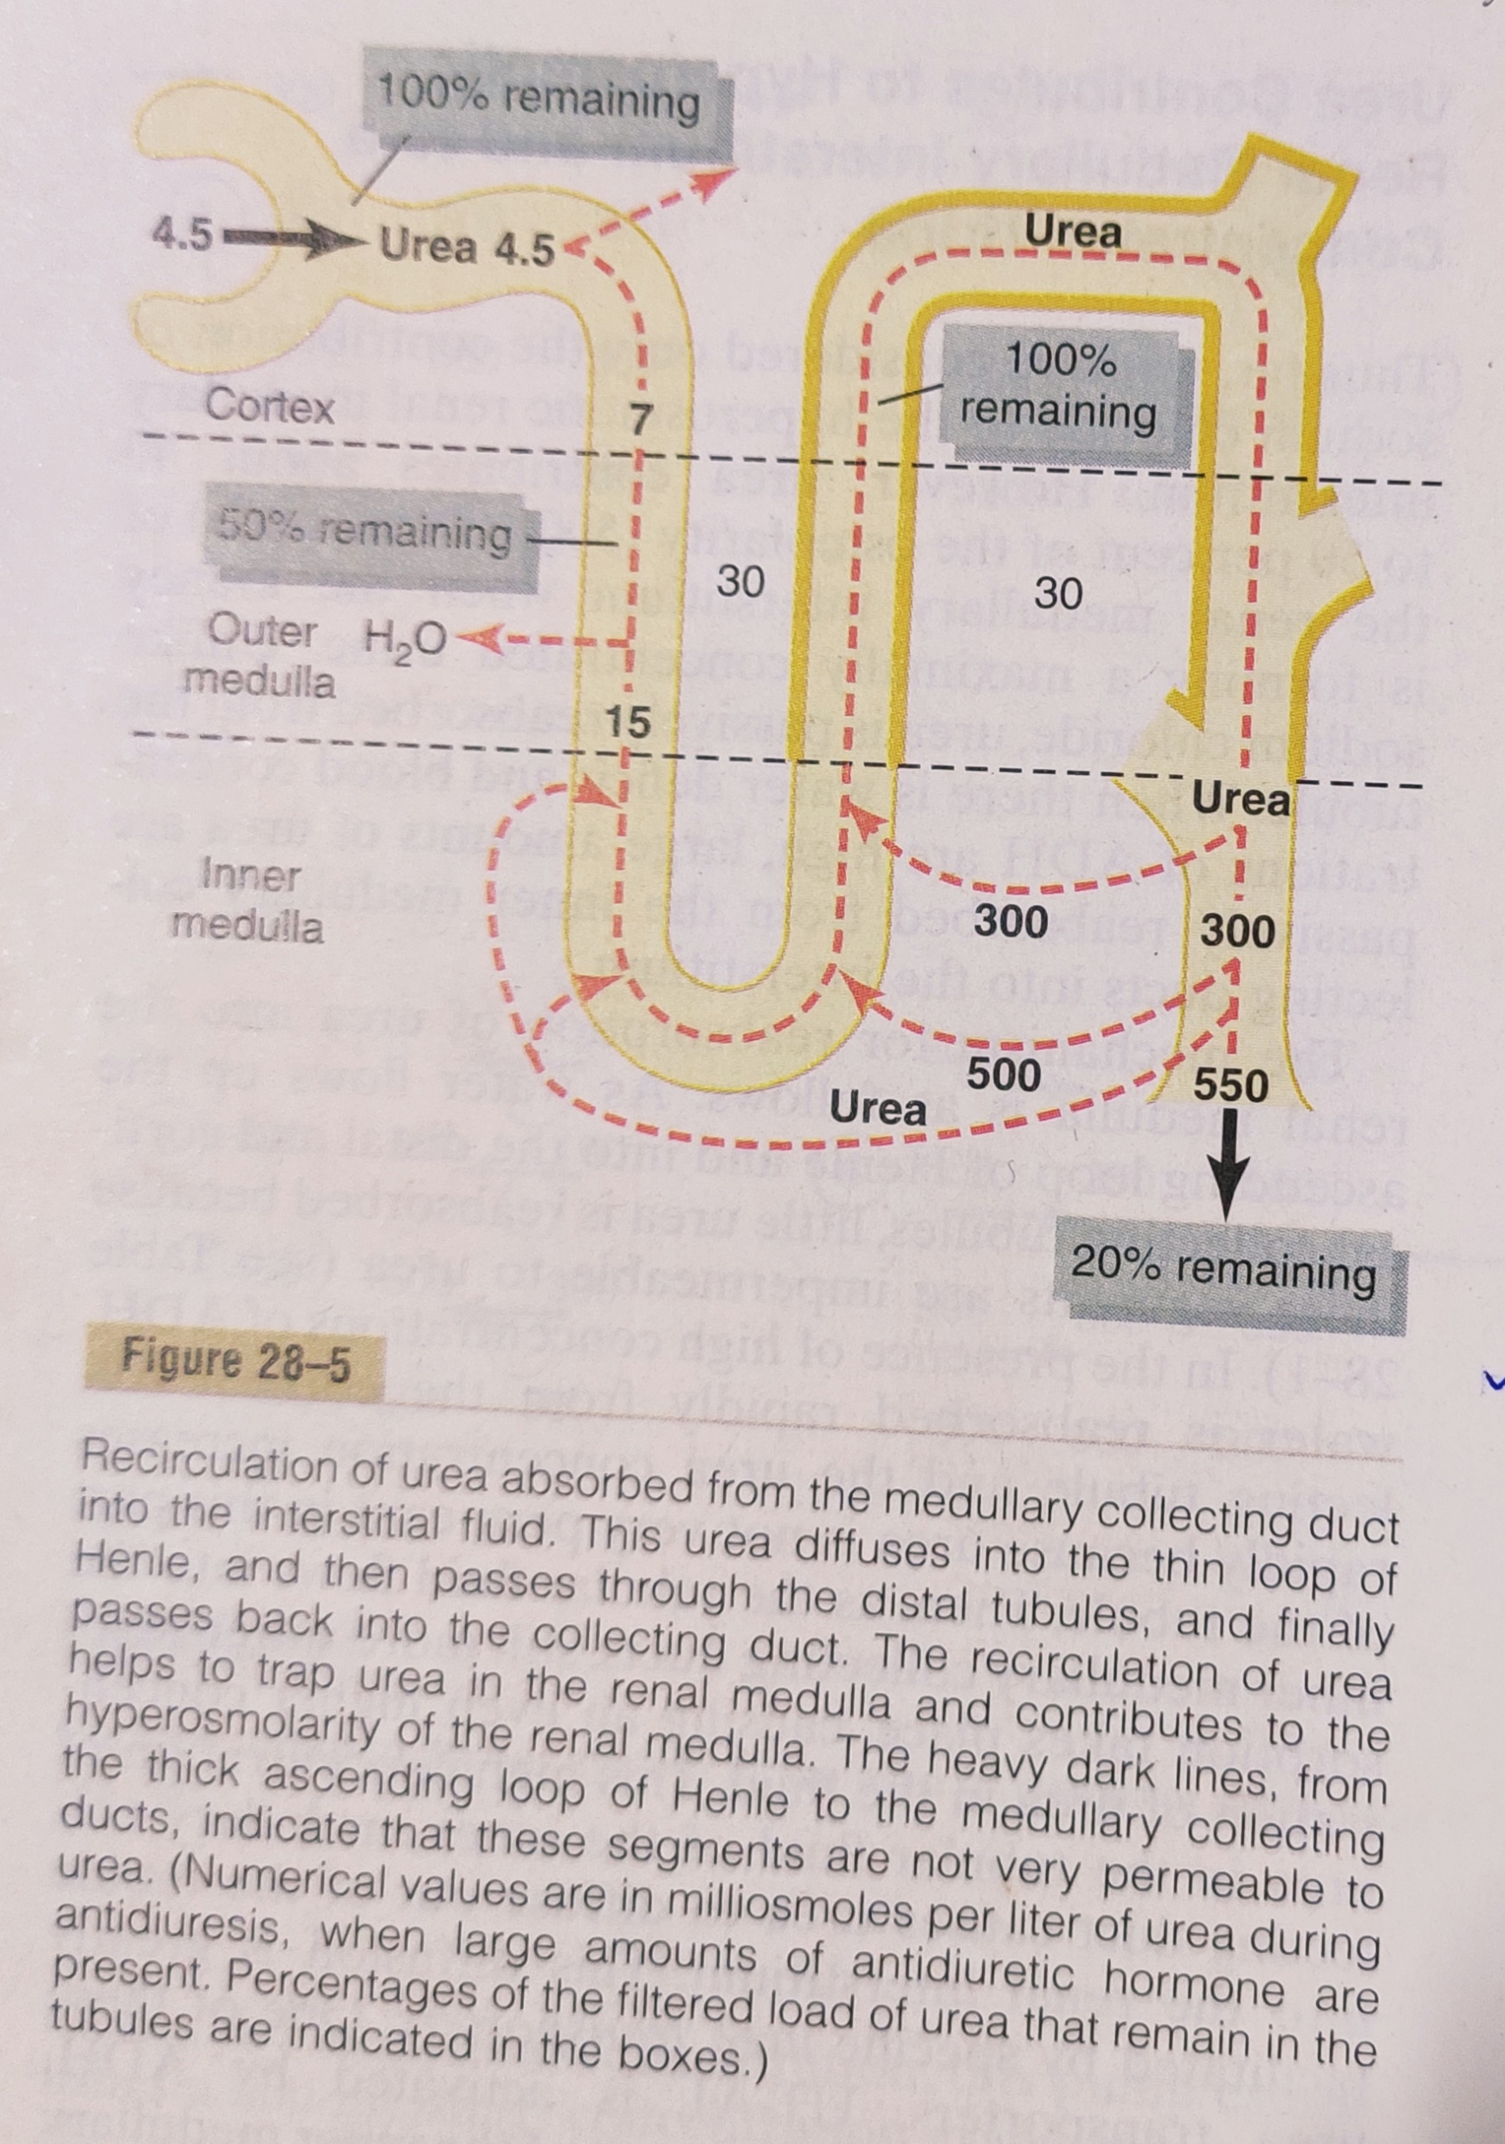
Absorption of urea

Slide 21
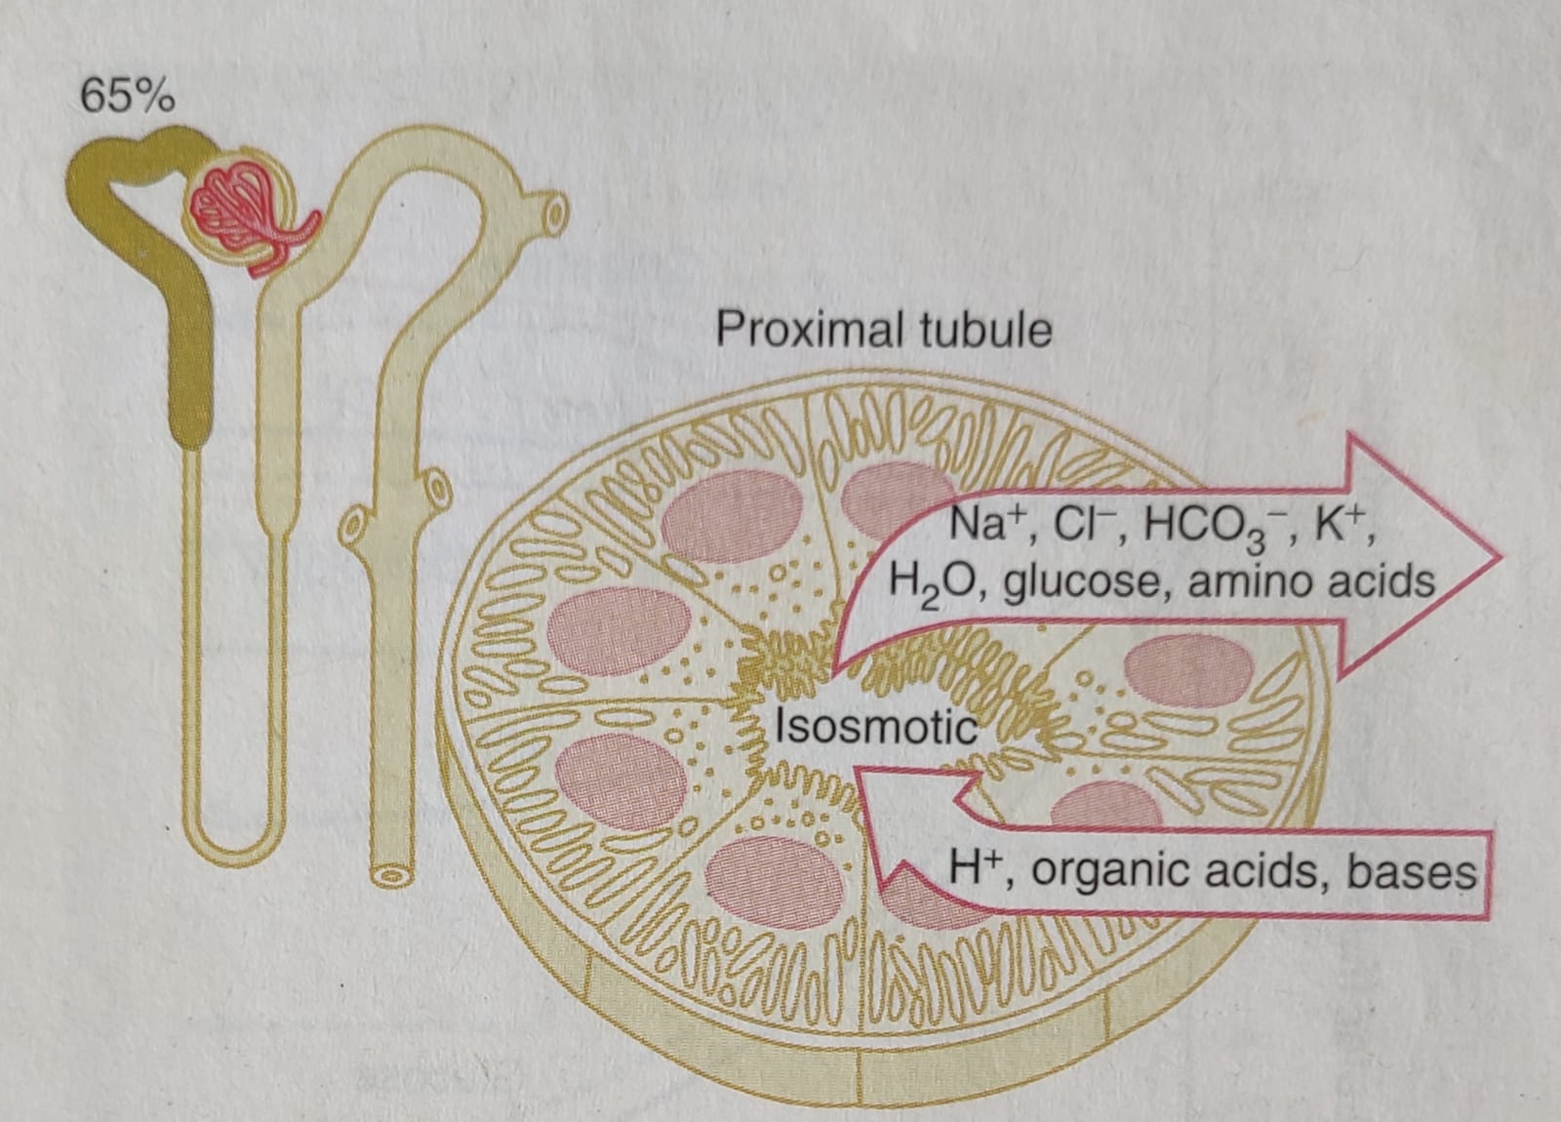
Transport Characteristic of Proximal Tubule

Slide 22
Solute and Water Transport in the Loop of Henle
The thin descending and thin ascending segments have thin epithelial membranes with no brush borders, few mitochondria, and minimal level of metabolic activity.
The descending part is highly permeable to water and moderately permeable to most solutes, including urea and sodium. This part allows mainly simple diffusion. Ascending limb is impermeable to water. About 20% of filtered water is reabsorbed in Loop of Henle.
The thick segment has thick epithelial cells with high metabolic activity and are capable of active reabsorption of Na, Cl and K. Considerable of other ions like Ca, bicarbonate, Mg are reabsorbed.
The thick ascending limb also has a sodium-hydrogen counter-transport mechanism.This segment is virtually impermeable to water.

Slide 23
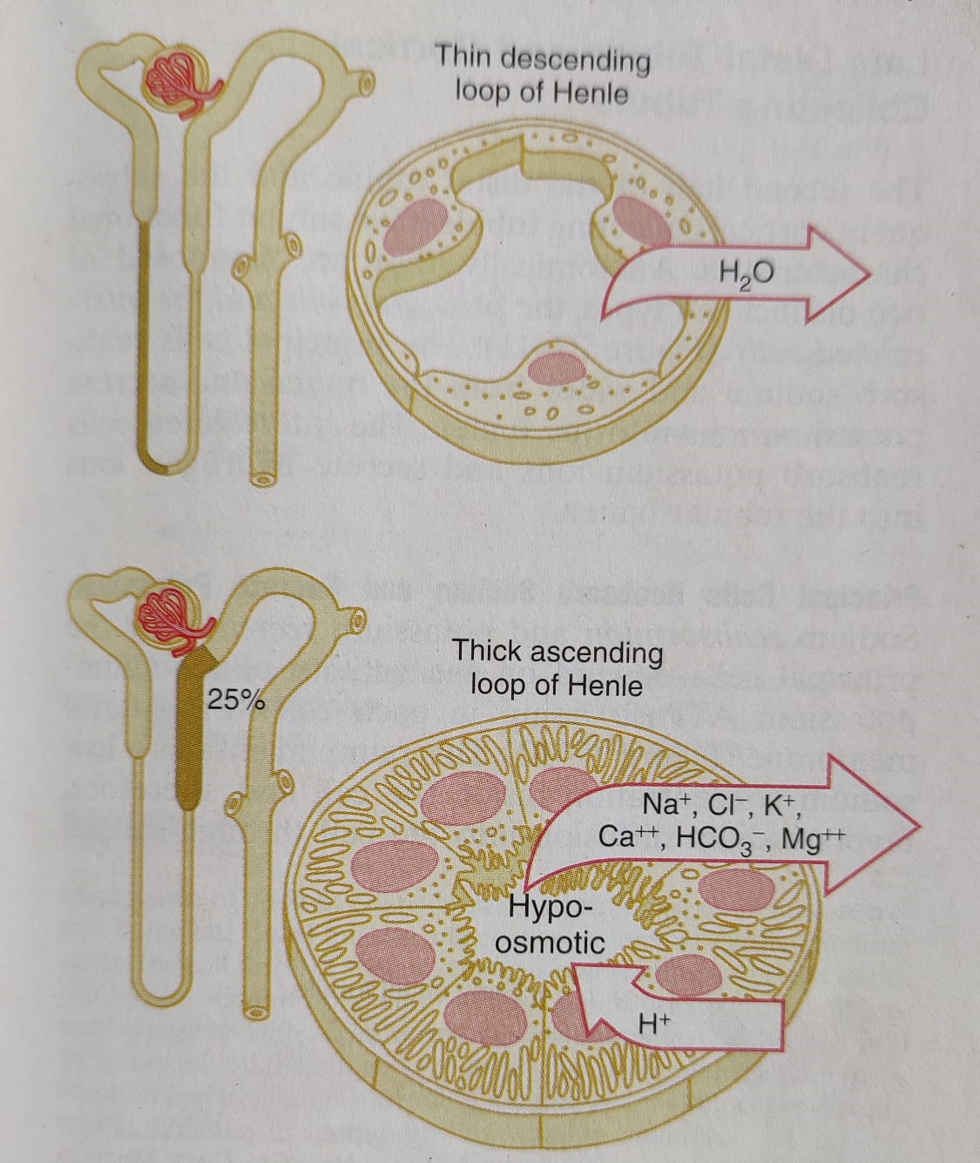
Transport Characteristics of Loop of Henle

Slide 24
Solute and Water Transport in the Distal Tubule
Very first segment forms juxtaglomerular complex that provides feedback control of GFR and blood flow in the nephron.
The next segment is highly convoluted and most of the ions has same resorptive characteristics of the thick segment of LoH. That is, it avidly resorbs most of the ions, but virtually impermeable to water and urea. For this reason, it is called diluting segment.
About 5% of filtered NaCl is reabsorbed in the early distal tubule.
The late distal tubule and subsequent cortical collecting tubule have similar functional characteristics. They are composed of two distinct cell types, the Principal cells (PC) and the Intercalated cells (IC). PC reabsorb Na and water and secrete K-ions into the lumen. IC reabsorbs K-ions and secrete hydrogen ions into the tubular lumen.

Slide 25
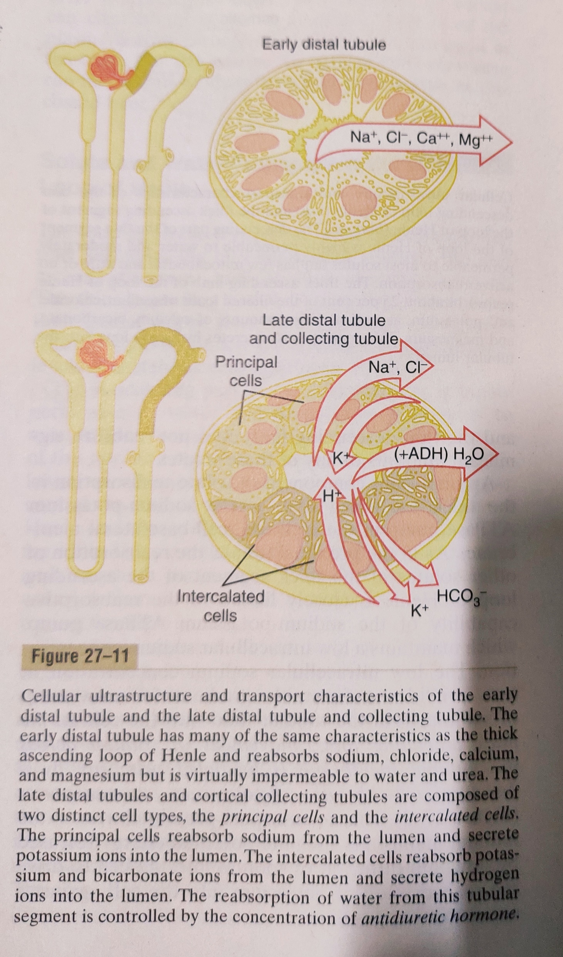
Early distal tubule

Slide 26
Functions of Late Distal Tubule and Cortical Collecting Tubule
Completely impermeable to urea.
Reabsorb sodium ions, and the rate of reabsorption is controlled by hormones, especially aldosterone. At the same time, they secrete K- ions from peritubular capillary blood into the tubular lumen.
The intercalated cells secrete hydrogen ions by an active hydrogen-ATPase mechanism that is 100 times faster than the secretion of hydrogen ions by the proximal tubule. Thus, the intercalated cells play a key role in acid-base regulation of the body fluids.
The permeability to water is controlled by ADH. With high levels of ADH, these segments are permeable to water, but in the absence of ADH, they are virtually impermeable. This special characteristic provides an important mechanism for controlling the degree of dilution or concentration of the urine.

Slide 27
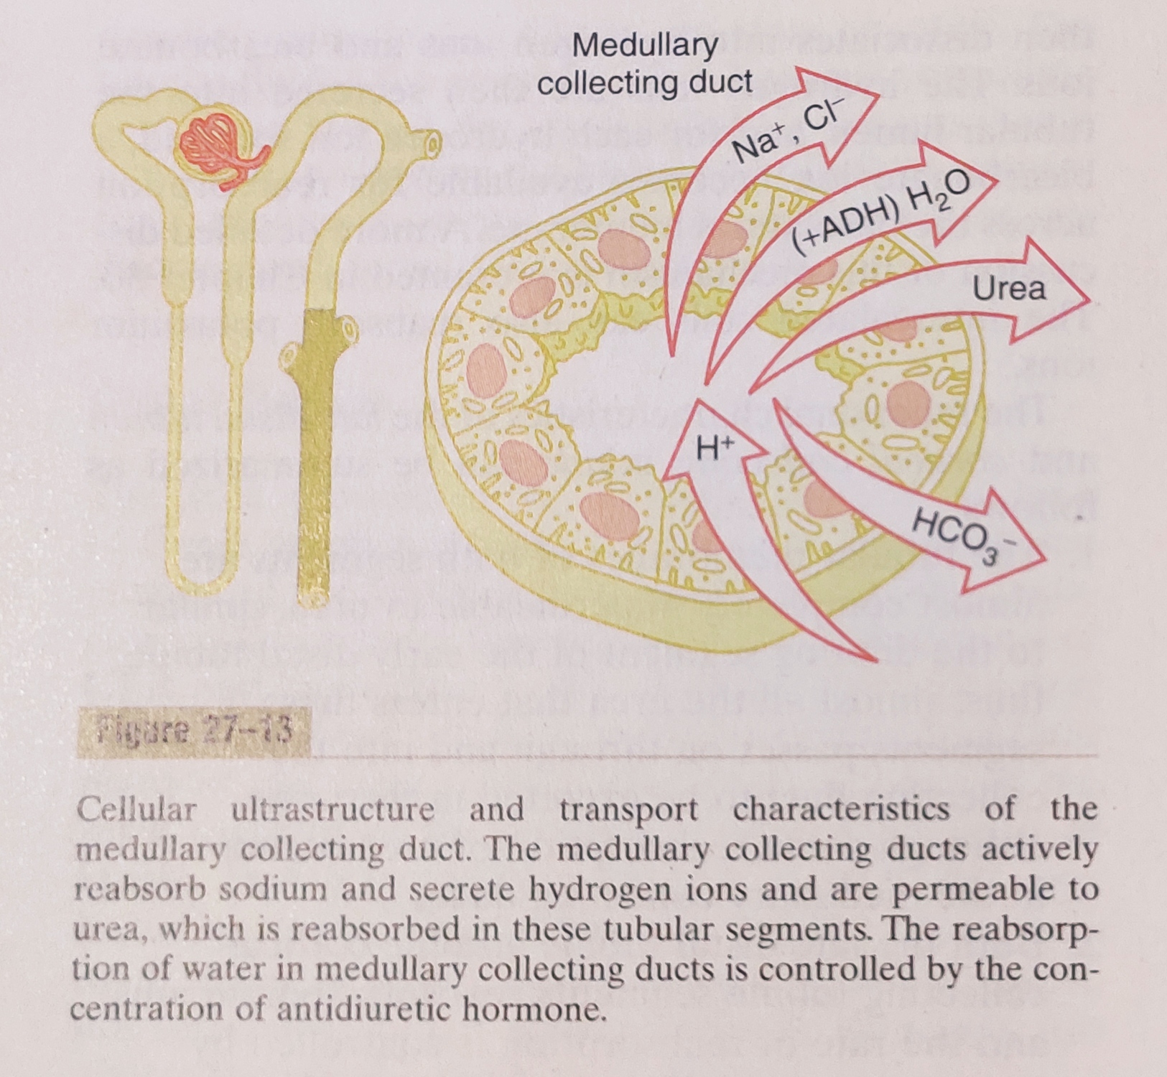
Medullary Collecting duct

Slide 28
Role of Medullary Collecting Duct
This is the final site for processing the urine.
Reabsorb less than 10% of filtered water and sodium.
Epithelial cells are cuboidal with smooth surfaces and few mitochondria.
The permeability to water is controlled by the level of ADH.
Unlike the cortical collecting tubule, it is permeable to urea. Therefore, some of the tubular urea is reabsorbed in the medullary interstitium, helping to raise the osmolality in this region of the kidneys.
This segment is also capable of secreting hydrogen ions against a large concentration gradient. Thus, the medullary collecting duct also plays a key role in regulating acid-base balance.

Slide 29
How Do ADH Increases Water Reabsorption
In the absence of ADH, the permeability of distal tubules and collecting ducts to water is low, causing the kidneys to excrete large amount of dilute urine.
ADH binds to specific V2 receptors increasing the formation of c-AMP and activating protein kinases. This, in turn, stimulates the movement of an intracellular protein, called aquaporin-2 (AQP-2), to the luminal side of the cell membrane.
The molecules of AQP-2 cluster together and fuse with the cell membrane by exocytosis to form water channels that permit rapid diffusion of water through the cells.
When the concentration of ADH decreases, the molecules of AQP-2 are shuttled back to the cell cytoplasm, thereby removing the water channels from the luminal membrane and reducing water permeability.

Slide 30
Regulation of Fluid Osmolarity
Kidney has tremendous capability to vary the relative proportions of solutes and water in the urine in response to various challenges. Kidney can excrete urine with an osmolarity as low as 50 mOsm/L to as high as 1400 mOsm/L.
The primary effector of this feedback is ADH. When osmolarity of the body fluids increases above normal, the posterior pituitary gland secretes more ADH, which increases the permeability of the distal tubules and collecting ducts to water. This allows large amounts of water to be reabsorbed and decreases urine volume but not alter excretion of the solutes.
When there is excess water in the body, secretion of ADH decreases resulting large amounts of dilute urine.

Slide 31
Requirements for Excreting Concentrated Urine
The renal medullary interstitium is very hyperosmotic, so that when ADH levels are high, water moves through the tubular membrane by osmosis into the renal interstitium; from there it is carried away by the vasa recta.
Counter current mechanism is required to maintain hyperosmotic medullary interstitium.
The counter current mechanism depends on the special anatomical arrangement of the Loops of Henle and the vasa recta.
Major factors to build up high solute concentration in renal medulla:
  Active transport of Na ions and co-transport of K, Cl and other ions from thick ascending limb of LoH and collecting ducts into the medullary interstitium.
  Facilitated diffusion of large amounts of urea from the inner medullary collecting ducts into the medullary interstitium.
  Diffusion of only small amounts of water from the medullary tubules into the medullary interstitium.

Slide 32
Steps Involved in Causing Hyperosmotic Renal Medullary Interstitium
First, assume that the LoH is filled with fluid of 300 mOsm/L (Step 1).
Step 2: Active pump of thick ascending limb is turned on and establishes a 200 mOsm/L concentration gradient between the tubular fluid and the interstitial fluid.
Step 3: Tubular fluid in the descending limb and the interstitial fluid quickly reach osmotic equilibrium because of osmosis of water out of the descending limb.
Step 4: Additional flow of fluid pushes the hyperosmotic fluid of descending limb into the ascending limb.
Step 5: When the hyperosmotic fluid reaches the ascending limb, additional ions are pumped again into the interstitium, until a 200 mOsm/L osmotic gradient is established.
Step 6: Then, once again, the fluid in the descending limb reaches equilibrium with the hyperosmotic medullary interstitial fluid, and this hyperosmotic fluid flows into the ascending limb.
These steps are repeated over and over and gradually traps solute in the medulla and multiplies the concentration gradient, eventually raising the interstitial fluid osmolarity to 1200 to 1400 mOsm/L. This repetitive reabsorption of NaCl by the thick ascending LoH and continued inflow of new NaCl from proximal tubule into the loop of Henle is called the countercurrent multiplier.

Slide 33
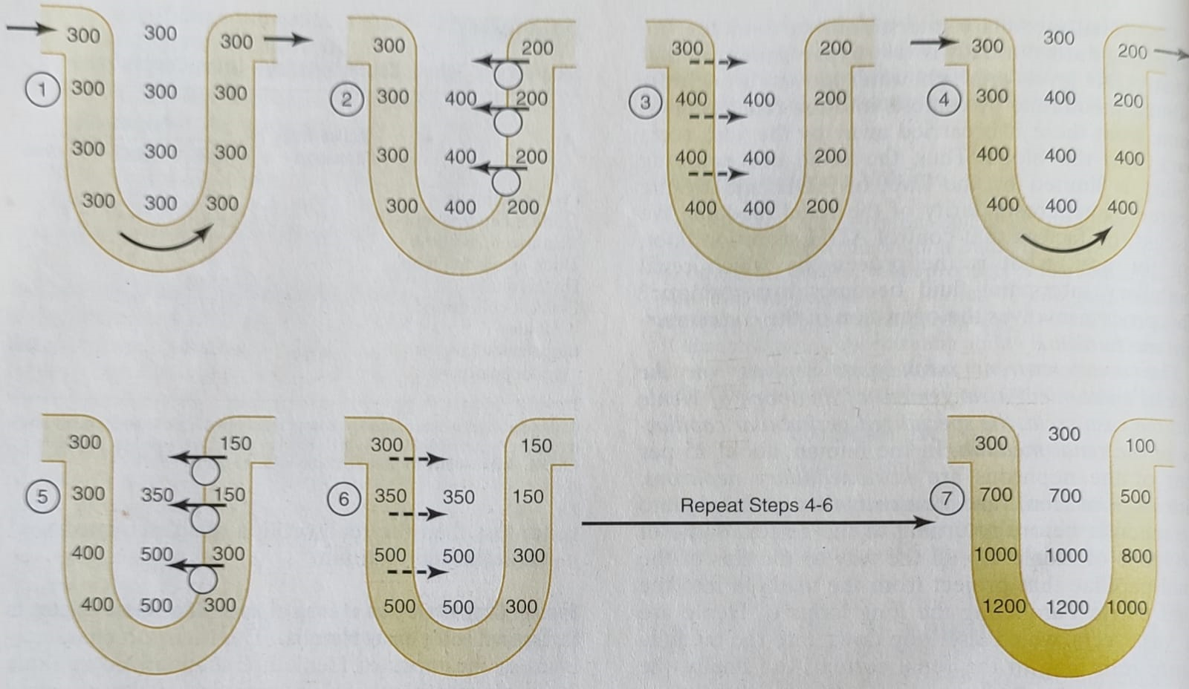
Countercurrent Multiplier System in the Loop of Henle

Slide 34
Countercurrent Exchange in the Vasa Recta
Two special features of medullary blood flow preserve high solute concentrations in the medullary interstitium:
1. The medullary blood flow is low (less than 5% of total renal blood flow). This sluggish blood flow helps to minimize solute loss.
2. The vasa recta serve as a countercurrent exchangers, minimizing wash out of solutes from the medullary interstitium.
Blood enters and leaves the medulla by way of vasa recta. The vasa recta, like other capillaries, are highly permeable to solutes, except for the plasma proteins. As blood slowly descends into the medulla toward the papillae, it becomes progressively more concentrated. As blood ascends back toward the cortex, it becomes progressively less concentrated.
Thus, although there is a large amount of solute and fluid exchange across the vasa recta, there is little net dilution of the concentration of the interstitial fluid because of the U shape of the vasa recta, which act as a countercurrent exchangers.

Slide 35
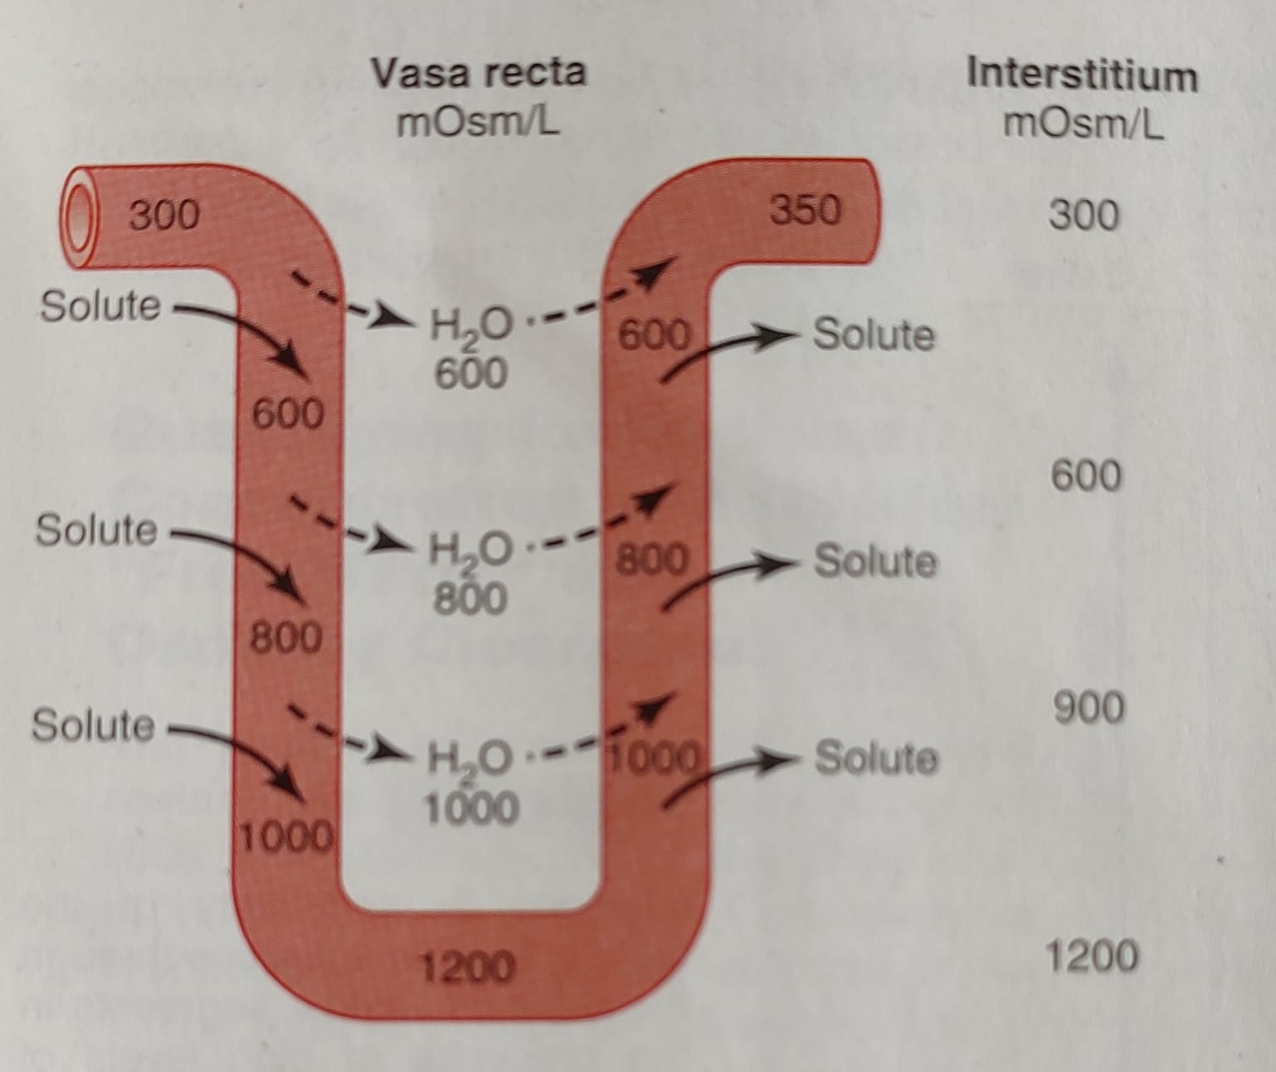
Countercurrent Exchange in the Vasa Recta

