Slide 1
Zoogeography
Dr. Tanmay Datta

Slide 2
Pangea (320 – 195 ma)

Slide 3
Present day World

Slide 4
Last Glacial Period (began around 12,800 years ago and ended around 11,700 years ago)

Slide 5
Zoogeographical Realms
P. L. Sclater (1857): Divided the geographical areas of the Earth into six parts, on the basis of the distribution of birds.
Alfred Russel Wallace (1867): Also divided the zoogeographical realms into six division. But include all the terrestrial vertebrates and invertebrates. However, he renamed the ‘Indian Region’ of Sclater to ‘Oriental Region’.
The realms were all separated by a distinctive barriers from each other and the separated lines are known as Wallace’s Line.

Slide 6
Zoogeographical Realms

Slide 7
Palaearctic Realm
Whole Europe, Northern Part of Africa, Northern part of Asian Himalaya and Nan ling range of China.
Deciduous forest, large grass land, Coniferous forest and mixed forest, Tundra.
Salmon, Salamander, Alligator, Geese, European bison, etc.

Slide 8
Fire Salamander & European Bison

Slide 9
Nearctic Realm
North America, Mexico, Greenland
Deciduous forest, huge grassland, coniferous forest, Tundra
Ambystoma, Phrynosoma, Turkey, Armadillo, Wolf.

Slide 10
Phrynosoma & Armadillo

Slide 11
Neotropical Realm
South and Central America, lower Mexico, West Indies
Tropical rain forest. Tropical region consists of Savannha
Lepidosiren, eel, Caecilia, Hyla, Boa, Alligator, Rhea, Toucan, Parakeet, Opposum, Armadillo, Tapir.

Slide 12
Lepidosiren & Toucan

Slide 13
Ethiopian Realm
Most of Africa, Madagascar and southern part of Arabia
Rain forest, dry deciduous forest, desert
Lung fishes (Protopterus), Xenopus, caecilians, Chameleon, ostrich, Zebra, baboon

Slide 14
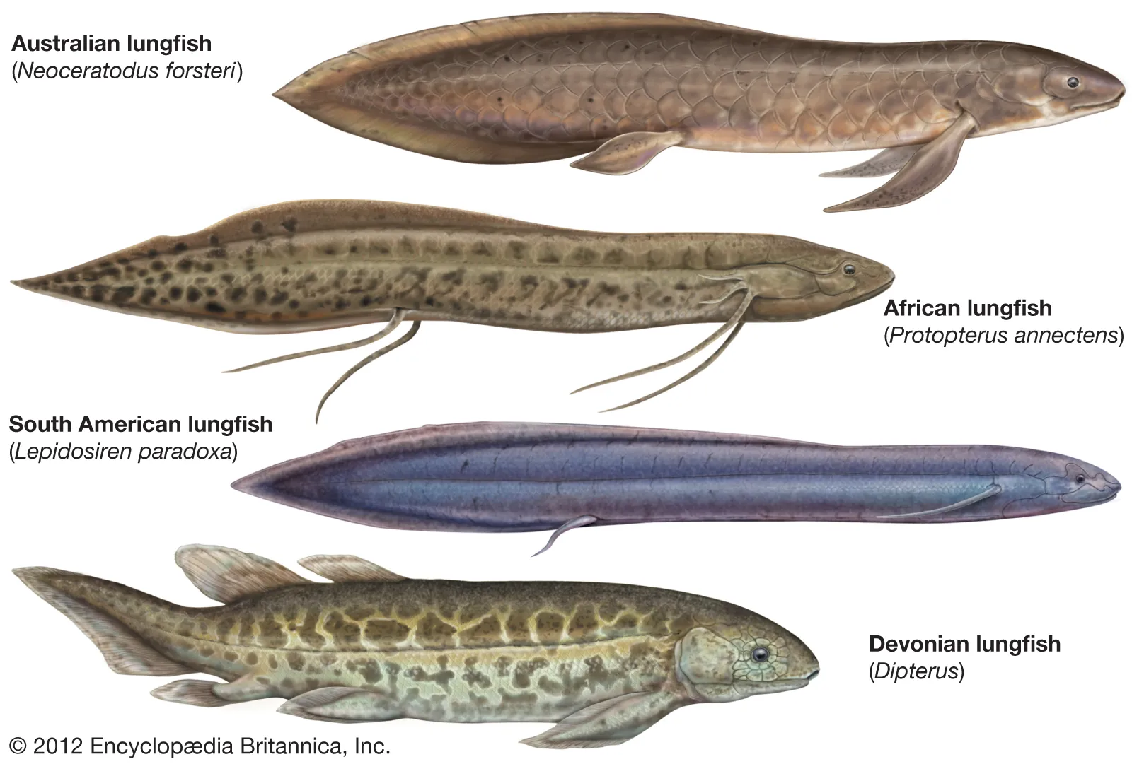

Slide 15
Ostrich & Baboon

Slide 16
Australian
Australia, New Zealand, New Guinea, Tasmania
Rain forest, grassland, Eucalyptus forest
Lung fish, Heleioporus, Sphenodon, Cassowary, Kangaroo, Platypus

Slide 17
Heleioporus (Giant Burrowing Frog) & Sphenodon (Tuatara)

Slide 18
Cassowary & Platypus

Slide 19
Oriental Realm
Asian countries situated in the southern side of Himalaya.
Sub-divisions: Indian sub-region, Ceylonese sub-region, Indo-Chinese sub-region, Indo-Malayan sub-region.
Dense rain forest, moderate forests
Carp, Notopteridae, Anurans, Gekko, vipers, Gavialis, Phesants, Pigeons, Pangolin, Gibbon, etc.
In the South east corner physical boundary is absent. In the North East Asia, rain forest is present. Towards the west desert is present. The remaining part shows plains and rivers hence this region show different types of conditions. Hence more vegetation is present and more fauna is seen.

Slide 20
Sub-divisions of Oriental Realm
1. Indian sub-region,
2. Ceylon sub-region.
3. Indo-China sub-region,
4. Indo-Malayan sub-region.

Slide 21
Indian Sub-region
It includes North India and Central part. It starts from the root of Himalaya and extend up to Malabar Coast. This region shows plains and deserts. It shows temperate and tropical conditions.
In this region Antelopes, Peacock, Indian Bison, Black Elephant, Equas and some important snakes are present.

Slide 22
Ceylon Sub-region
It includes Ceylon, Small Indian Peninsula. It shows Loris, Elephants, Equas, Rat, Bandicoots and Snakes.

Slide 23
Indo-China Sub-region
It includes China south of Palaearctic region. It includes Gibbons, Lemurs, Rhinoceros, Salamanders, Disc tongued frogs are present.

Slide 24
Indo-Malayan Sub-region
It includes Malayan peninsula and surrounding Islands. This region supports 132 families of fauna Gibbon, Rhinoceros, Badger, Broad bills etc. are very common in this region.

Slide 25
Fishes in Oriental Region
Fish fauna of Oriental region will resemble that of Ethiopian region. Oriental fish fauna is dominated by Carps and Cat fishes.
1. Notopteridae,
2. Anabantklae,
3. Syngnathus,
4. Cypsilurusetc.,

Slide 26
Amphibians in Oriental Region
Tailed Amphibians are very rare, only one genusis represented Tylptotriton verrucosus. Anura and Apoda Amphibians are more.
1. Rana species,
2. Hyla.
3. Rhacophorus,
4. Bufo,
5. Discoblastidae nembers,
6. lcthyophis,
7. Uraeotyphlus,
8. Gegenophis etc.

Slide 27
Reptiles in Oriental Region
Many reptiles are seen in this region. This fauna Is dominated by lizards, snakes, turtles and Crocodiles.
1. Gvialis,
2. Gecko (Flying Lizard),
3. Chameleon
4. Varanus (Indian Monitor Lizard),
5. Python,
6. Typhlops.
8. Testudo,
9. Cobra etc., In this region Xenopeltidae, Uropeltidea forms are exclusive. -

Slide 28
Birds in Oriental Region
In this region 66 families of Birds are included.
1. Honey Guides,
2. Wood Pecker,
3. Horn bill,
4. Pea- cock etc.

Slide 29
Mammals in Oriental Region
This region includes 30 mammalian families.
1. Shrews,
2. Rabbit,
3. Canis,
4. Cat,
5. Aye-aye (Hyaena),
6. Sues,
7. Equas
8. Rhinoceros,
9. Great apes like Orangutan, Gibbon Gorilla, Chimpanzee Alirus (Himalayan Pander)
10. Camel etc.,
In this region tree Shrews, flying lemurs, Indian Bisons are exclusive.

